Slide 1
Quality Control in Biotechnology
Andrew Lees, Ph.D.
Scientific Director
Fina BioSolutions LLC
www.FinaBio.com

Slide 2

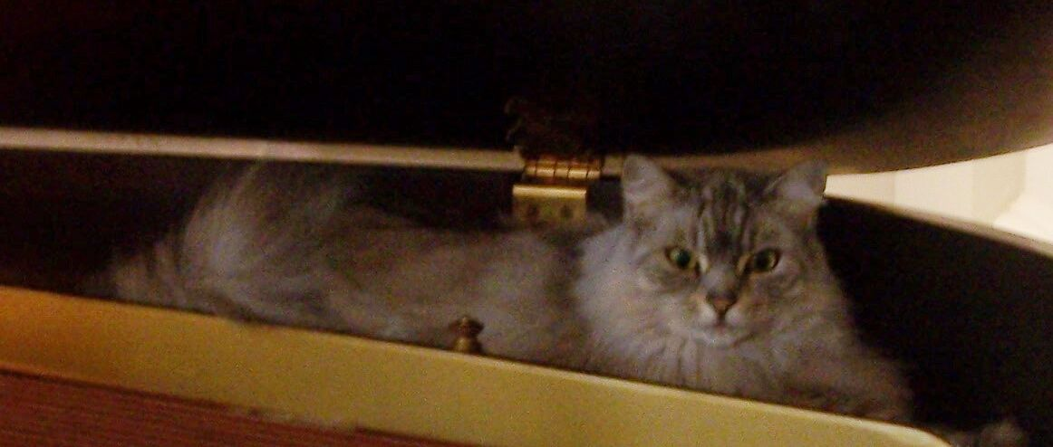
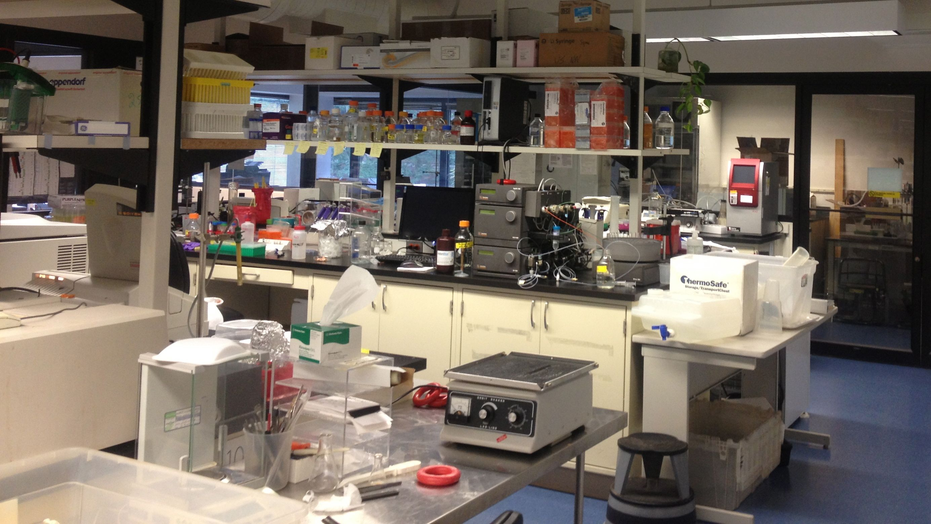
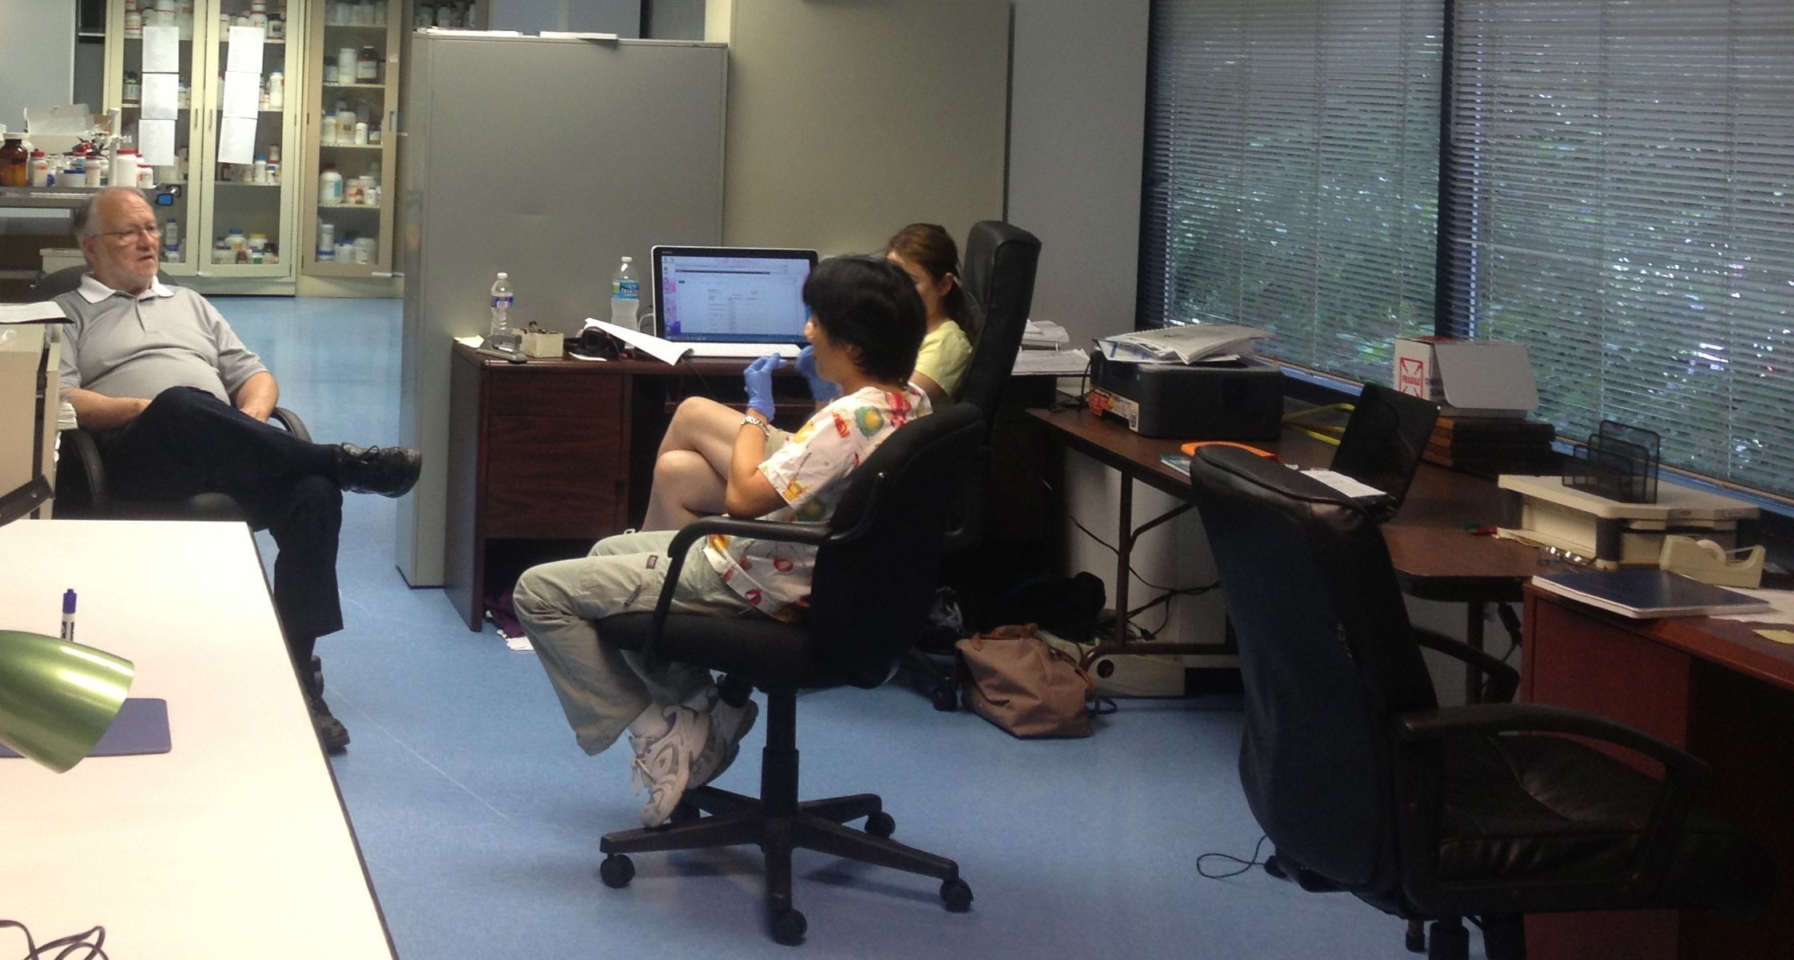
Fina

Slide 3
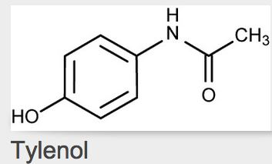
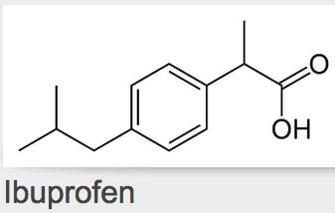
Chemical drugs vs Biologicals
Chemical drugs can be precisely defined
  Physical chemical characterization
    NMR- structure
    Mass Spectrometry- molecular weight
    Chromatography- purity, quantity
  Potency
  Formulation
Relatively easy to create “generics”

Slide 4
Chemical drugs vs Biologicals
Biologicals are produced by living cells
Impossible to
  control every variable
  completely characterize
  Precisely replicate
Traditionally, biologicals are defined by “product by process”
  Product is defined by the manufacturing process
  Quality is compliance-driven
Goal is a “well-characterized biological”

Slide 5
current Good Manufacturing Process
cGMP
Doing what you said you were going to do
Proving that you did what you said
Documenting that you did it.
Following SOPs
Validated methods

Slide 6
Examples of Biologicals
Insulin
EPO
Interferons
Toxins
Antibody
Conjugates
  Antibody-drug conjugates
  Fusion proteins

Slide 7
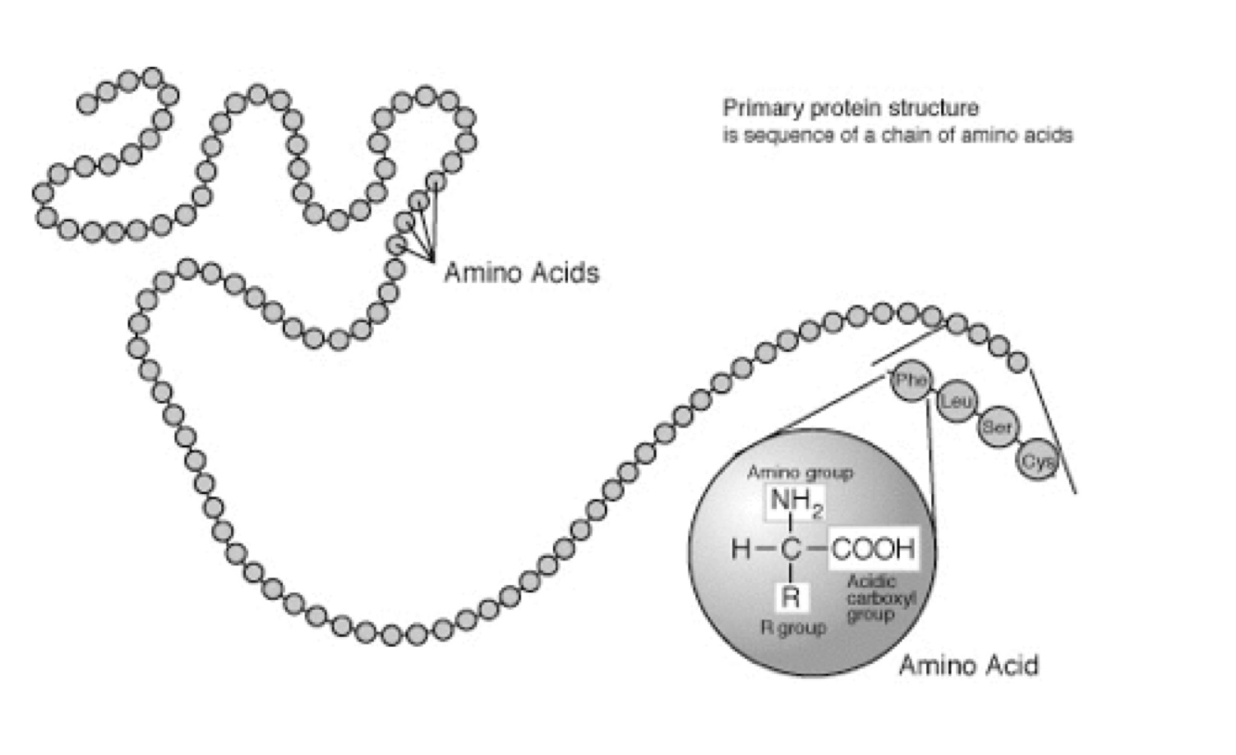
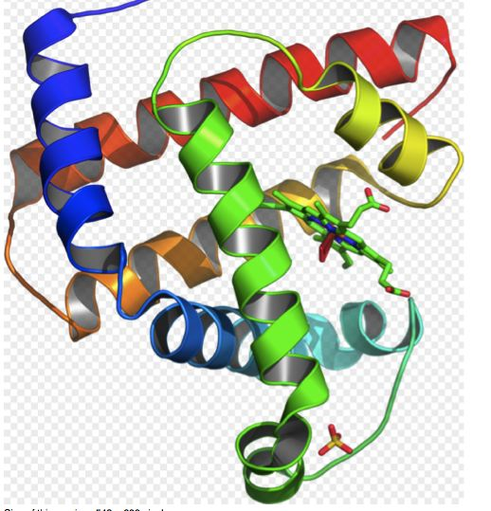
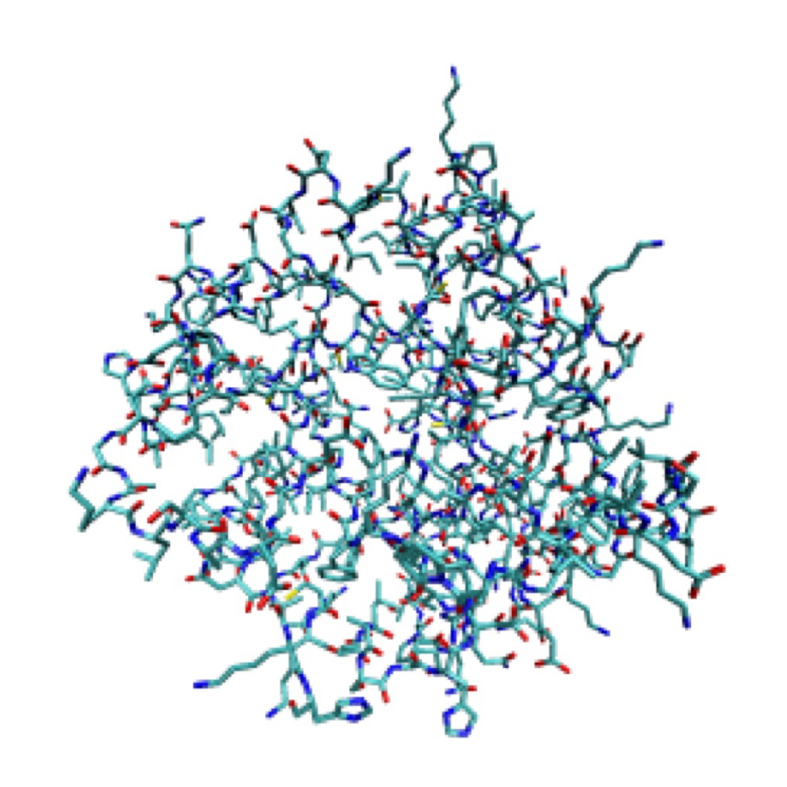
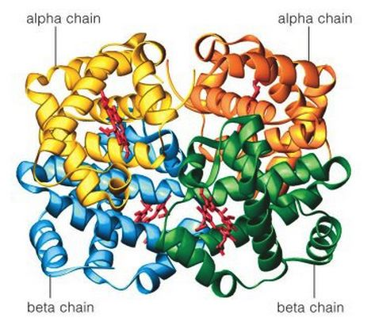
Protein Structure
Secondary Structure:
3-dimensional structure of segments
Primary Structure:
Amino acid sequence
Tertiary structure:
Quaternary structure:
Arrangement of multiple folded protein or coiling protein molecules in a multi-subunit complex.
Final specific geometric shape that a protein assumes

Slide 8
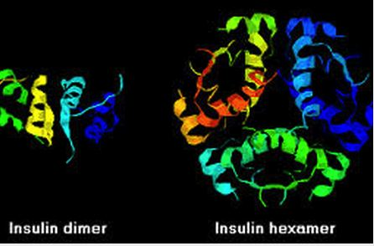
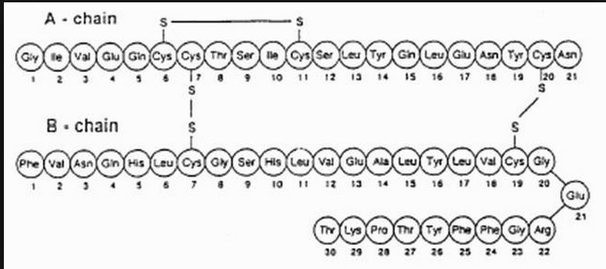
Insulin

Slide 9
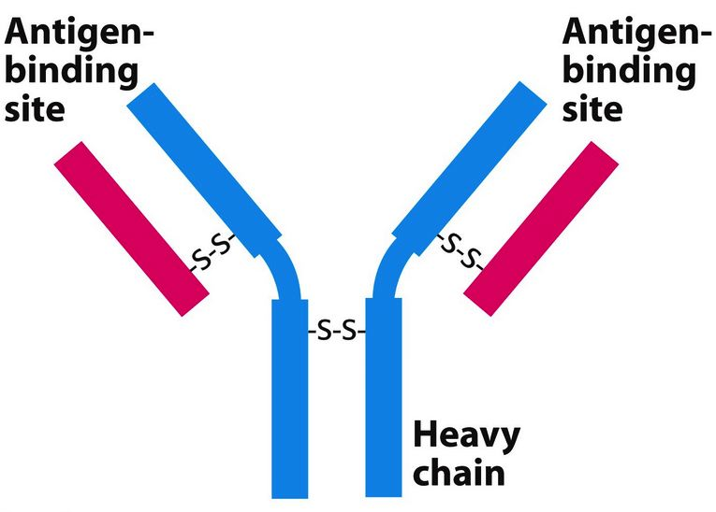
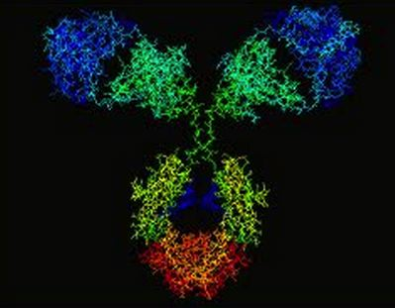
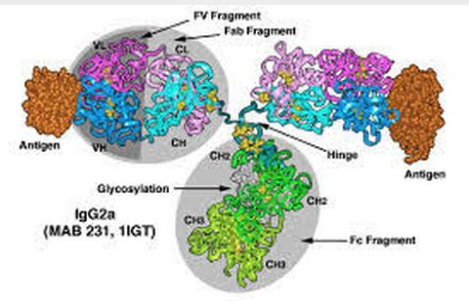
Antibody

Slide 10
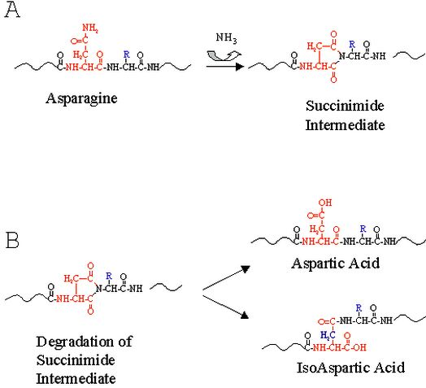
Modifications
Post-translation modifications
  Chemical changes not directly coded in DNA
    Glycosylation
    Phosphorylation
    Lipidation
Chemical degradations
  Oxidations
  De-amidation
  Rearrangements

Slide 11
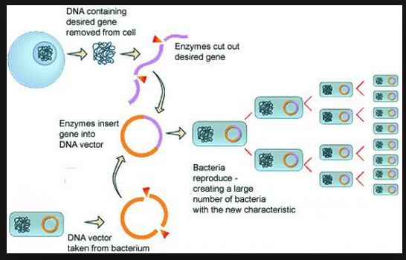
Genetic Engineering (bacterial)

Slide 12
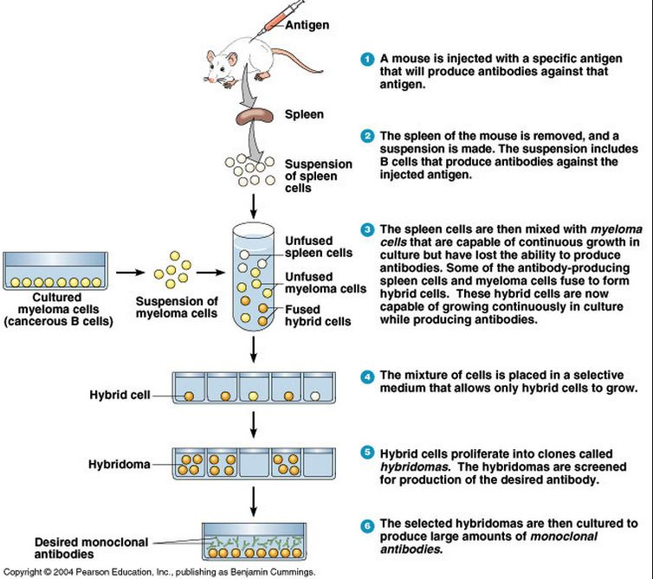
Monoclonal
Antibodies

Slide 13
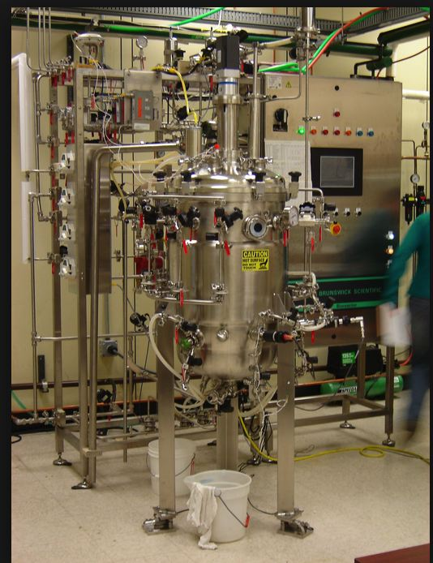
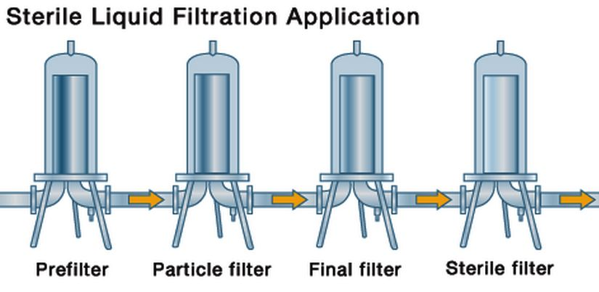
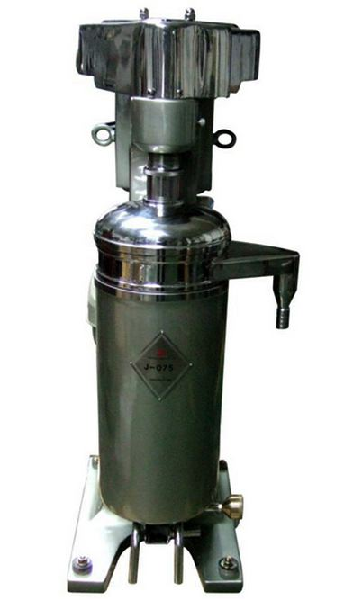
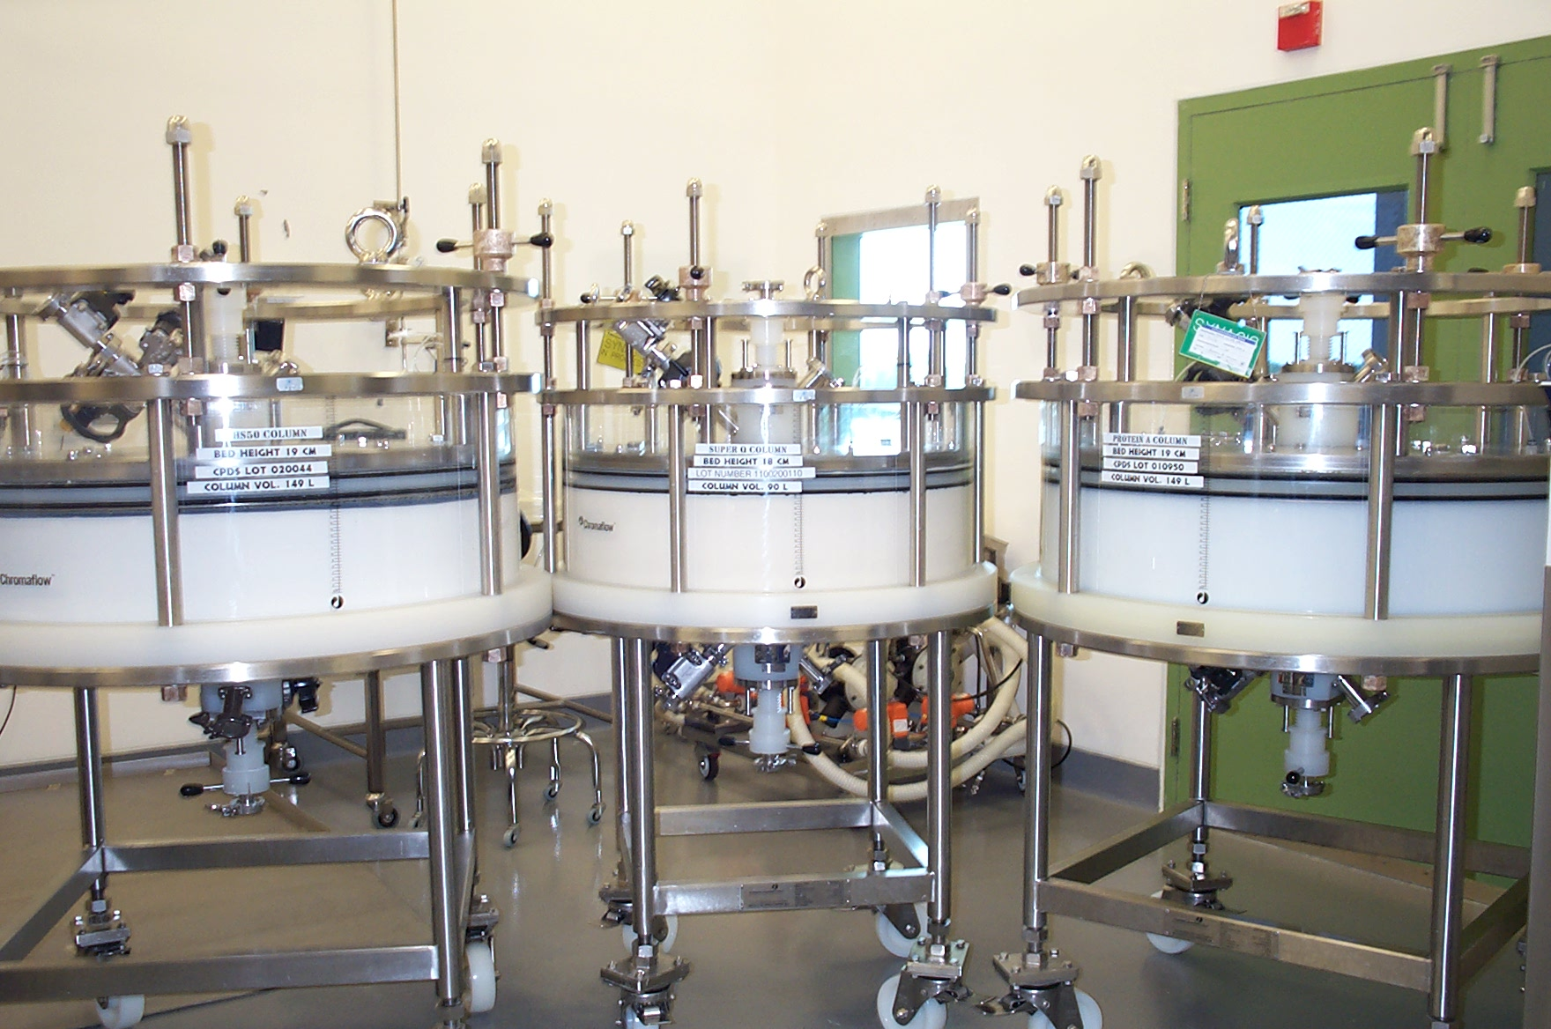
Bioprocessing
Unit Operations
Fermentation
Centrifugation
Chromatography

Slide 14
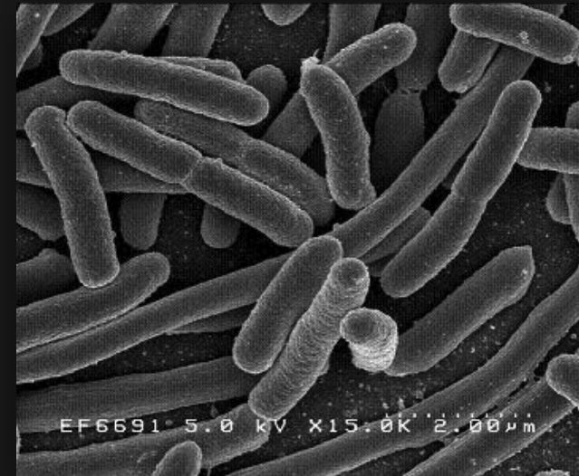
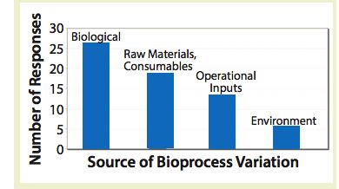
Inherent heterogeneity
Stochastic processes
Variable inputs
Variable
crude product
Biologically derived
Chemically derived
Cells
“black box”
Heterogeneous
product
Process variables
Formulation

Slide 15
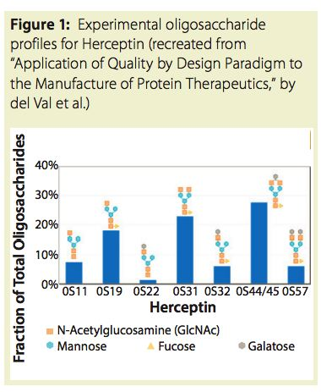
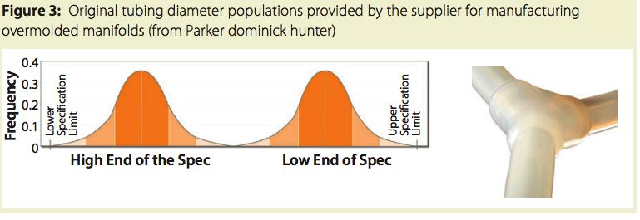
Herceptin
(anti-cancer antibody)
Seven different glycoforms,
each with different levels of
biological acitivity.
Variability of materials

Slide 16
Product by process
Lot release criteria- pass/fail
Very difficult to make process improvements
Quality by Design (QbD)
Operate within a specified design space
Target Product Profile
Critical Quality Attributes
Critical Product Attributes
Better understanding of process and product
Defining design space
Allows for more variability
Process Analytical Technologies
Real time monitoring & feedback.

Slide 17
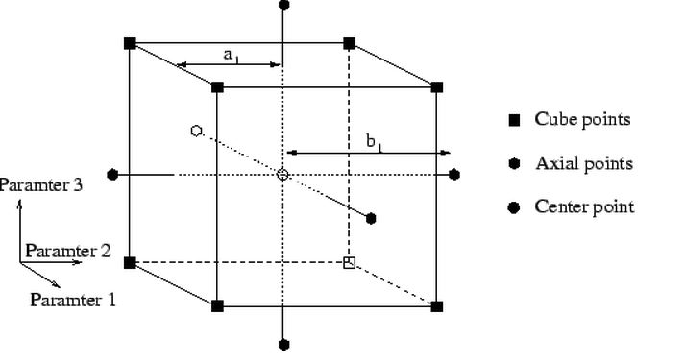
Understanding the operating space
Design of Experiment

Slide 18
Design of Experiment (DOE)
A statistical method to model a process
Many fewer experiments than “one factor at a time”
Allows for modeling interactions
Useful to determine critical parameters
Critical for “Quality by Design”

Slide 19
Application of Design of Experiment to Conjugate Vaccines

Slide 20
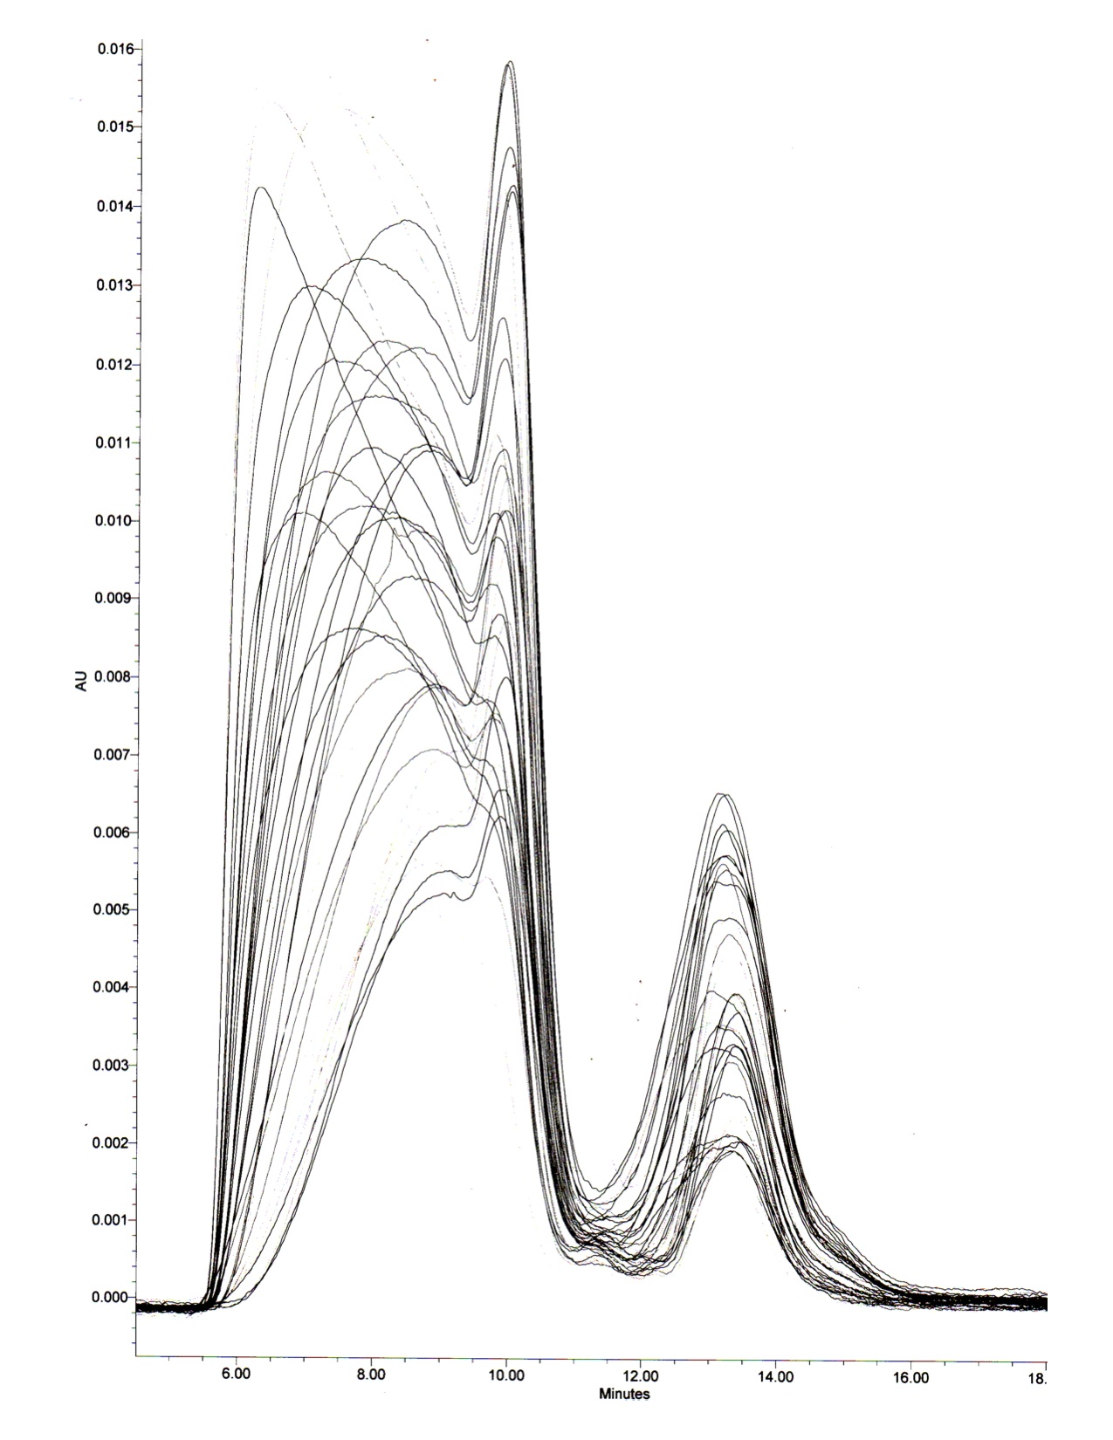
Design of Experiment
% conjugate
CDAP Ratio
Concentration

Slide 21
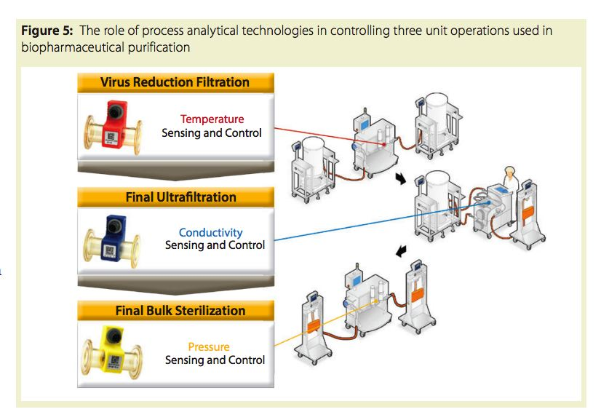
Process Analytical Technologies (PAT)
Real time feedback to control process

Slide 22
Types of Vaccines
Subunit (protein) vaccines
  Tetanus toxoid
  Diptheria toxoid
  Pneumococcal (PneumoVax)
Killed vaccines
  Rubella, Measles,
  Polio (Salk)
  Flu
  Hepatitis A
  Conjugate vaccines
    Pneumococcal (Prevnar)
    Meningicoccal (Menactra)
    Haemophilus b (Hib)
Live attenuated vaccines
  Polio (Sabin)
  Flu (Flumist)
  Rotavirus (Rotarix)
Virus Like Particles (VLP)
  HPV (Gardisil)
New Generation Vaccines
  DNA vaccines

Slide 23
Polysaccharide Vaccine
Conjugate
Vaccine
+
Polysaccharide
Protein
  Poorly immunogenic in infants
  No boosting or memory
  No class switching
  No affinity maturation
Immunogenic in infants
Boosting and memory
Class switching
Affinity maturation

Slide 24
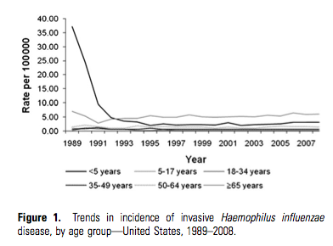
Conjugate Vaccines are Effective

Slide 25
Why Conjugate Vaccines?
Haemophilus influenzae b (Hib)
Neisseria meningiditis
Streptococcus pneumoniae
Salmonella typhi
Expensive
Challenging to manufacture
Many serotypes

Slide 26
TETANUS TOXOID PRODUCTION
Cl. tetani
HARVARD STRAIN
Revival On ATG medium
INTERMEDIATE SEED
HIGB (18 -32 hrs)
Inculcation into production
FERMENTOR
35 ± 5°C
ANAEROBIC CULTURE
48 hours at 37 °C
Medium (Muller &Miller)
(PH – 7.5 ± 0.1)
5th
^{Day} sample collection for SMEAR, pH, growth lysis
Detoxification with 0.5 % Formalin
Millipore Filter
Clarification
CRUDE TOXOID SUBLOT
STERTILE TOXIN
CULTURE HARVEST 6\7 days
4 days at Room temperature & 4 weeks at 35 °C
Sterilization
LF/ML
Sterility test
SMEAR
LF/ML
PH
Detoxification test in mice
MLD
LF/ML
MTV
Antigenic purity
Millipore Filter [30 KDa] 0.2 to 0.45 micron
Centrifugation
(4000 rpm @45 minutes)
Precipitation with ammonium
CONCENTRATED TOXOID
pooling
POOLED CONCETRATE
(1-2 SUBLOTS)
SUPERNATANT
Centrifuge
4000 rpm
@ 1 hour
Sulphate – I st salting (10% - 12%)
LF Test
LF Test
Final Filtration (Cartridge Filter)
Precipitate with high ammonium sulphate (22% - 24%)
BULK PURIFIED TETANUS TOXOID
STERILE FILTRATION
PURIFIED TOXOID
Dialysis
PRECIPITATION
0.2 micron bag pore size
Sterility test
Antigenic purity
LF/ML
Released for Blending
Specific Toxicity
Irreversibility test

Slide 27
Synthesis of Conjugate Vaccines
Polysaccharide
Activated saccharide
Identity
Polysaccharide composition
Moisture content
Protein impurity
Nucleic acid impurity
Pyrogen content
Molecular size
distribution
Extent of activation
Molecular size distribution
Conjugation
Carrier Protein
Bulk Conjugate
Identity
Purity
Toxicity
Extent of derivatisation (if
appropriate) NR
Identity
Residual reagents
Saccharide:protein ratio & conjugation
markers
Capping markers
Saccharide content NR
Conjugated v. free saccharide
Protein content
Molecular size distribution
Sterility
Specific toxicity of carrier (if appropriate)
Endotoxin content
WHO Recommendations for the production and control of pneumococcal conjugate vaccines, ECBS, October 2003. Updated 2009.
Notes:
27

Slide 28
Bulk Conjugate2
Bulk Conjugate1
Bulk Conjugate3
Bulk Conjugate13
Bulk Conjugate4
Formulated
Vaccine
Bulk Conjugate5
Bulk Conjugate12
Bulk Conjugate11
Bulk Conjugate6
Bulk Conjugate10
Bulk Conjugate7
Bulk Conjugate9
Bulk Conjugate8
Multivalent pneumococcal conjugate vaccine

Slide 29
Control testing of Pn conjugates
Polysaccharide
Activated saccharide
Identity
Polysaccharide composition
Moisture content
Protein impurity
Nucleic acid impurity
Pyrogen content
Molecular size
distribution
Extent of activation
Molecular size distribution
Conjugation
Formulation
Carrier Protein
Bulk Conjugate
Final Vaccine
Identity
Purity
Toxicity
Extent of derivatisation (if
appropriate) NR
Identity
Residual reagents
Saccharide:protein ratio & conjugation
markers
Capping markers
Saccharide content NR
Conjugated v. free saccharide
Protein content
Molecular size distribution
Sterility
Specific toxicity of carrier (if appropriate)
Endotoxin content
Identity
Sterility
Saccharide content (of each)
Residual moisture
Endotoxin content
Adjuvant content (if used)
Preservataive content (if used)
General safety test
pH
Inspection
WHO Recommendations for the production and control of pneumococcal
conjugate vaccines, ECBS, October 2003. Updated 2009.
Notes:
29

Slide 30
Complexity of Supply Chain & Quality Control
>300 GMP steps for Prevnar13
Managing supply chain & supply chain quality
Each ingredient must be ready at the right time
QA/QC for bulk and formulated vaccine

Slide 31

Thank You!
www.FINABIO.com

