Slide 1
69th ASQ World Conference
Perspectives and Insights
3-6 May 2015
Prepared for Section 0511

Slide 2
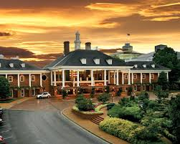
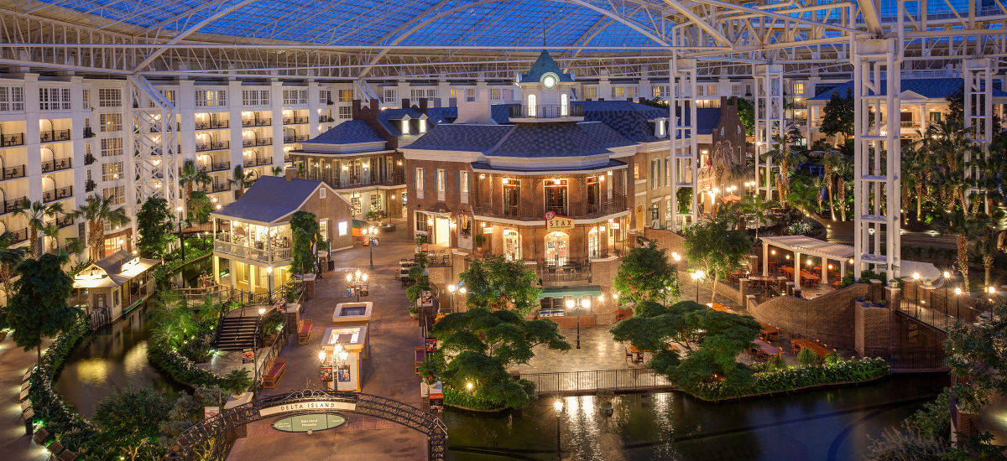
Nashville Venue Overview
Gaylord Opryland Convention Center & Resort
America’s largest meeting structure outside Las Vegas
5 Keynote speakers
Over 100 specialized seminars across the entire ASQ quality spectrum
Notes:
Gaylord Opryland from outside AND inside view from our meeting area

Slide 3
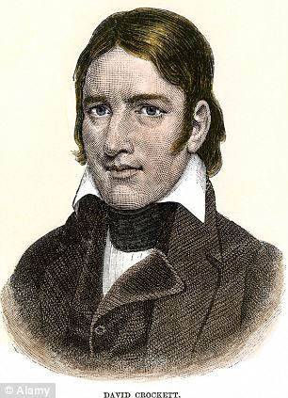
Gaylord Opryland as a Case Study
Flexible agility and rapid delivery is their mantra
Excellent Guest experience is their key focus
All employees embody the importance of a 1st impression
Check-in / Stay / Check-out
Guest facing components – 24/7
Housekeeping
Dining and beverages
Security
Convention engineers
Management and staff meet regularly and walk a consistent gemba making adjustments for continuous improvement
Notes:
Slide developed from interviews with staff and management
Gemba walk provides 3 actuals – Place, People, and Process – in operation
Gemba is a key ingredient in the Gaylord brand
Employees and managers walk – and more importantly – deliver on their talk
Thanked for choosing Gaylord brand at check-in, thanked for using Gaylord brand at check-out… and invited to return!

Slide 4
Gaylord Opryland Floor Plan
ASQ used the “blue” areas and Delta Island (“pink”) areas on multiple levels
Notes:
Briefing “filler” to showcase complexity of our Conference and its infrastructure

Slide 5
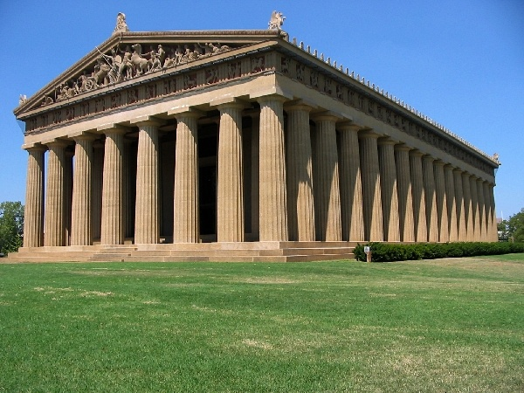
Your Section Colleague Presenters
Ellen Quinn
Bob Orkin
Barbara McCullough
Ray Crawford
Gregg Monaco
Notes:
Nashville’s Centennial Park is home to the only fully complete, 100% scale Parthenon
Erected 30 years after the Civil War to show Tennessee as “rebuilt”, new, and recovered from Civil War ravages
Downtown Nashville and “Broadway”

Slide 6
Ray – National Board Member
National Board spent 3 extra days after World Conference working strategic vision
Quality Performance that can be quantified is a key metric measurement focus
Continuous Improvement at the Section level is the emphasis
Section’s measure themselves against their past performance NOT against sections in different regions
Will speak at a future Section Dinner Meeting
Notes:
Ray Crawford’s “national director” perspective
Ray’s background comes from many years in the Design and Construction Division

Slide 7
Gregg Items – Chair/Vice-Chair Sessions
Many U.S. Sections face challenges similar to us
Tremendous willingness to share ideas and successes
Section 0511 is viewed as having the best potential speaker base given our unique metropolitan area
We garner respect because Dr. W. Edward Demings wanted a section closer to his “home office” in the twilight of his career and started “0511” to fulfill that goal
Western States experimenting with live Internet broadcast of dinner meeting speakers
Map of American Regions/Sections is being sent to us for Web Site inclusion
Notes:
Highlights from Chair/Vice-Chair sessions that occur on Saturday and Sunday before the official Conference begins

Slide 8
Barb Photos

Slide 9
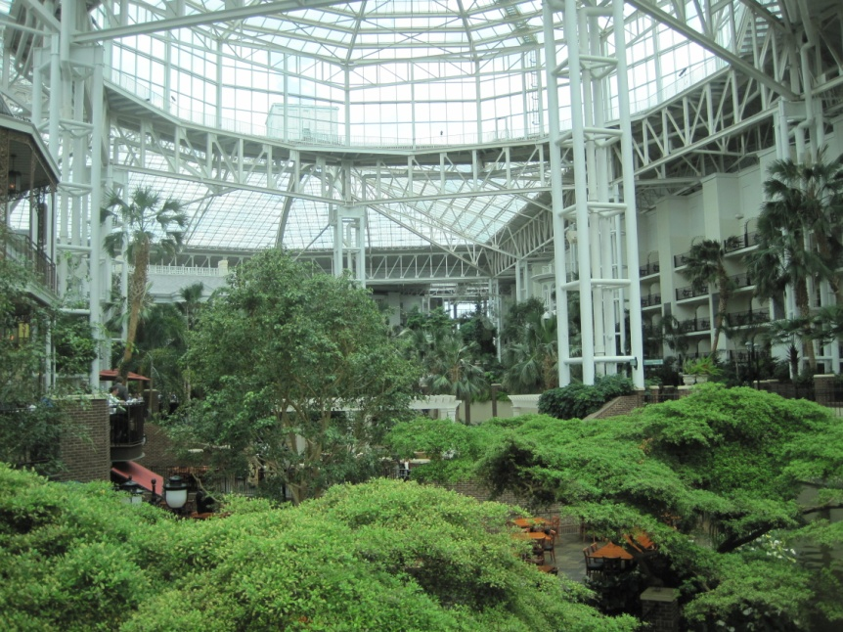
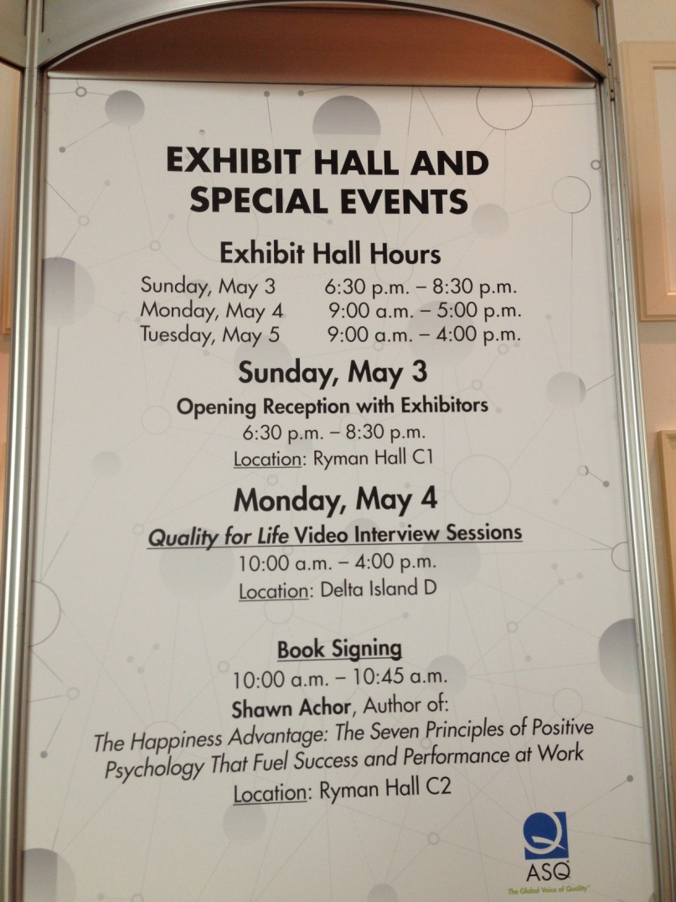
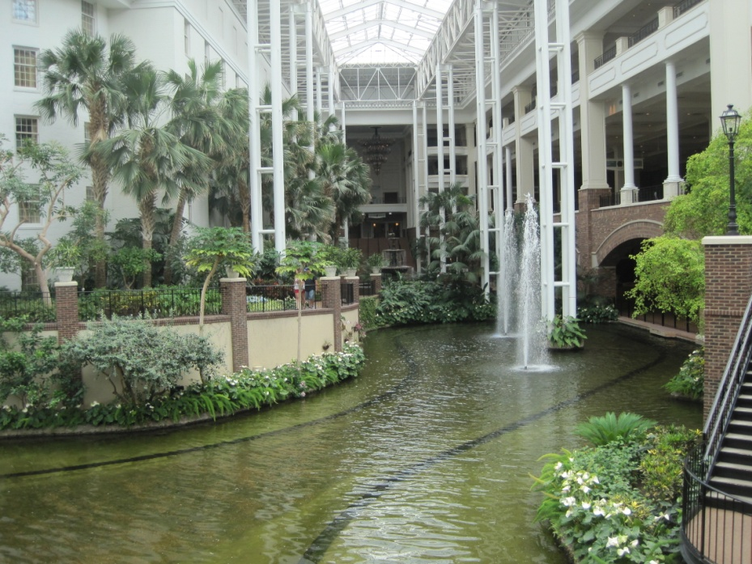
Gaylord Opryland Resort Vignettes

Slide 10
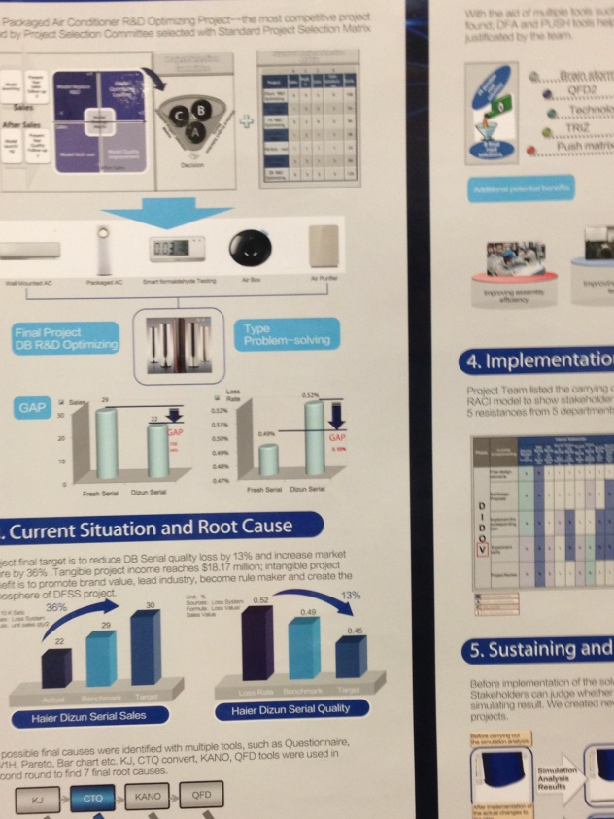
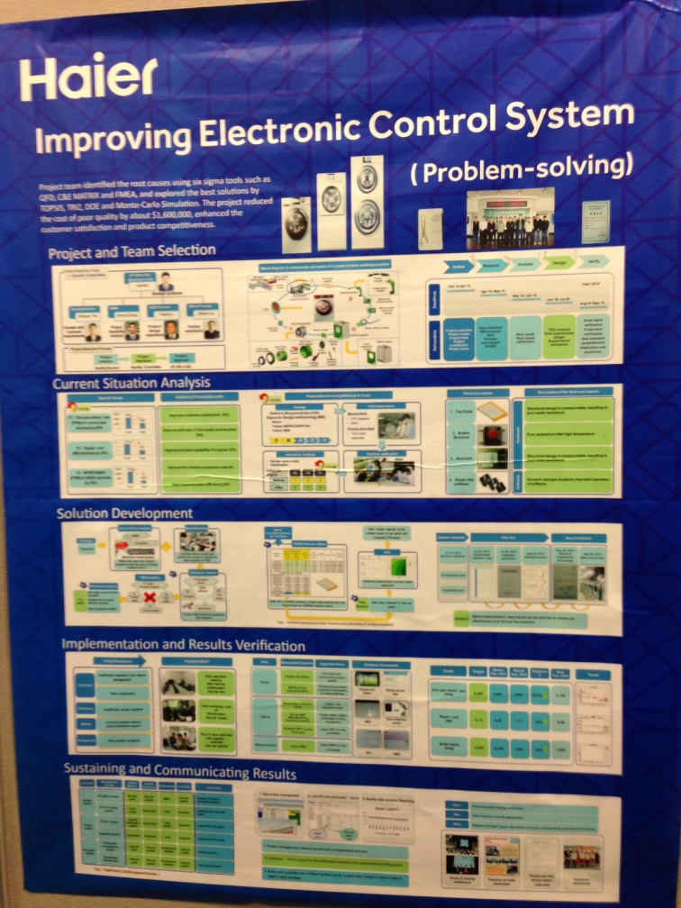
Team Excellence Award Posters
Haier’s management and quality professionals are “All-In” as evidenced by winning 6 awards
Notes:
Haier is a large China company dominating household consumer goods
As is typical for Chinese, they are very competitive and strive for “gold medal” performances

Slide 11
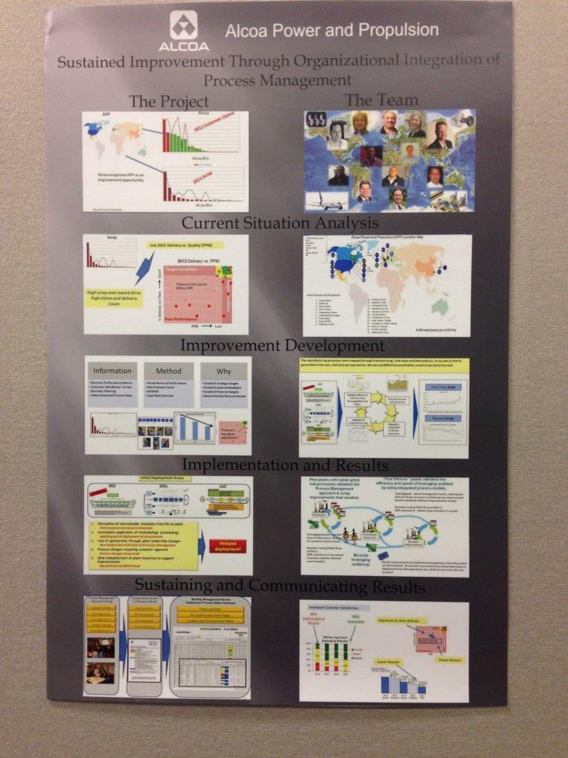
Team Excellence Storyboard Posters
Notes:
More winning storyboards

Slide 12
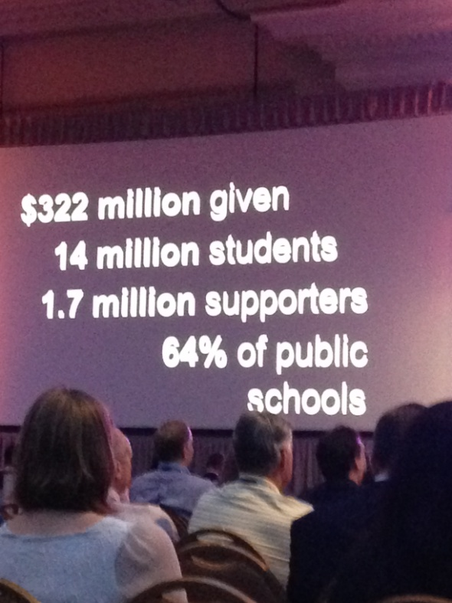
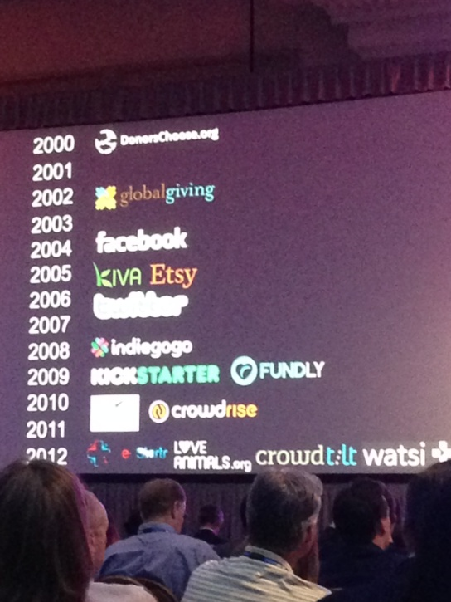
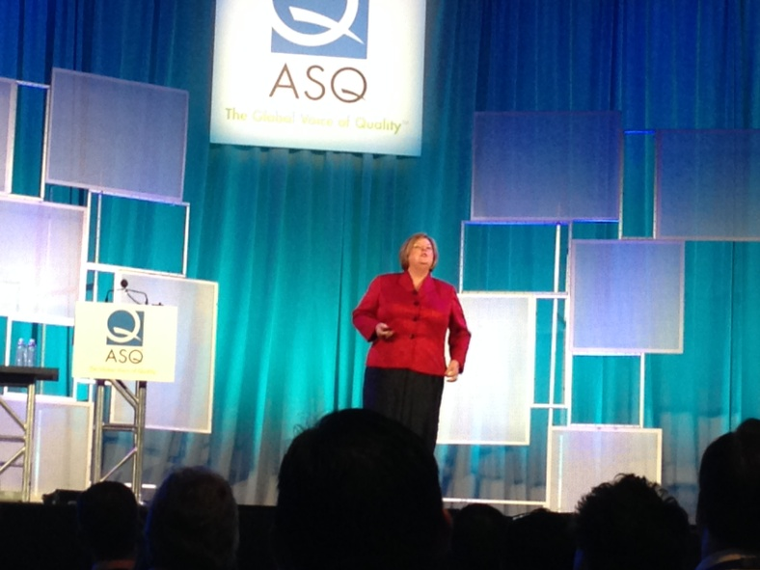
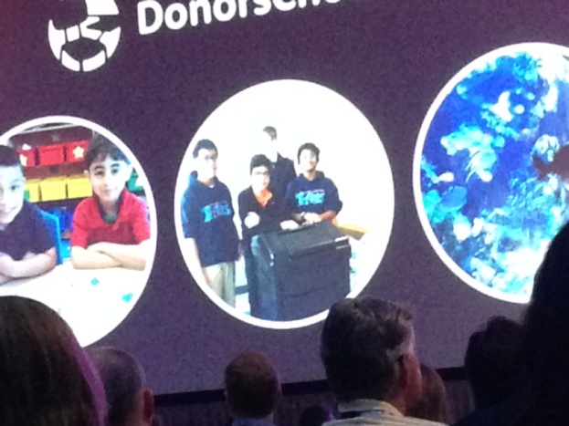
Keynote Speakers
Donor’s Choose
Charles Best
JoAnn Sternke
Notes:
Afternoon Keynotes book-ended morning keynotes

Slide 13
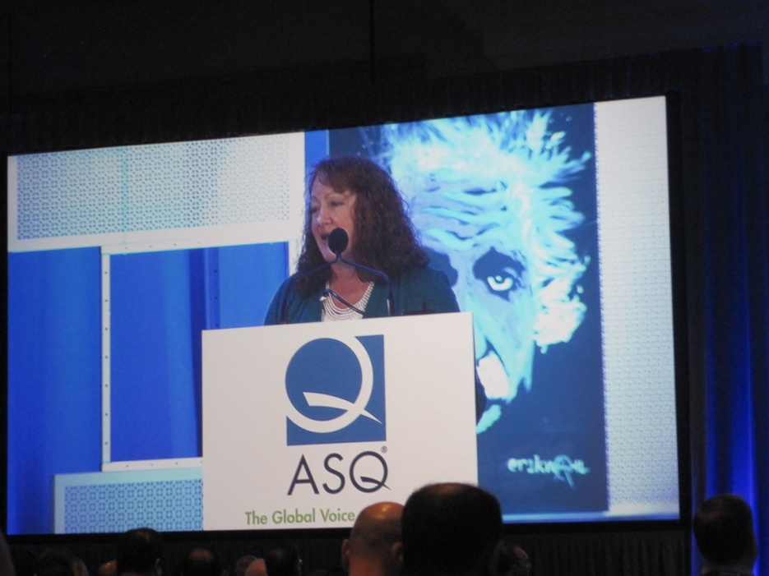
Keynote Speakers
Analjit Singh – Max India Limited
Janet Raddatz – Introductions
Chair of ASQ Conference Board
Notes:
Closing day

Slide 14
Collecting Donations
With the donation of Erik Wahl’s “live in real-time” painting from last year’s conference, the ASQ Emerging Quality Leaders Program collected thousands of dollars and one lucky winner took home this painting.
(I saw Erik paint it last year and it was amazing! ☺ )
Notes:
The actual Einstein painting on display

Slide 15
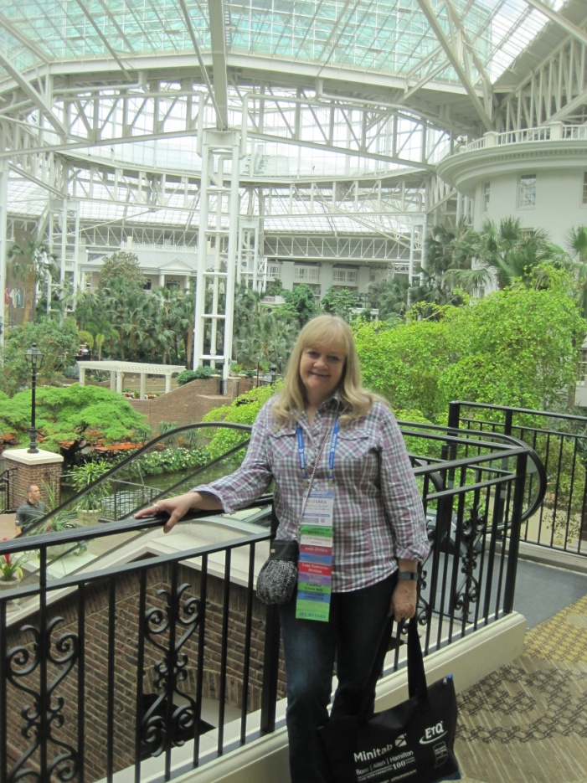
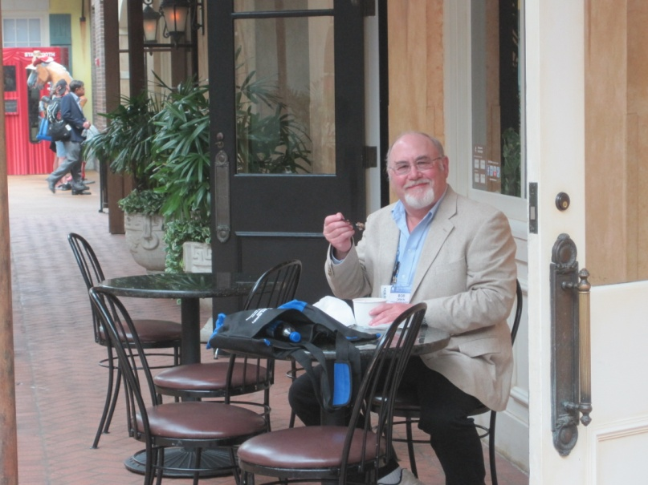
Faces and Places
Bob Orkin, Barb McCullough and Gregg Monaco
Dolly & Garth & Minnie in the Exhibit Hall
Notes:
Group “selfie” and candid opportunities

Slide 16
Exhibit Hall
Entertainment – Nashville Style and Beat
The Lunch Line
(which went extremely fast!)
Notes:
Exhibit Hall and Dining “flowed” into one another
Exhibitors arranged in rows 100 through 900

Slide 17
Bob Orkin – ‘Volunteer’ in Blue & White
Notes:
The University of Tennessee Volunteers are known for “Orange and Cream” colors on their uniforms… Volunteer Bob models ASQ Blue and White
ASQ pays the $95 registration fee for volunteers and World Conference cannot run without volunteers
Volunteers handle the dynamically evolving changes, provide directions in the “Opryland Labyrinth” and do what is necessary
Bob’s background and specialty is “Design and Construction Division”… and yes, he did a lot of booth duty!

Slide 18
Ellen Pix
Ellen is Vice Chair for the Quality Management Division (QMD)
Largest Division in ASQ
Touches every other division
Impacts
National Headquarters (Milwaukee, WI)
Individual Sections
QMD subsidizes full-time students to attend ASQ World
Enterprise Sponsor corporations (employers) significantly subsidize employee ASQ memberships
Notes:
Ellen arrived on Thursday night to supervise the 7 kits required to assemble the QMD booth AND participate in QMD meetings on Friday through Sunday

Slide 19
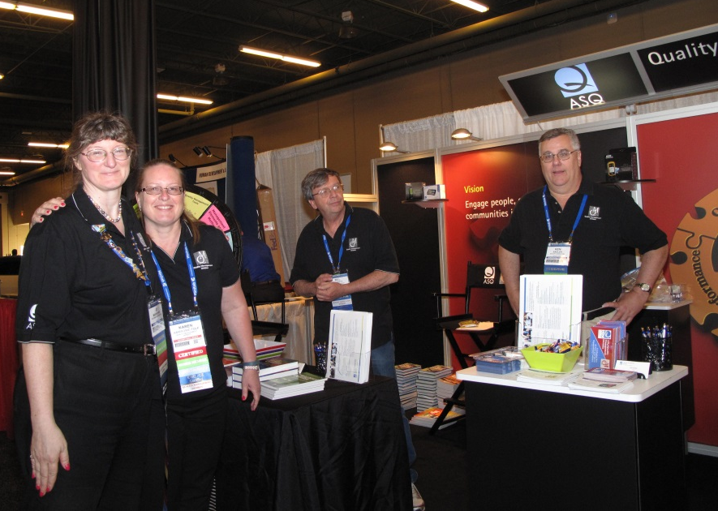
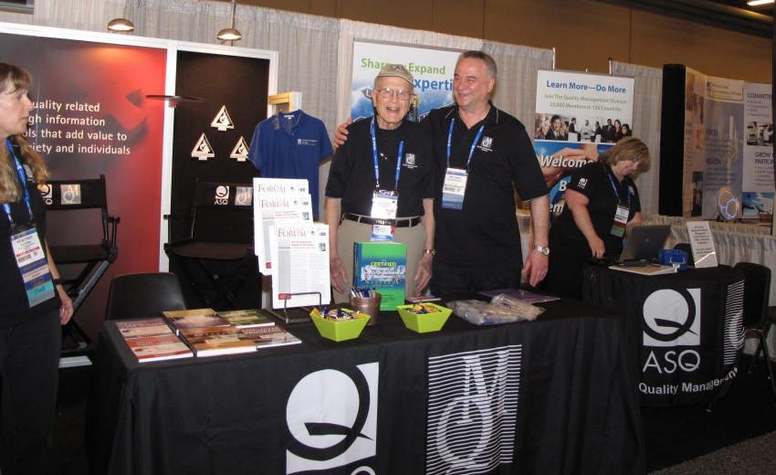
Benefits of attending WCQI
Hear from industry experts (keynotes)
Team competition
Attend a selection of sessions
Network with your peers
Notes:
Thanks, Ellen, for pix and recognizing your booth-mates

Slide 20
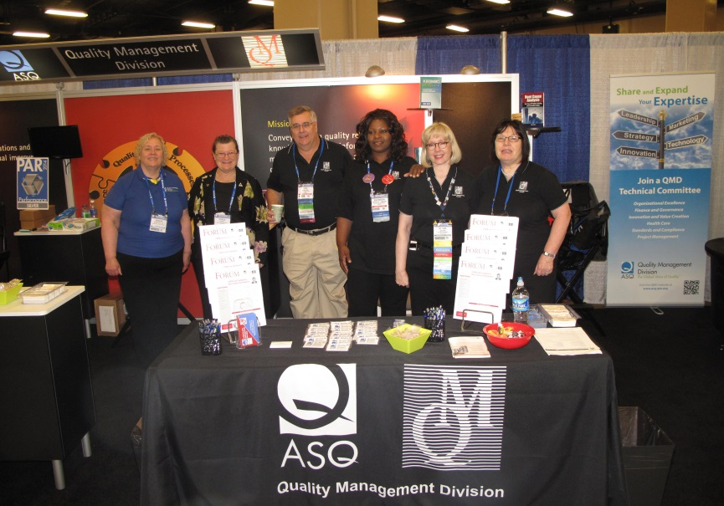
QMD at WCQI
Events:
Member breakfast
Booth
Hospitality Suite
Session speakers
CMQ/OE certification prep class
Pre-conference training sessions
Notes:
Just the tip of the iceberg of QMD touch-points with the larger ASQ audience

Slide 21
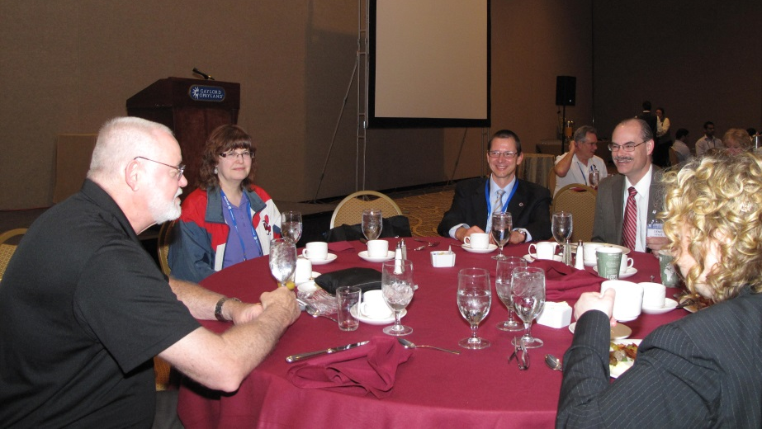
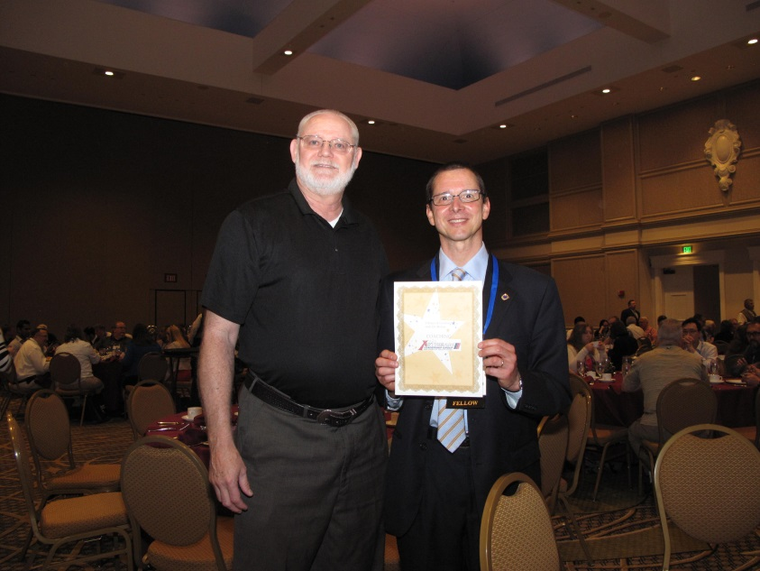
2015 WCQI (Continued)
Member Breakfast
Monday morning – JR McGee sponsor and speaker; combined with annual QMD meeting (over 500 people using a room for 300)
Notes:
This is one place where some 3,000 people actually know and understand what you as an individual do in your daytime job!

Slide 22
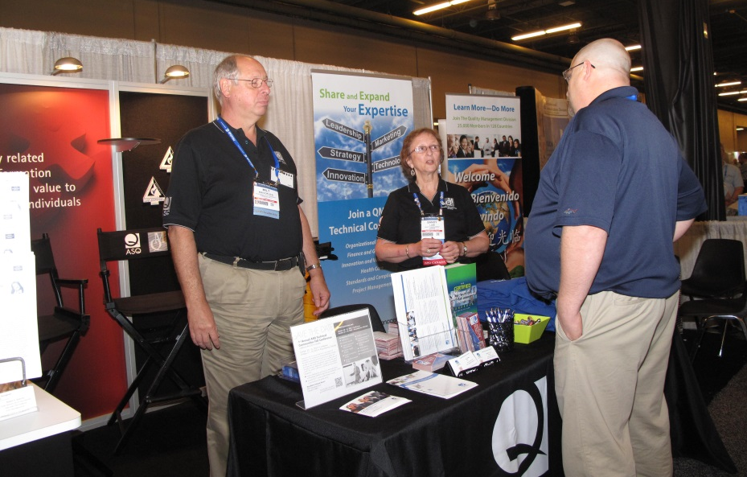
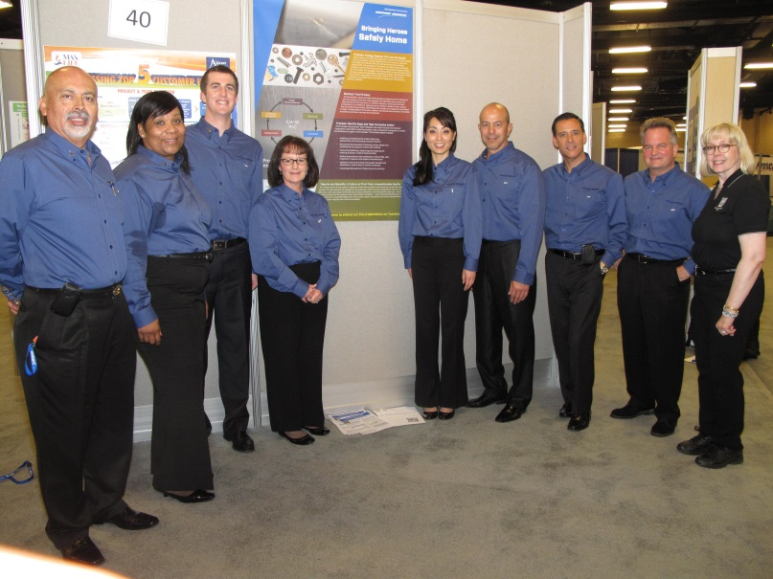
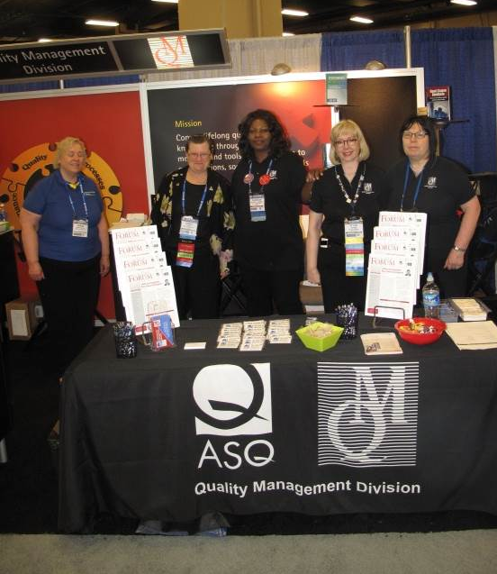
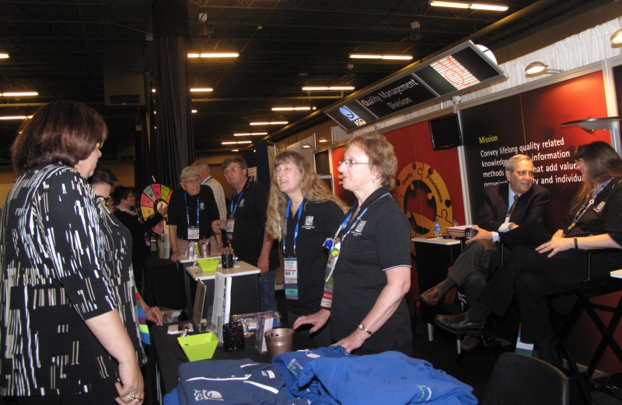
WCQI and QMD Is a People Business
Notes:
Booth-duty “warriors” and visitors

Slide 23
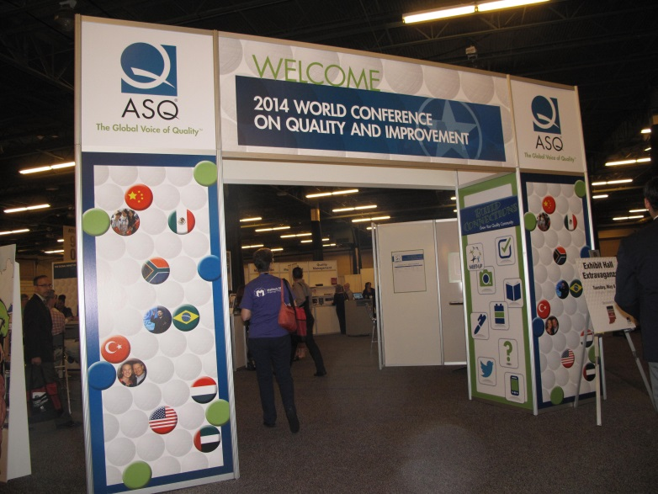
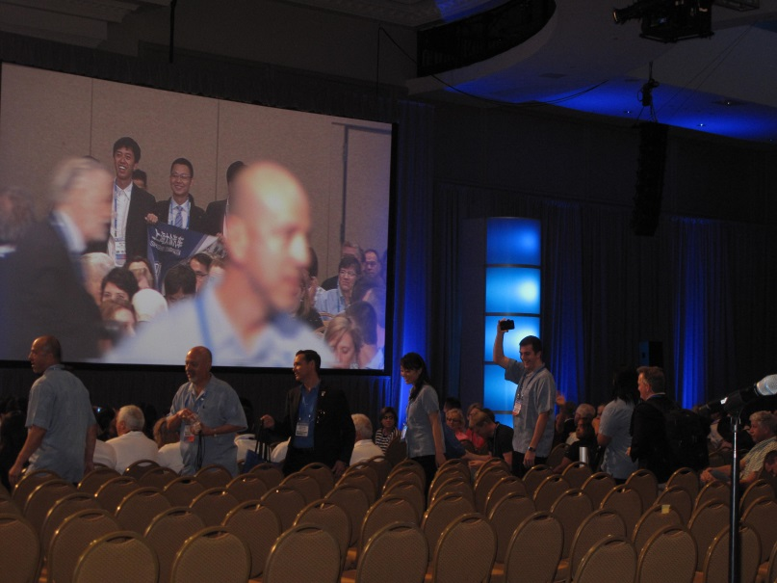
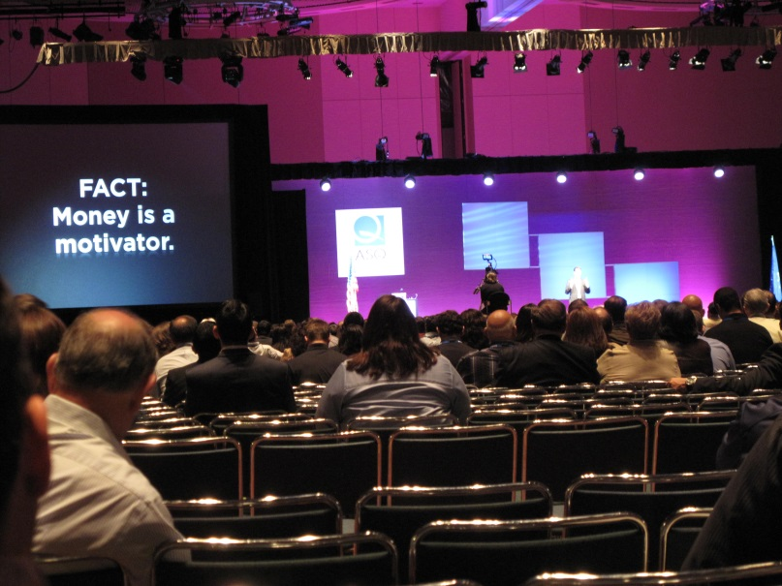
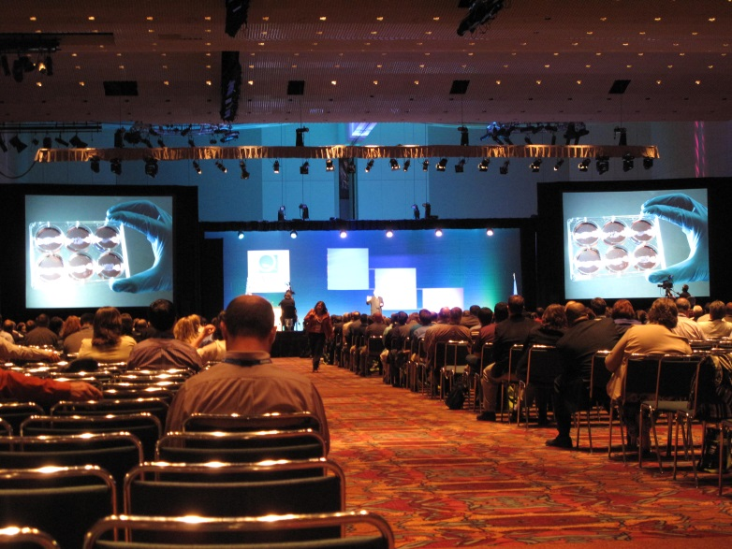
ASQ WCQI
Notes:
Portal to the Exhibit Hall
Scenes from the Keynote Room – easily held 3,000+ people

Slide 24
Gregg – New Guy Experience
Many participants have deep connections from 6-25 years of attendance
“Welcome” mat is out for the new guy
100 Seminars across 2.5 days on quality topics
Fresh ideas and observations not only welcome but highly desired
Keen desire to receive (and share) Section process and methodologies
Most Sections face similar challenges in our all-volunteer network
Section 0511 known for consistently featuring National/International speakers at or dinner meetings

Slide 25
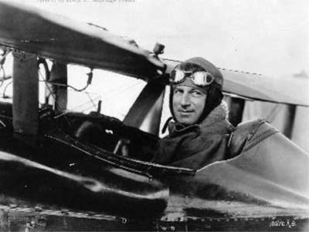
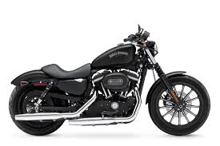
70th ASQ World Conference
Milwaukee: 15-18 May 2016
Home Town Images
Notes:
National and Division Leaders begin assembling Friday, May 13
Things relevant to Milwaukee:
Harley Davidson Motorcycles
Lite Beer from Miller
Baseball – Milwaukee Brewers
Basketball – Milwaukee Bucks
Football – Green Bay Packers
Milwaukee International Airport named after General Billy Mitchell
Father of American Airpower and a true, original American Hero
Trained folks like Hap Arnold (5 Star Chief of Staff) and
Fiorello LaGuardia – WWI fighter pilot and Ace; later Mayor of NYC
B/G Robin Olds sat by his fighter pilot dad’s knee as a lad (became a triple ace – WW2, Korea, ‘Nam) and listened to then Major Mitchell

Slide 26
Milwaukee Hotel Space Limited
Hilton and Hyatt are the main hotels adjacent to the Milwaukee Convention Center
Book a room in December 2015 when May 2016 meeting opens for web Registration
Leaders should be in place Friday/Saturday
Attendees should be in place Sunday
Can always cancel room at a later date without penalty
Other hotels require cabs/significant walks
If able, Thursday departures avoid pandemonium associated with thousands of people converging on an airport
Notes:
Try to make at least one (1) ASQ World Conference in person during your ASQ affiliation
ASQ is our professional “quality union”
Milwaukee is in Central Time
Available airports include:
Milwaukee International (General Billy Mitchell Field)
Chicago O’Hare
Chicago Midway

