Slide 1
ASQ Sections
“The Bedrock of ASQ”

Slide 2
To Our New Members & Guests…
Hey there! Hi there! Ho there! You’re as
as can be!
We’re glad to have you!

Slide 3
New Members
John Camuso
Ann Shows
Jackie Lawrence
Drake Wauters
Vinod Jyothikumar
Jenny Peterson
Kenrick St. Louis
Tracy Holmes
Mary Clair
John Oliver
Carlton Moffett
Jonathan McCann
Sean Cortopassis
Shane Van Wyngaardt
Matthew Motley

Slide 4
ASQ Organization
World Headquarters
Milwaukee, Wisconsin
Founded 16 February 1946 to
Maintain quality gains of World War II
Divisions – The Backbone of ASQ
27 Quality specialty practices
Strong interface with industry & manufacturers
Sections – The Bedrock of ASQ and Members
Local connection with other quality professionals
Over 300 sections across North America

Slide 5
Section Organization
25 Regions across the world
1 Director (volunteer) for each region
Regions are subdivided into Sections
Numeric Coding (RRSS)
Section 0511
05 – Region
11 – Section
Numbers sequentially assigned as each section is created

Slide 6
Sister Section Locations (05nn)
00 Lehigh Valley, PA
01 North Central, PA (State College)
02 Baltimore, MD
03 Harrisburg, PA
05 Philadelphia, PA
06 Delaware (only 3 counties in entire state!)
08 Southern New Jersey
09 Washington, DC and Suburban Maryland
10 Reading, PA
11 Northern Virginia (outside Washington, DC)
04 & 07 <Open>

Slide 7
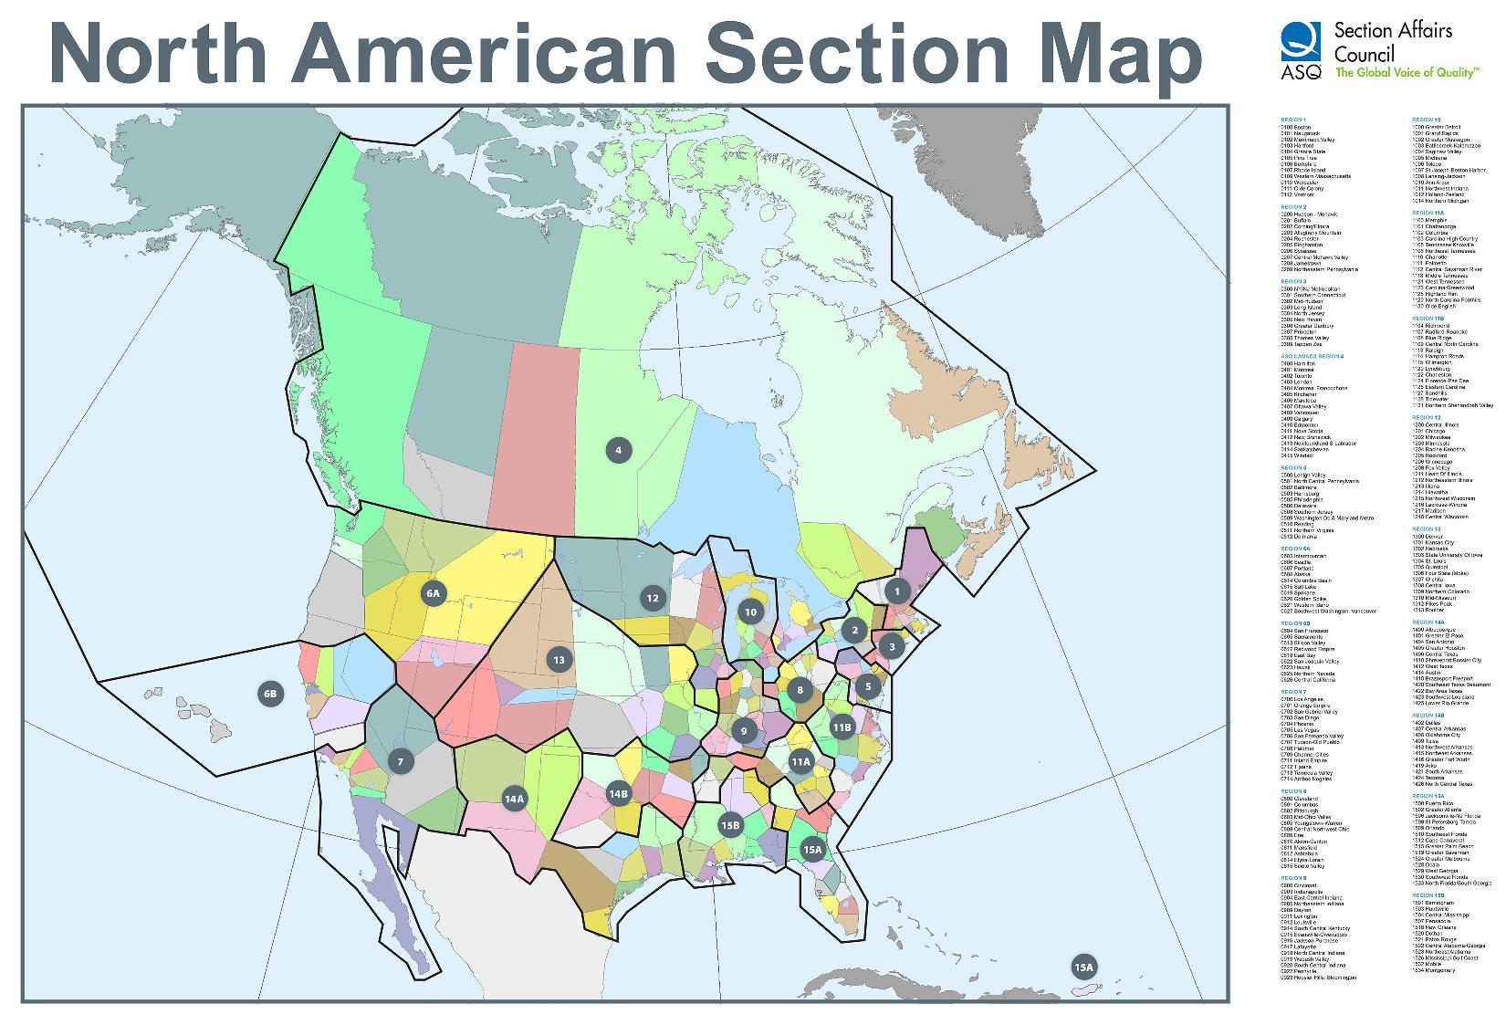
United States & Canada

Slide 8
Section 0511 Origins
Emerged from the ultra large Section 0509
Metropolitan Washington, DC geographic area
1,500+ Members before reapportionment
Washington, DC with adjoining Maryland and Northern Virginia suburbs
W. Edwards Deming, PhD led its creation in 1982
Dr. Deming wanted a dedicated Northern Virginia Section closer to his residence and home office
Brought in colleagues like Dr. Joseph Juran

Slide 9
Section 0511 Original Benefits
Access to National and International experts
Meeting speakers (from Deming’s rolodex)
Networking
Convenient way for quality professionals to meet monthly on the way home from work
…those benefits continue to this day!

Slide 10
Section 0511 – Factoids
5 Northern Virginia Counties – 1,582 Square Miles
Arlington
Fairfax
Loudoun
Prince William
Stafford
Membership – 562
Preponderance in 5 key counties
Work Relocated (government & corporation)
Out-of-State (retirees, members who like us)

Slide 11
Section 0511 in 2015
2nd Wednesday of each month is our Monthly Dinner Meeting with a Presentation Speaker
We provide ASQ Certification Exam preparation training classes throughout the year
We provide exam testing venues the 1st Saturday of:
March / October (certification exam series 1)
June / December (certification exam series 2)

Slide 12
Certification Exams (17 Certifications)
Series 1 – March/October
Biomedical Auditor
HACCP Auditor
Manager of Quality / Organization Excellence
Master Black Belt
Quality Inspector
Quality Technician
Reliability Engineer
Six Sigma Black Belt
Six Sigma Yellow Belt
Series 2 –
June/December
Calibration Technician
Pharmaceutical GMP Pro
Quality Auditor
Quality Engineer
Quality Improvement Associate
Quality Process Analyst
Six Sigma Green Belt
Software Quality Engineer
Exam matrix established by ASQ Headquarters

Slide 13
Rules of Thumb: Registration & Exam
Registration 2nd Friday of:
January for
April for
August for
October for
Exam 1st Saturday of:
March
June
October
December

Slide 14
ASQ Exam Prep Classes
October 3 (Sa) Exams
Olde Colony (Boston) offering on-line training
December 5 (Sa) Exams
TBD
Need expressed candidate interest

Slide 15
Saturday Exam Dates
October 3 – Series 1
Location: PPC Corporation
1760 Old Meadow Road; McLean, VA 22102
Registration Surcharge now in effect
December 5 – Series 2
Location: PPC Corporation
1760 Old Meadow Road; McLean, VA 22102
Register by: Friday, October 16
(Thank-you, Paul Strasser, CEO of PPC for your generous support)

Slide 16
Certification Renewals
ASQ Certifications MUST be renewed every 3 years
Work with the Recertification Chair
Recertification Units (RU) earned by:
Working in your specialty area
Attending monthly Dinner/Program meetings
Developing courseware / Delivering courseware
Serving in a Leadership position (any level)
Special Interest Group (SIG) participation
Proctoring an exam
And many others

Slide 17
Recertification
Contact Recertification Chair
Recertification15@asq0511.org
Follow our Website Recertification Notes and Guidelines (results in faster processing)
Most prolific renewal months
June
December

Slide 18
Special Interest Groups (SIG)
Section 0511 participates in
Software Developer SIG with 0509 and local IEEE Chapter
4th Tuesday of the month
Six Sigma SIG with 0509 and local IEEE Chapter
4th Wednesday of the month
Venues alternate between 0509 and 0511 dependent upon host Section
Pizza and soda menu
Guest speaker often an expert from SIG field
0509, 0511 and IEEE alternate finding speakers

Slide 19
Section 0511 Board Members (1 of 3)
Elected Officers
Chair (CEO) – John Mullins
Chair Elect (COO) – Gregg Monaco
Secretary – Barbara McCullough
Treasurer – Leslie Braun
Past Chair – Melissa Butler

Slide 20
Section 0511 Board Members (2 of 3)
Appointed Chairs
Arrangements
Database / RU tallies – Marie Rondot
Venues – Carolyn Miller
Audit – Charlotte Wild
Education – Paul Mills
Finance – Mike Coleman
Historian – Rick Wells
Lean Six Sigma SIG – Kristine Hejna
Membership – Mike Coleman
Nominating – Melissa Butler

Slide 21
Section 0511 Board Members (3 of 3)
Appointed Chairs (Continued)
Placements –
Programs – Paul Meyers
Recertification – Christine Kurowski
Testing Proctor – Muzzafar Zaffar
Treasurer Elect –
Voice of the Customer – Jai Singh
Web / Internet Liaison – Jeff Parnes

Slide 22
Our Innovations
Web-delivered certification course training
Video recording and archiving of dinner meetings
Cloud data storage
Smart Phone friendly web site rendering
Section Leadership Position descriptions
Complimentary Operating Instructions
Work break down structures (WBS) by position

Slide 23
Impact Beyond Northern Virginia
Section 0511 is known for providing:
ASQ World Presidents
ASQ World Board of Director Members
Division Leadership across many specialties
Special project focus at ASQ and Division levels

Slide 24
Upcoming Conferences (1 of 3)
ASQ World: 15-18 May 2016 (Milwaukee, WI)
Service Quality (24th Annual) (Division)
28-29 Sep 2015 (Orlando, FL)
Fall Technical Conference (Division)
8 Oct 2015 (Houston, TX)
Audit Conference (Division)
22 Oct 2015 (Reno, NV)
Technical Communities Conference (Division)
22 Oct 2015 (Orlando, FL)

Slide 25
Upcoming Conferences (2 of 3)
ASQ World: 15-18 May 2016 (Milwaukee, WI)
Int’l Conference on Quality Standards
9 Nov 2015 (Indianapolis, IN)
Education Division Conference & Workshop (Division)
14 Nov 2015 (Houston, TX)
71st Annual Deming Conference on Applied Statistics
6 Dec 2015 (Atlantic City, NJ)

Slide 26
Upcoming Conferences (3 of 3)
ASQ World: 15-18 May 2016 (Milwaukee, WI)
Aviation, Space and Defense (Division)
Feb 2016 (Orlando)
Six Sigma (Division)
Feb 29 – Mar 1, 2016 (Phoenix)

Slide 27
SIG Meetings
Software SIG – 4th Tuesday
September 22
Includes Section 0509 and IEEE
MITRE, Tysons Corner
Six Sigma SIG – 5th Wednesday
September 30
Includes Section 0509 and IEEE
Teknology Corner, McLean
Speaker – Mr. Norman Jones, NRO

Slide 28
Next Section 0511 Dinner
October 14 – Maggiano’s (Tysons Corner)
Our annual “Big Meeting”
No “Walk-in” because of venue contract
Coming Attractions
November 11 – CGI Federal
December 9 (TBD) Holiday Social

