Slide 1
Hidden Risks in the Supply Chain
Steve McNamara
September 9, 2015

Slide 2

What You Can’t See Can Hurt You
No Privity of Contract with Lower-tier Suppliers
Terms and Conditions
Counterfeit Parts
Escape Defects
Unqualified Suppliers
Lack of Visibility
Poor Source Selection

Slide 3
Privity of Contract
Privity Between Government and Prime
Privity Between Prime and Subcontractor
Government
Prime Contractor
Subcontractor
No Privity exists
between Government and Subcontractor

Slide 4
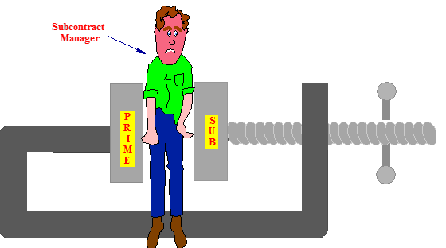
Incompatible Terms and Conditions
Areas of vulnerability:
Specifications
Contractual Terms and Conditions
Payment Terms
Funding
Warranties
Rights in data and data access
Termination clauses
Post delivery support
Access to facilities
Schedules

Slide 5
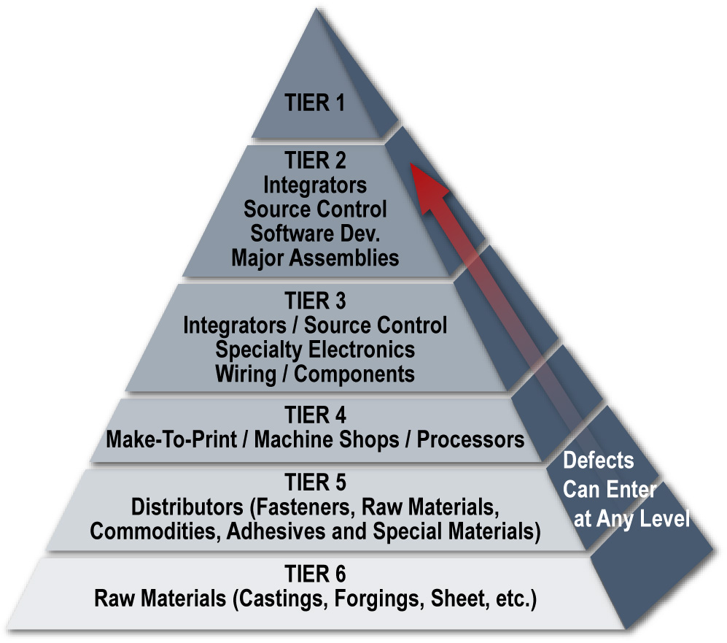
Lower-tier Supplier Management
"The more tiers the more tears."
Ed Jopson, MDA/QS, Asst Dir. (Assurance Integration)

Slide 6
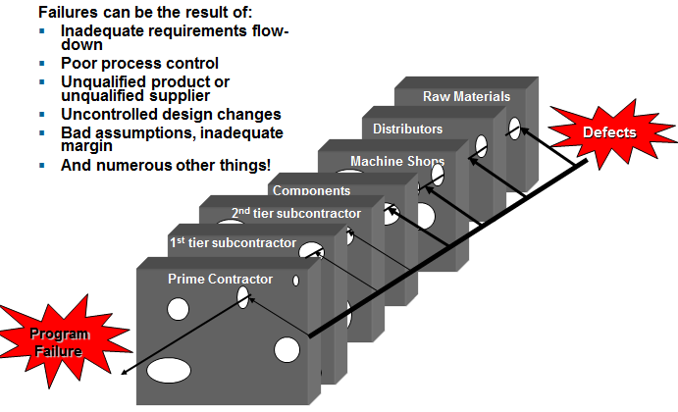
Defects In The Supply Chain Can Be Devastating
Adapted from: James Reason, Managing the Risks of Organizational Accidents, 1997, p. 12

Slide 7
Balancing Lower-Tier Supplier Management
How do we apply to lowest levels of the Supply Chain?
How do we ensure our contractual rights to audit?
How do we validate processes within the Supply Chain?
How do we ensure that the lower-level suppliers manage their supply chain?
Privity of Contract
Visibility &
Access to Lower-tiers

Slide 8
Demand Supplier Management of Next Lower Tier Supplier (LTS)
Step 1 – Define expectations
  Focus capture and evaluation processes to include lower tier management
  Flow down requirements – including quality clauses, technical specification allocation, linked and integrated schedules, terms and conditions (sub-tier access), risk assessment, mandatory pass-thru to sub-tier suppliers
  Identify high risk suppliers and mitigate risk
Step 2 – Source evaluation and selection - add criteria:
  Thoroughness of higher risk supplier identification
  Quantity and experience of resources to manage LTS
  Risk mitigation plans
  Flow down of management provisions to LTS
  Program performance – focus on risk associated with LTS

Slide 9
Demand Supplier Management of Next Lower Tier Supplier (LTS)
Step 3 – Improve proactive management
  Subcontract Management Teams implementing improved insight/oversight
  Increased QA/MA participation
  Plan for lower tier management in program funding
  Focus on supplier process adherence at all tiers
  Add sub-tier management throughout process: instructions in RFP
  Require 1st tier suppliers to:
    Identify higher risk sub-tier suppliers in the risk management plan,
    Tailored risk assessment for small suppliers
    Provide visibility to sub-tier supplier performance

Slide 10
Indicators of Effective Lower-tier Processes
How does the lower-tier supplier manage and control its suppliers?
  Source Selection
  Requirements Flow-down
  Quality (pre-award surveys, audits, corrective actions)
  Special Processes
Look for evidence of effective and strong processes in the Suppliers' Supply Chain Management infrastructure
  Review their internal procedures
  Look at some Subcontracts and Purchase Orders
  Review their Quality Records
  Review special process controls
  How frequently do they audit their suppliers?
  Sample some failure analyses, root cause, and corrective actions
  Meet with their supplier management and quality personnel

Slide 11
Rating Suppliers
Rating systems should have the following attributes:
  Frequent
  Objective
  Consistent across the enterprise
  Ability to rate Lower-tier Supplier Management
  Ability to rate Hardware, Software and Services Suppliers
  360° feedback to suppliers
  Management review
  Supportive of analysis

Slide 12
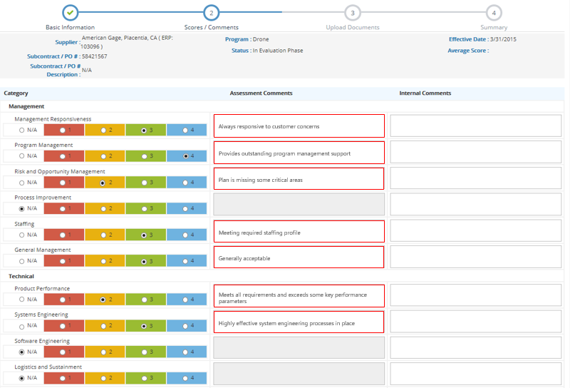
Sample Supplier Rating

Slide 13
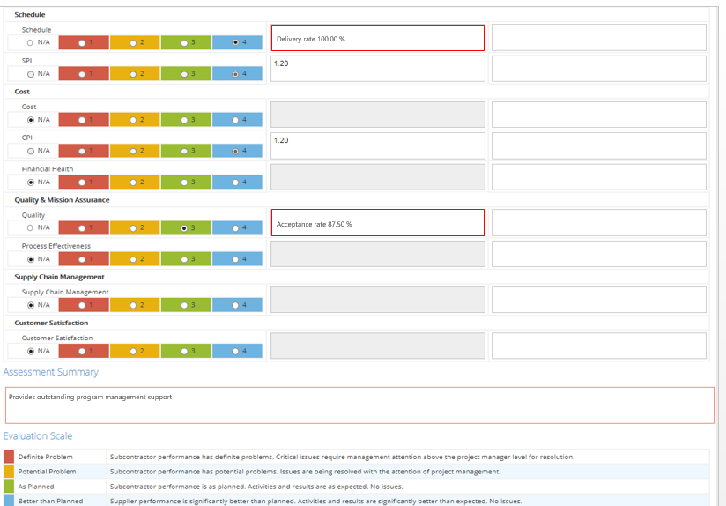
Sample Supplier Rating
Lower-tier Supplier Management

Slide 14

Counterfeit Parts
Counterfeit parts have become an increasingly serious threat to the aerospace and defense industry
Counterfeit electronic and mechanical parts have entered the supply chain primarily from 3rd world sources and China
  Many of these parts have been salvaged from discarded computers and other waste products and then remarked and re-branded for sale by unscrupulous brokers
Much of the material used to make counterfeit electronic parts is electronic waste (e-waste) shipped from the U.S. and the rest of the world to China. In its January 2010 study, the Department of Commerce’s said that e-waste has turned into an abundance of discrete electronic components and microcircuits for counterfeit parts. The failure of a single electronic part can leave a soldier, sailor, airman, or Marine vulnerable at the worst possible time. A flood of counterfeit electronic parts has made it a lot harder to have confidence that won’t happen.
- Senator Carl Levin

Slide 15


The Problem With Electronic Waste
Electronic Waste
Components Removed
Sorted By Package/Lead Types

Slide 16
Counterfeit Parts
The net result is that some of the most complex and sophisticated defense systems have been made vulnerable by the infiltration of counterfeit parts, placing our warfighters in harm’s way and weakening the defense of our nation
This threat became so serious that in 2012, the Senate Armed Services Committee held hearings on this subject
The GAO issued a report in February 2012 stating that: “Counterfeit parts - generally the misrepresentation of parts’ identity or pedigree - can seriously disrupt the Department of Defense (DOD) supply chain, harm weapon systems integrity, and endanger troops’ lives.”
The CEO’s from some of the top Defense Contractors were called before the Senate to testify on the impact of counterfeit parts on their programs
As a result of these hearings the 2012 National Defense Authorization Act was amended to include Section 818 to provide strict preventive measures for counterfeit parts

Slide 17
Section 818 Summary
Section 818 of the 2012 NDAA, which is now the law, states that:
Contractors who supply electronic parts or products that include electronic parts are responsible for detecting and avoiding the use or inclusion of counterfeit electronic parts or suspect counterfeit electronic parts in such products and for any rework or corrective action that may be required to remedy the use or inclusion of such parts
The cost of counterfeit electronic parts and suspect counterfeit electronic parts and the cost of rework or corrective action that may be required to remedy the use or inclusion of such parts are not allowable costs under Department of Defense contracts
Any contractor or subcontractor who becomes aware, or has reason to suspect, that any end item, component, part, or material contained in supplies purchased by a contractor or subcontractor contains counterfeit electronic parts or suspect counterfeit electronic parts report in writing within 60 days to appropriate Government authorities and the Government-Industry Data Exchange Program

Slide 18
DFARS Case 2012-DO55 Final Ruling May 6, 2014
DoD reviewed the public comments in the development of the final rule. A Summary of Significant Changes From Proposed Rule is as follows:
  The definitions of “counterfeit part” and “suspect counterfeit part” are substantively revised and limited to electronic parts;
  The definition of “legally authorized source” is deleted; and
  A new definition of “obsolete part” is added.
  The criteria for a contractor's counterfeit electronic part detection and avoidance system at DFARS 246.870-2(b) and paragraph (c) of the clause at DFARS 252.246-7007 are expanded and clarified and three new criteria have been added. In addition, the use of a risk-based system by the contractor is clarified.
  Applicability of the counterfeit system criteria only to CAS-covered prime contractors is clarified, as is the required flow down to all subcontractor tiers providing electronic parts or assemblies containing electronic parts.

Slide 19
Summary of DFARS 246.870-2(b)
Contractors that are subject to the Cost Accounting Standards (CAS) and that supply electronic parts or products that include electronic parts and their subcontractors that supply electronic parts or products that include electronic parts, are required to establish and maintain an acceptable counterfeit electronic part detection and avoidance system. Failure to do so may result in disapproval of the purchasing system by the contracting officer and/or withholding of payments (see 252.244-7001, Contractor Purchasing System Administration).

Slide 20
Summary of 252.246-7007
Counterfeit electronic part means an unlawful or unauthorized reproduction, substitution, or alteration that has been knowingly mismarked, misidentified, or otherwise misrepresented to be an authentic, unmodified electronic part from the original manufacturer, or a source with the express written authority of the original manufacturer or current design activity, including an authorized aftermarket manufacturer.
The Contractor shall establish and maintain an acceptable counterfeit electronic part detection and avoidance system. Failure to maintain an acceptable counterfeit electronic part detection and avoidance system, as defined in this clause, may result in disapproval of the purchasing system by the Contracting Officer and/or withholding of payments.

Slide 21
Summary of 252.246-7007
Counterfeit electronic part detection and avoidance system shall include risk-based policies and procedures that address, at a minimum, the following areas:
The training of personnel
The inspection and testing of electronic parts
Processes to abolish counterfeit parts proliferation
Processes for maintaining electronic part
Use of suppliers that are the original manufacturer, or sources with the express written authority of the original manufacturer or current design activity, including an authorized aftermarket manufacturer or suppliers that obtain parts exclusively from one or more of these sources. When parts are not available from any of these sources, use of suppliers that meet applicable counterfeit detection and avoidance system criteria.
Reporting and quarantining of counterfeit electronic parts and suspect counterfeit electronic parts.
Methodologies to identify suspect counterfeit parts and to rapidly determine if a suspect counterfeit part is, in fact, counterfeit.

Slide 22
Summary of 252.246-7007 (Continued)
Design, operation, and maintenance of systems to detect and avoid counterfeit electronic parts and suspect counterfeit electronic parts.
Flowdown of counterfeit detection and avoidance requirements, including applicable system criteria provided herein, to subcontractors at all levels in the supply chain that are responsible for buying or selling electronic parts or assemblies containing electronic parts, or for performing authentication testing.
Process for keeping continually informed of current counterfeiting information and trends, including detection and avoidance techniques contained in appropriate industry standards, and using such information and techniques for continuously upgrading internal processes.
Process for screening GIDEP reports and other credible sources of counterfeiting information to avoid the purchase or use of counterfeit electronic parts.
Control of obsolete electronic parts in order to maximize the availability and use of authentic, originally designed, and qualified electronic parts throughout the product's life cycle.

Slide 23
Impact of DFARS Counterfeit Parts Clauses
In order for your company to have an approved purchasing system, you must implement a counterfeit parts prevention program on all DoD programs subject to this new DFARS clause
Contractors must purchase electronic parts or assemblies that contain electronic parts in accordance with the sourcing requirements of NDAA 2012 Section 818
  Original Component Manufacturers or
  Authorized Distributors
  If parts are not available from the above, contractors must subject them to a rigorous inspection and testing protocol to validate authenticity
Contractors must “establish and maintain an acceptable counterfeit electronic parts avoidance and detection system”. This is to be accomplished by flowing down “counterfeit system criteria” from the prime contractor to all subcontractor tiers providing electronic parts or assemblies containing electronic parts
Contractors must report all instances when their program has reason to suspect that counterfeit parts have been used in deliverable products

Slide 24
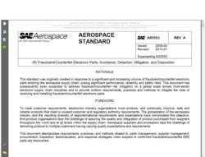
AS5553A – The New Standard for Counterfeit Parts
Fraudulent/Counterfeit Electronic Parts; Avoidance, Detection, Mitigation, and Disposition
Electronic parts should be purchased, whenever
possible, directly from OCMs or from authorized suppliers
Independent distributors should be used only after
consideration of alternate parts, redesign, schedule
adjustments and a reasonable search for material from
authorized (franchised) sources has been conducted
and approval has been obtained from a designated authority
OCMs and distributors (authorized (franchised) and independent) should be required to provide certificates of conformance and acquisition supply chain traceability; otherwise the purchaser assumes unknown risks
  Note: such documentation has the potential to be forged or falsified
Acquisition supply chain traceability consists of the name and location of all supply chain intermediaries from the part manufacturer to the direct source of the product
The organization should ensure that these requirements are clearly stated as deliverable data within the procurement documents, regardless of which level of the supply chain provides the parts
If supply chain traceability is unknown or documentation is suspect, appropriate risk mitigation should be used as described in this document.

Slide 25
Implementation Challenges
Parts availability – lead time
Obsolete parts
Impact on Socio-Economic supplier goals
Flow-down and implementation by sub-tier suppliers
Commercial Off-the-Shelf (COTS) Products
Impact on Program Cost

Slide 26
Summary
There are many risks in the supply chain
With the globalization of the supplier base, increased attention needs to be placed on processes that control procurement
Standards such as AS9100 make it clear that organizations are responsible for the conformity of the product, irrespective of where or how it is obtained. AS9100C paragraph 7.4.1

