Slide 1
ASQ Sections
“The Bedrock of ASQ”

Slide 2
To Our New Members & Guests…
Hey there! Hi there! Ho there! You’re as
as can be!
We’re glad to have you!

Slide 3
ASQ Organization
World Headquarters
Milwaukee, Wisconsin
Founded 16 February 1946 to
Maintain quality gains of World War II
Divisions – The Backbone of ASQ
27 Quality specialty practices
Strong interface with industry & manufacturers
Sections – The Bedrock of ASQ and Members
Local connection with other quality professionals
Over 300 sections across North America

Slide 4
Section Organization
25 Regions across the world
1 Director (volunteer) for each region
Regions are subdivided into Sections
Numeric Coding (RRSS)
Section 0511
05 – Region
11 – Section
Numbers sequentially assigned as each section is created

Slide 5
Sister Section Locations (05nn)
00 Lehigh Valley, PA
01 North Central, PA (State College)
02 Baltimore, MD
03 Harrisburg, PA
05 Philadelphia, PA
06 Delaware (only 3 counties in entire state!)
08 Southern New Jersey
09 Washington, DC and Suburban Maryland
10 Reading, PA
11 Northern Virginia (outside Washington, DC)
12 Del-Mar-Va (Delaware–Maryland–Virginia triangle)
04 & 07 <Open>

Slide 6
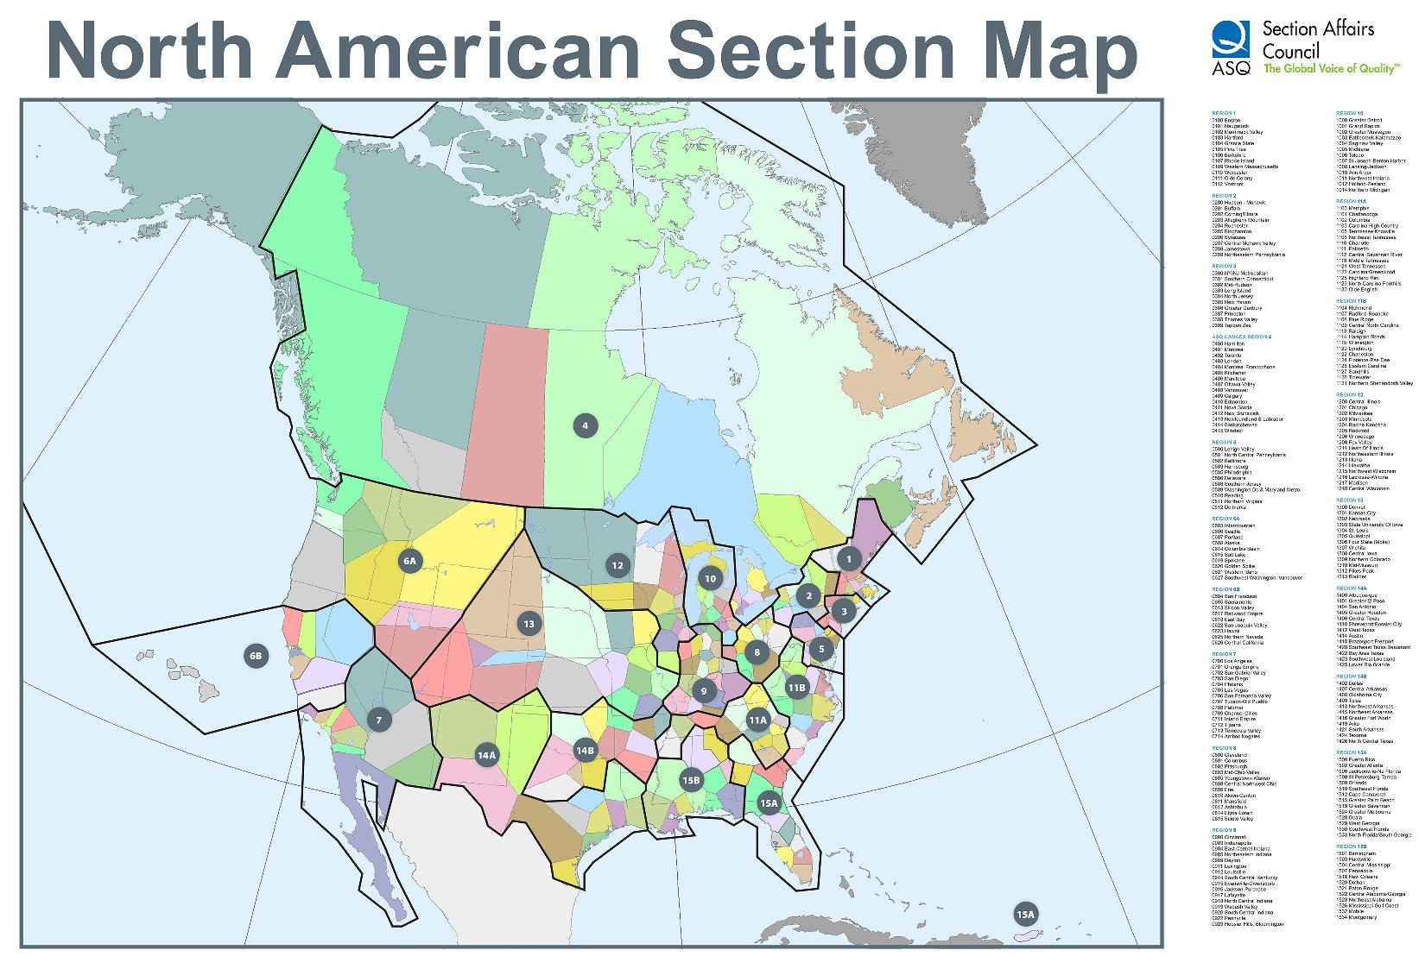
United States & Canada

Slide 7
Section 0511 Origins
Emerged from the ultra large Section 0509
Metropolitan Washington, DC geographic area
1,500+ Members before reapportionment
Washington, DC with adjoining Maryland and Northern Virginia suburbs
W. Edwards Deming, PhD led its creation in 1982
Dr. Deming wanted a dedicated Northern Virginia Section closer to his Herndon residence and home office
Brought in colleagues like Dr. Joseph Juran

Slide 8
Section 0511 Original Benefits
Access to National and International experts
Meeting speakers (from Deming’s rolodex)
Networking
Convenient way for quality professionals to meet monthly on the way home from work
…those benefits continue to this day!
“We maintain the ‘Deming Flame Legacy’ while pioneering new frontiers and vistas in quality”

Slide 9
Section 0511 – Factoids
5 Northern Virginia Counties – 1,582 Square Miles
Arlington
Fairfax
Loudoun
Prince William
Stafford
Membership – 582
Preponderance in 5 key counties
Work Relocated (government & corporation) TAD/TDY
Out-of-State (retirees, members who ‘like’ us)

Slide 10
Section 0511 in 2015
2nd Wednesday of each month is our Monthly Dinner Meeting with a Presentation Speaker
We provide ASQ Certification Exam preparation training classes throughout the year
We provide exam testing venues the 1st Saturday of:
March & October (certification exam Series 1)
June & December (certification exam Series 2)

Slide 11
Certification Exams (17 Certifications)
Series 1 –
March & October
Biomedical Auditor
HACCP Auditor
Manager of Quality / Organization Excellence
Master Black Belt
Quality Inspector
Quality Technician
Reliability Engineer
Six Sigma Black Belt
Six Sigma Yellow Belt
Series 2 –
June & December
Calibration Technician
Pharmaceutical GMP Pro
Quality Auditor
Quality Engineer
Quality Improvement Associate
Quality Process Analyst
Six Sigma Green Belt
Software Quality Engineer
Exam matrix established by ASQ Headquarters

Slide 12
Rules of Thumb: Registration & Exam
Registration 2nd Friday of:
January for
April for
August for
October for
Exam 1st Saturday of:
March
June
October
December
$ Extra Registration Fee in Effect $

Slide 13
ASQ Exam Prep Classes
March 5 (Sa) Exams
Certified Manager of Quality/Organizational Excellence Certification (www.asq0511.org)
June 4 (Sa) Exams
TBD

Slide 14
Saturday Exam Dates
March 5 – Series 1
Location: PPC Corporation
1760 Old Meadow Road; McLean, VA 22102
Register by Friday, January 15
June 4 – Series 2
Location: PPC Corporation
1760 Old Meadow Road; McLean, VA 22102
Register by: Friday, April 15
(Thank-you, Paul Strasser, CEO of PPC for your generous support)

Slide 15
ASQ World Exam Date
Milwaukee – Hilton Milwaukee City Center
Sunday, May 15 (7 AM)
Every Single ASQ Certification
Register by Friday, April 1
Otherwise, extra fee required

Slide 16
Certification Renewals
ASQ Certifications MUST be renewed every 3 years
Work with the Recertification Chair
Recertification Units (RU) earned by:
Working in your specialty area
Attending monthly Dinner/Program meetings
Developing courseware / Delivering courseware
Serving in a Leadership position (any level)
Special Interest Group (SIG) participation
Proctoring an exam
And many others

Slide 17
Recertification
Contact Recertification Chair
Recertification16@asq0511.org
Follow our Website Recertification Notes and Guidelines. Results in:
Faster processing
Minimizes returns of packages for corrections
Most prolific renewal months
June
December

Slide 18
Special Interest Groups (SIG)
Section 0511 participates in
Software Developer SIG with 0509 and local IEEE Chapter
4th Tuesday of the month
Six Sigma SIG with 0509 and local IEEE Chapter
4th Wednesday of the month
Venues alternate between 0509 and 0511 dependent upon host Section
Pizza and soda menu
Guest speaker often an expert from SIG field
0509, 0511 & IEEE alternate sponsoring speakers

Slide 19
Section 0511 Board Members (1 of 3)
Elected Officers
Chair (CEO) – Gregg Monaco
Chair Elect (COO) – Melissa Cicotello
Secretary – Barbara McCullough
Treasurer* – Cynthia Reichart (2016-18)
Past Chair – John Mullins
* Term Limited by ASQ Articles of Incorporation

Slide 20
Section 0511 Board Members (2 of 3)
Appointed Chairs
Arrangements
Database / RU tallies – Marie Rondot (need backfill ASAP)
Venues – Carolyn Miller
Audit – Charlotte Wild
Education – Paul Mills
Finance – Mike Coleman
Historian – Rick Wells
Lean Six Sigma SIG – Kristine Hejna
Membership – Mike Coleman
Nominating – John Mullins

Slide 21
Section 0511 Board Members (3 of 3)
Appointed Chairs (Continued)
Placements –
Programs – Paul Meyers
Recertification – Christine Kurowski
Testing Proctor – Muzzafar Zaffar
Treasurer Elect –
Voice of the Customer – Jai Singh
Web / Internet Liaison – Jeff Parnes
We Welcome Volunteers!

Slide 22
Our Innovations
Web-delivered certification course training
Video recording and archiving of dinner meetings
Cloud data storage
Smart Phone friendly web site rendering
Section Leadership Position descriptions
Complimentary Operating Instructions
Work break down structures (WBS) by position
Virtual bank administrative coordination

Slide 23
Impact Beyond Northern Virginia
Section 0511 is known for providing:
ASQ World Presidents
ASQ World Board of Director Members
Division Leadership across many specialties
Special project focus at ASQ and Division levels
“We Channel the Spirit of Deming”

Slide 24
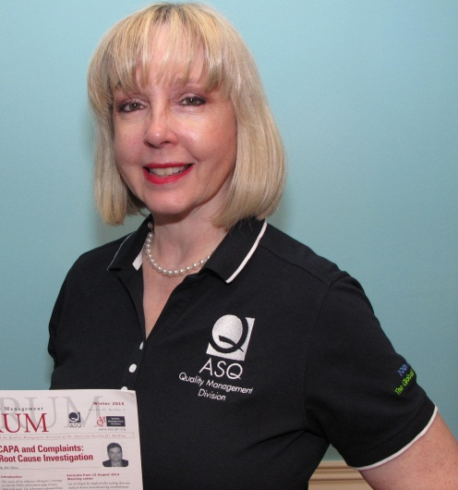
All-New ASQ Polo Shirts
Created and Designed by our member Ellen Quinn! (Vice Chair, Management Division)
Being made available at ASQ World in May
70th Anniversary
Section 0511 gets early access!
First selection on your exact size
Delivery to Northern Virginia
No packing for your return trip

Slide 25
Upcoming Conferences (1 of 1)
ASQ World: 15-18 May 2016 (Milwaukee, WI)
Register EARLY to get lodging in Hilton City Center
Limited downtown parking & transportation
Be prepared to “hike” from other hotels
Six Sigma (Division)
Feb 29 – Mar 1, 2016 (Phoenix)
Aviation, Space and Defense (Division)
Mar 7-8 2016 (Cape Canaveral)

Slide 26
SIG Meetings
Software SIG – 4th Tuesday
February 23
Includes Section 0509 and IEEE
MITRE, Tysons Corner
Six Sigma SIG – 4th Wednesday
Febuary 24
Includes Section 0509 and IEEE
Teknology Corner, McLean

Slide 27
Next Section 0511 Dinner
March 9 – Not Your Average Joe’s (Reston) NEW!
Coming Attractions
April 13 – Fiona’s (Alexandria/Kingstowne)
May 11 – PJ Skidoos (Fairfax)
June 8 – On the Border (Reston) NEW!
July 13 – Pending
August 9 – Pending
September – Pending
October – Maggiano’s (Tysons Corner)
November – Pending
December – Pending

