Slide 1
Compliance Challenges in Clinical Research Naïve Locations: Case Study “STRIVE Clinical Trial for Ebola Vaccine in Sierra Leone” Presented By Seema Garg, MS, MBA, CQA, CSGB Manager, Quality Assurance Technical Resources International, Inc. Direct Line: (301) 897-7144 Main Line: (301) 564-6400 Fax: (301) 897-7403 sgarg@tech-res.com

Slide 2
Challenges
Background
Infrastructure and Facilities
Study Personnel
Subject Recruitment
Subject Follow up
Credential Verification
Standardization of services
TRI Experience
Fun Facts

Slide 3
Background
Reporting on Ebola outbreak in West Africa started in March 2014
In response to this outbreak CDC, WHO and several other health organization activated emergency operations in West Africa
We saw operations by organizations like UNICEF, UKAid, ChinaAid etc.
The West African Governments instituted a campaign of sanitation in response to this crisis with billboards mandatory hand washing and temperature checks etc.
On January 14, 2016, WHO declared West Africa free of Ebola virus

Slide 4
Areas Affected by Ebola virus
http://www.cdc.gov/vhf/ebola/outbreaks/2014-west-africa/distribution-map.html

Slide 5
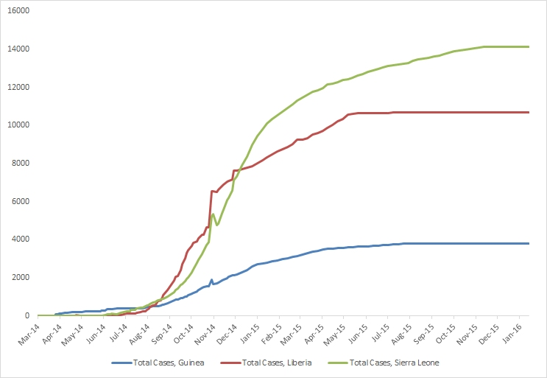
Total suspected, probable, and confirmed cases of Ebola virus disease in Guinea, Liberia, and Sierra Leone, March 25, 2014 – January 10, 2016, WHO Situation Report, n=28601
http://www.cdc.gov/vhf/ebola/outbreaks/2014-west-africa/cumulative-cases-graphs.html

Slide 6
STRIVE (Sierra Leone Trial to Introduce a Vaccine against Ebola)
Single dose vaccine trial with 2 arms
Immediate vaccination (vaccinated within 7 days of enrollment)
Deferred vaccination (vaccinated in 18 to 24 weeks after enrollment)
Subject participation: ~6,173 voluntary healthy individuals working in healthcare facilities or on frontline activities related to Ebola response in Sierra Leone
Clinical sites in several different districts were identified to participate
Goal is to determine the vaccine efficacy in preventing Ebola

Slide 7
Challenge: Infrastructure and Facilities
Infrastructure and Facilities are not optimal in Sierra Leone for a vaccine that needs to be stored at -80ºC
All of the sites were not on the National Power Grid
Round the clock power supply is not guaranteed
Buildings are not built per the fire safety and emergency evacuation codes, Handicap access is limited
Public transportation and the road network to connect the sites is limited
Each site had to have a generator and some had to have 2 generators (primary and back-up)

Slide 8
Challenge: Staff recruitment
This is the first Clinical Trial in Sierra Leone
There were no personnel already trained on FDA, GCP, ICH or E6 regulations
The country has a regulatory authority for clinical trials in their Pharmacy Board, however, there have been no previous clinical trials conducted
Massive training program had to be initiated to train the local personnel on the clinical trial regulations

Slide 9
Challenge: Subject Recruitment
Lack of awareness about the clinical trial
Media campaign would have been ineffective because more than half of the country is not wired
Illiteracy and lack of trust in modern science
Either people thought that the vaccine was proven to prevent Ebola
Or people thought that the trial was injecting them with live virus
Lack of understanding of the clinical trial process
Sometimes people would refuse to take the vaccine if they got randomized in the immediate arm
Some subjects did not feel responsible to complete follow up visits
CDC set up several workshops at health care facilities to educate the healthcare workers about the clinical trial, distributed printed material etc.

Slide 10
Challenge: Subject Follow-up
The study required several follow-ups of the subject as each subject was followed for any adverse event or change in their situation for 6 months
Most of the country does not have road names or house/apartment #s
Most of the population does not possess phones or devices to stay connected
CDC issued a mobile phone to each subject that they could use to call the data centers
Each subject file included 2 additional contacts to facilitate tracking, if needed

Slide 11
Challenge: Credential Verification
Most of the local study personnel were either government employees or medical students of the local Medical School, so their credentials were assumed to be filed with the government or the Medical School but were not available to audit
Typically credentials of the medical staff are part of the Trial Master File and always available for inspections and audits.
After a few discussions the study managers agreed to obtain copies of study staff credentials.

Slide 12
Challenge: Credential Verification
There is a lack of standardization of services throughout the country, people are very helpful, however you cannot rely on being able to buy the same product or receive the same service again 2 weeks in a row or longer
All trial related supplies were shipped from US, anything that was bought in country was bought in bulk to last through the study.
As study went along some Xerox vendors were identified to bulk copy the study forms etc.

Slide 13
TRI Experience
TRI QA team currently has 12 auditors, 80% are CQA certified. TRI’s auditors have on average 5 to 10 years of experience with CLIA (Clinical Laboratory Improvement Amendments), CAP (College of American Pathologists), EMA, ISO, Good Manufacturing Practices (GMP), Good Laboratory Practices (GLP), 21 CFR 58, 21 CFR 312, 21 CFR 812, 21 CFR 11, ICH E6, and the Bioresearch monitoring compliance program.
TRI team has conducted over 500 audits in the last 5 years at some very interesting places like Australia, Brazil, Cameroon, Tanzania, Ghana, Germany, UK, Malawi, Thailand, Tunisia, Peru, Chile, South Africa, Sierra Leone, Kenya, Canada, Philippines, and China.
We have significant amount of experience in auditing high risk trials for Infectious Diseases and other indications. Some of the Infectious Disease trials that we have audited in the last 5 years include trials for MRSA, HIV, Anthrax, Ebola etc.

Slide 14
Fun Facts about Sierra Leone
The locals made plaques showing CDC and WHO as response teams to Ebola
Smoking is permitted in public places
Humus, Pita and Shawarma are on menu at all restaurants, the country has a large population of Lebanese migrants
Mohammed is most popular name

Slide 15
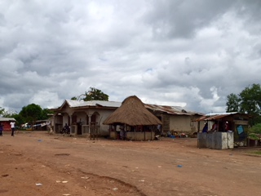
Pictures

Slide 16
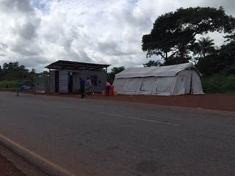
Pictures

Slide 17
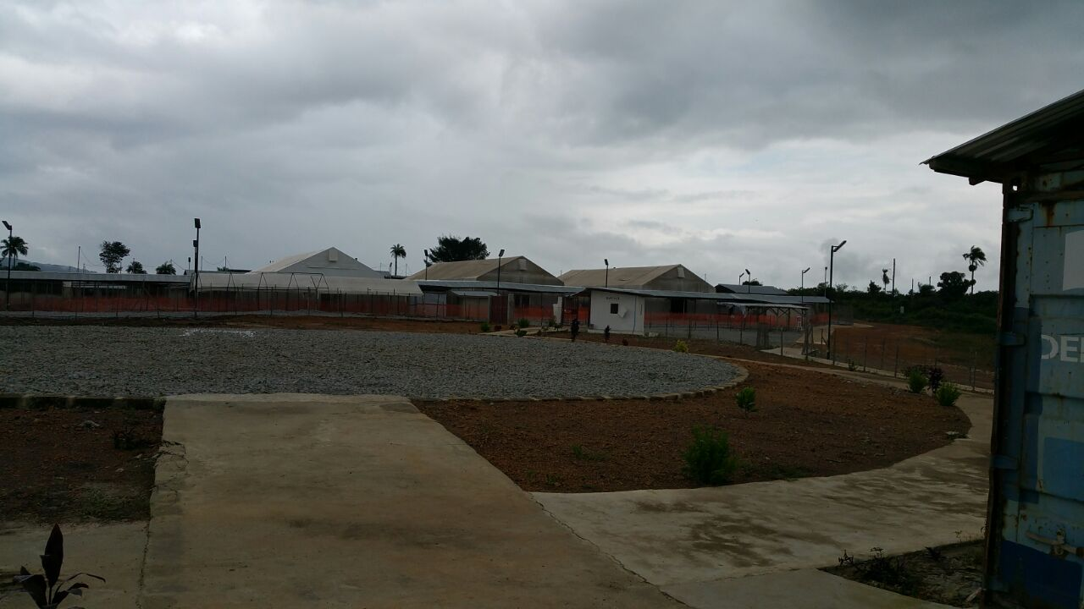
Pictures

Slide 18
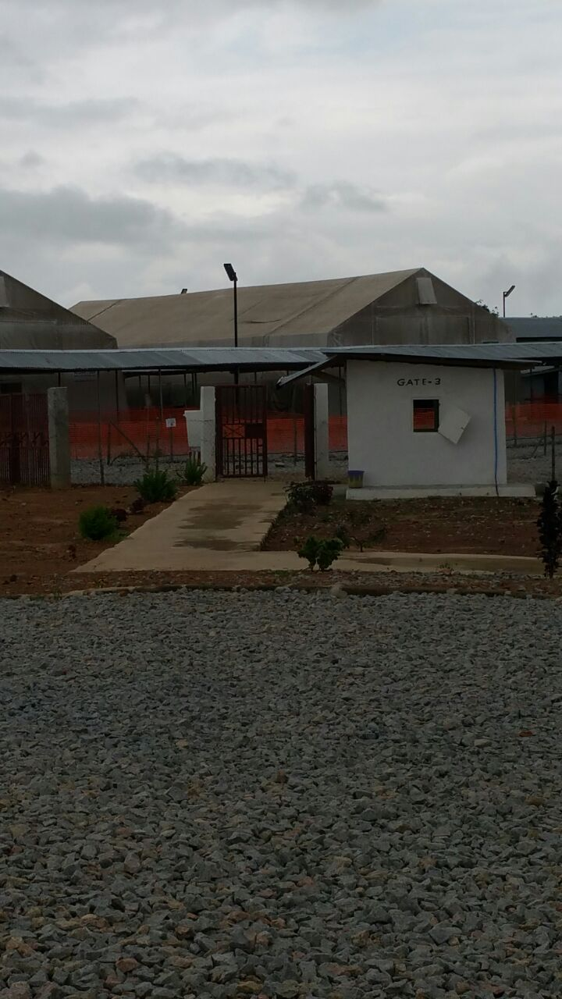
Pictures

Slide 19
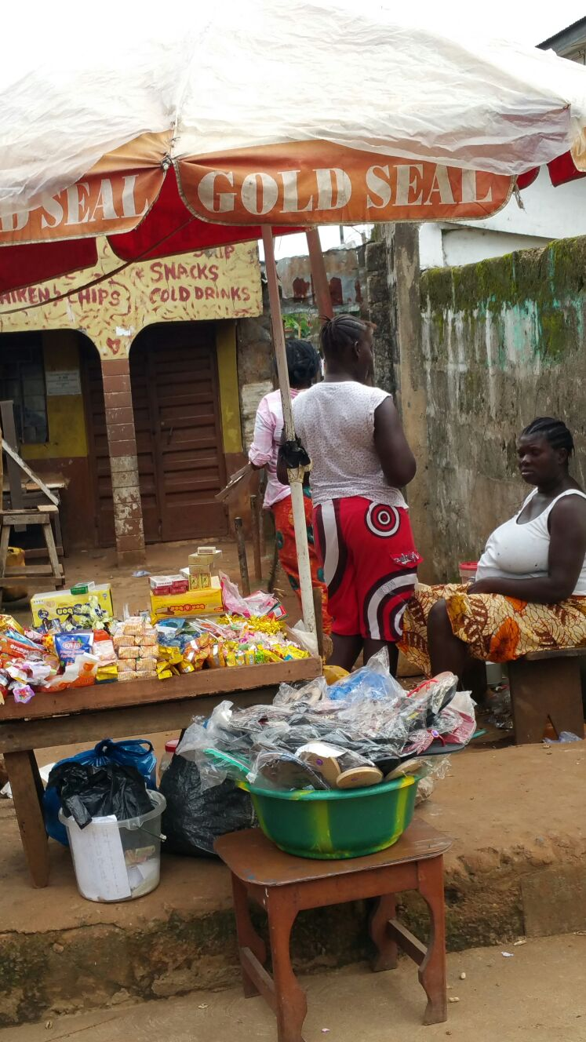
Pictures

