Slide 1
Your Organization's Quality Management System is OK. Now What? Using Enterprise Architecture to Enhance Organizational Performance
Michael J. Novak
ASQ Section 0511 Meeting, February 8, 2017

Slide 2
Agenda
Background:
Strategic Management
Enterprise Engineering
Quality Management
Moving Forward:
Enterprise Architecture

Slide 3
A Note about Models
All models are wrong. Some are useful.
‒ W. Edwards Deming

Slide 4
Concept Relationships
Strategic Management
Enterprise Engineering
Quality Management
Enterprise Architecture

Slide 5
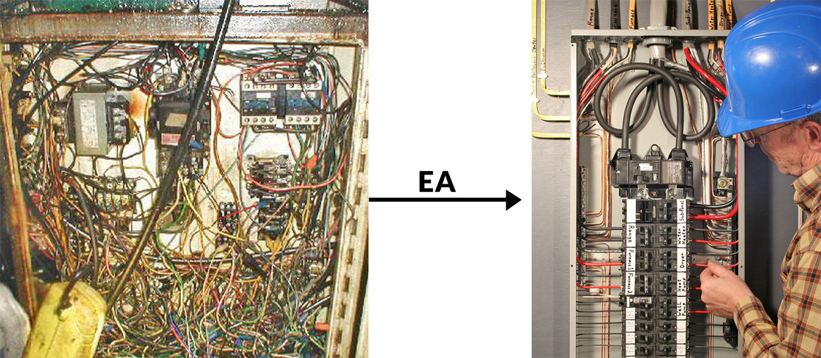
Why Enterprise Architecture?

Slide 6
Strategic Management
“Everything eventually focuses on the Purpose, Vision, and Strategic Objectives.”

Slide 7
Strategic Management Exists in Three Dimensions
Strategic
Focused on Purpose and Vision
Operational
Focused on Mission Elements
Tactical
Focused on Programs, Projects, and Day-to-day Tasks

Slide 8
Strategic, Operational, and Tactical “Building Blocks”
Purpose
Vision
Strategies
Strategic Objectives
Mission Elements
Operational Objectives
Programs, Projects, Day-to-day Tasks
Tactical Objectives
Resources

Slide 9
Hierarchy of “Building Blocks” – Organizational Operations
Purpose
Vision
Program/Project/Task
Mission Element
Mission Element
Program/Project/Task
Program/Project/Task
Program/Project/Task

Slide 10
Hierarchy of “Building Blocks” – Organizational Objectives
Purpose
Vision
Operational Objective
Strategic Objective
Tactical Objective
Strategic Objective
Operational Objective
Tactical Objective
Operational Objective
Tactical Objective
Operational Objective
Tactical Objective
Tactical Objective
Tactical Objective
Tactical Objective
Tactical Objective

Slide 11
Enterprise Engineering
“Everything eventually focuses on the Business Drivers.”

Slide 12
Enterprise Engineering
“Building Blocks” of Enterprise Engineering
Business Drivers
Work Processes
Work Systems
Desired/Required Outputs/Results/Outcomes

Slide 13
Enterprise Engineering “Building Blocks”
Business Drivers
Customer Requirements
Customer Concerns
Customer Satisfaction Data
Customer Engagement Data
Customer Loyalty Data
Work System
Results
Product Quality Indicators
On-time Delivery
After-sales Service
Materials
Processes
Regulatory
Partners
Competencies
Suppliers

Slide 14
What’s A “Work System?”
“Everything that affects the delivery of a product/service to the customer.”
Internal factors
External environment

Slide 15
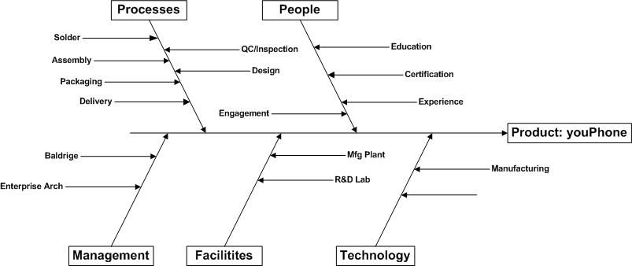
What’s A “Work System?”

Slide 16
Work Processes – The Traditional View
Supplier
Process
Output
Input
Outcome
Customer
CQM/OE (or Baldrige Examiner) Question: What’s missing in this diagram?

Slide 17
Work Processes – The Enterprise Engineering View
Business Driver(s)
Process Design
Process Implementation
Process Management
Desired/ Required Results

Slide 18
What Drives Required/Desired Results?
Required/ Desired Results
Customers
Community
Legal/ Regulatory
Contract Specifications
Standards
Competitors
Stockholders

Slide 19
Quality Management
“Everything eventually focuses on the Quality of the Product/ Service.”

Slide 20
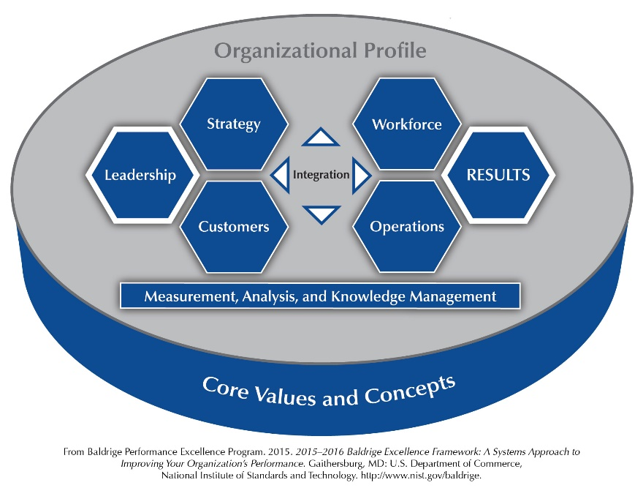




Slide 21
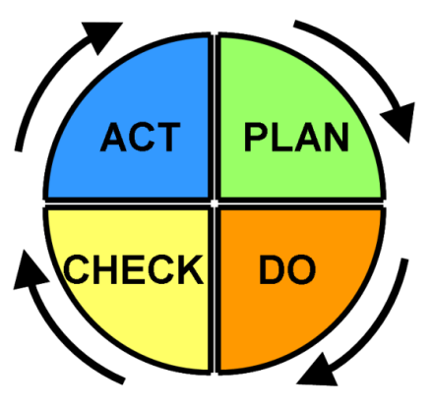
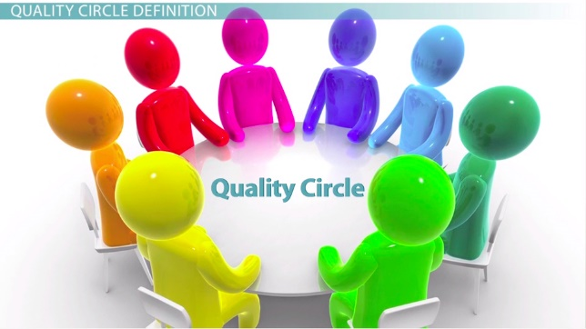
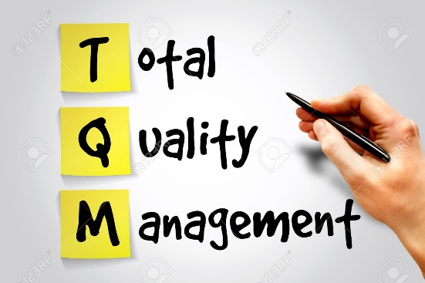
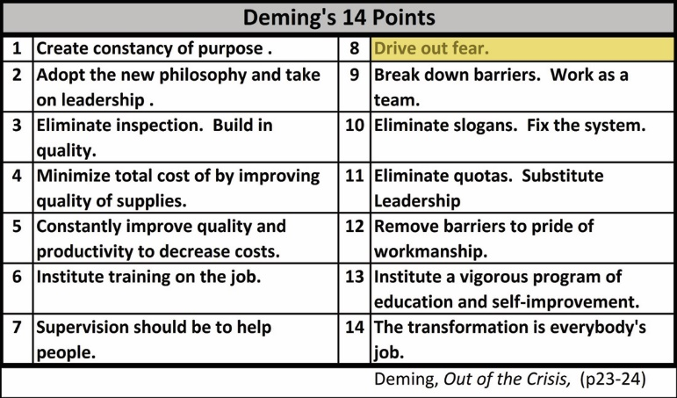
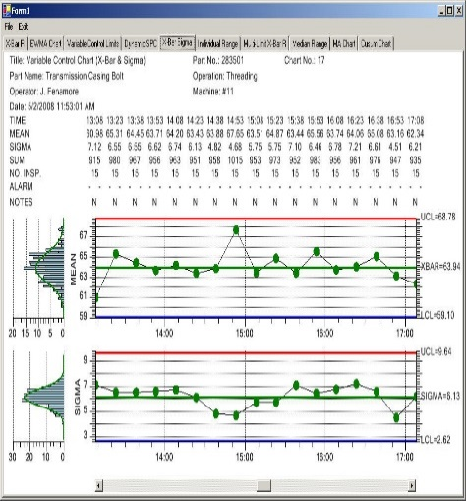
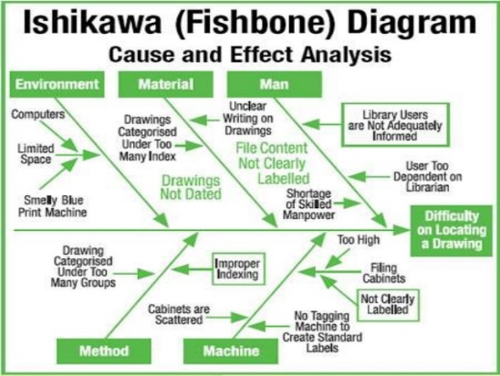
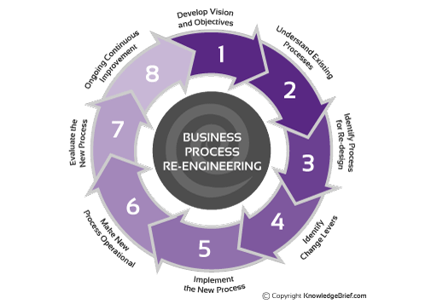
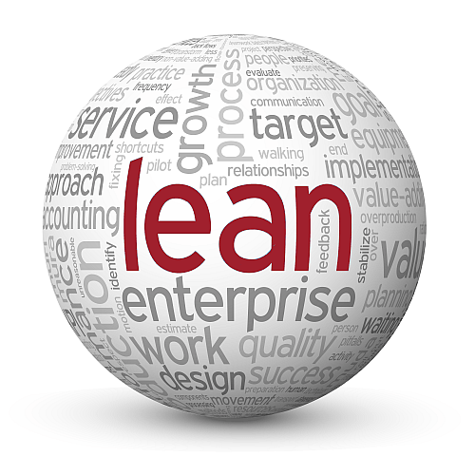
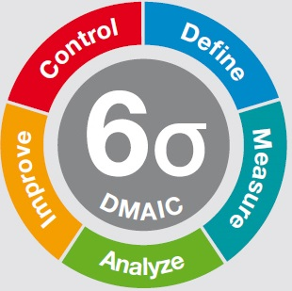

Slide 22
Enterprise Architecture
“Everything eventually focuses on Transforming the Organization.”

Slide 23
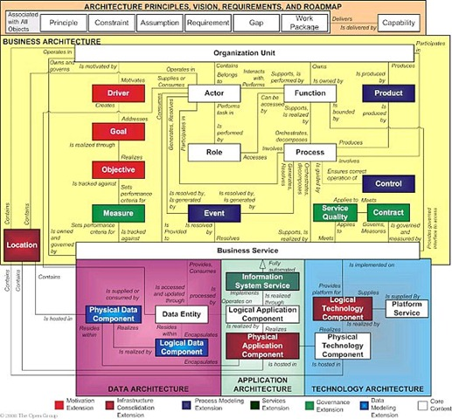

Slide 24
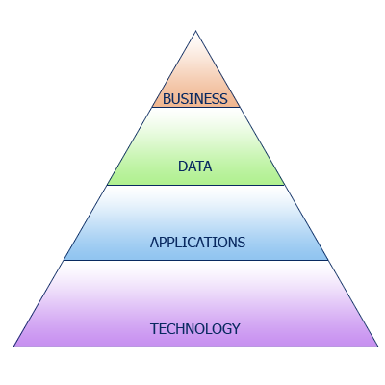
Four Dimensions of Enterprise Architecture

Slide 25
Enterprise Architecture
“Building Blocks” of Enterprise Architecture
Business Architecture
Data/Information/Knowledge Architecture
Application Architecture
Technology Architecture
Architecture Roadmap

Slide 26
Why Enterprise Architecture?
A more efﬁcient business operation
A more efﬁcient IT operation
Better return on existing investment, reduced risk for future investment
Faster, simpler, and cheaper procurement

Slide 27
Business Architecture
“The Business Architecture describes the product and/or service strategy, and the organizational, functional, process, information, and geographic aspects of the business environment.”
‒ Open Group Standard TOGAF® Version 9.1

Slide 28
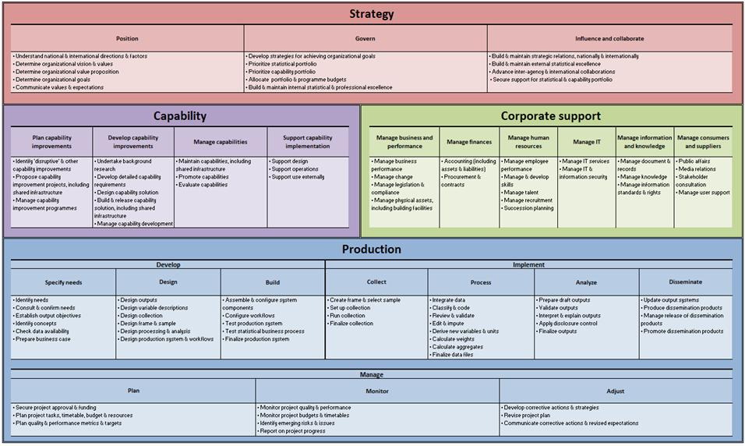

Slide 29
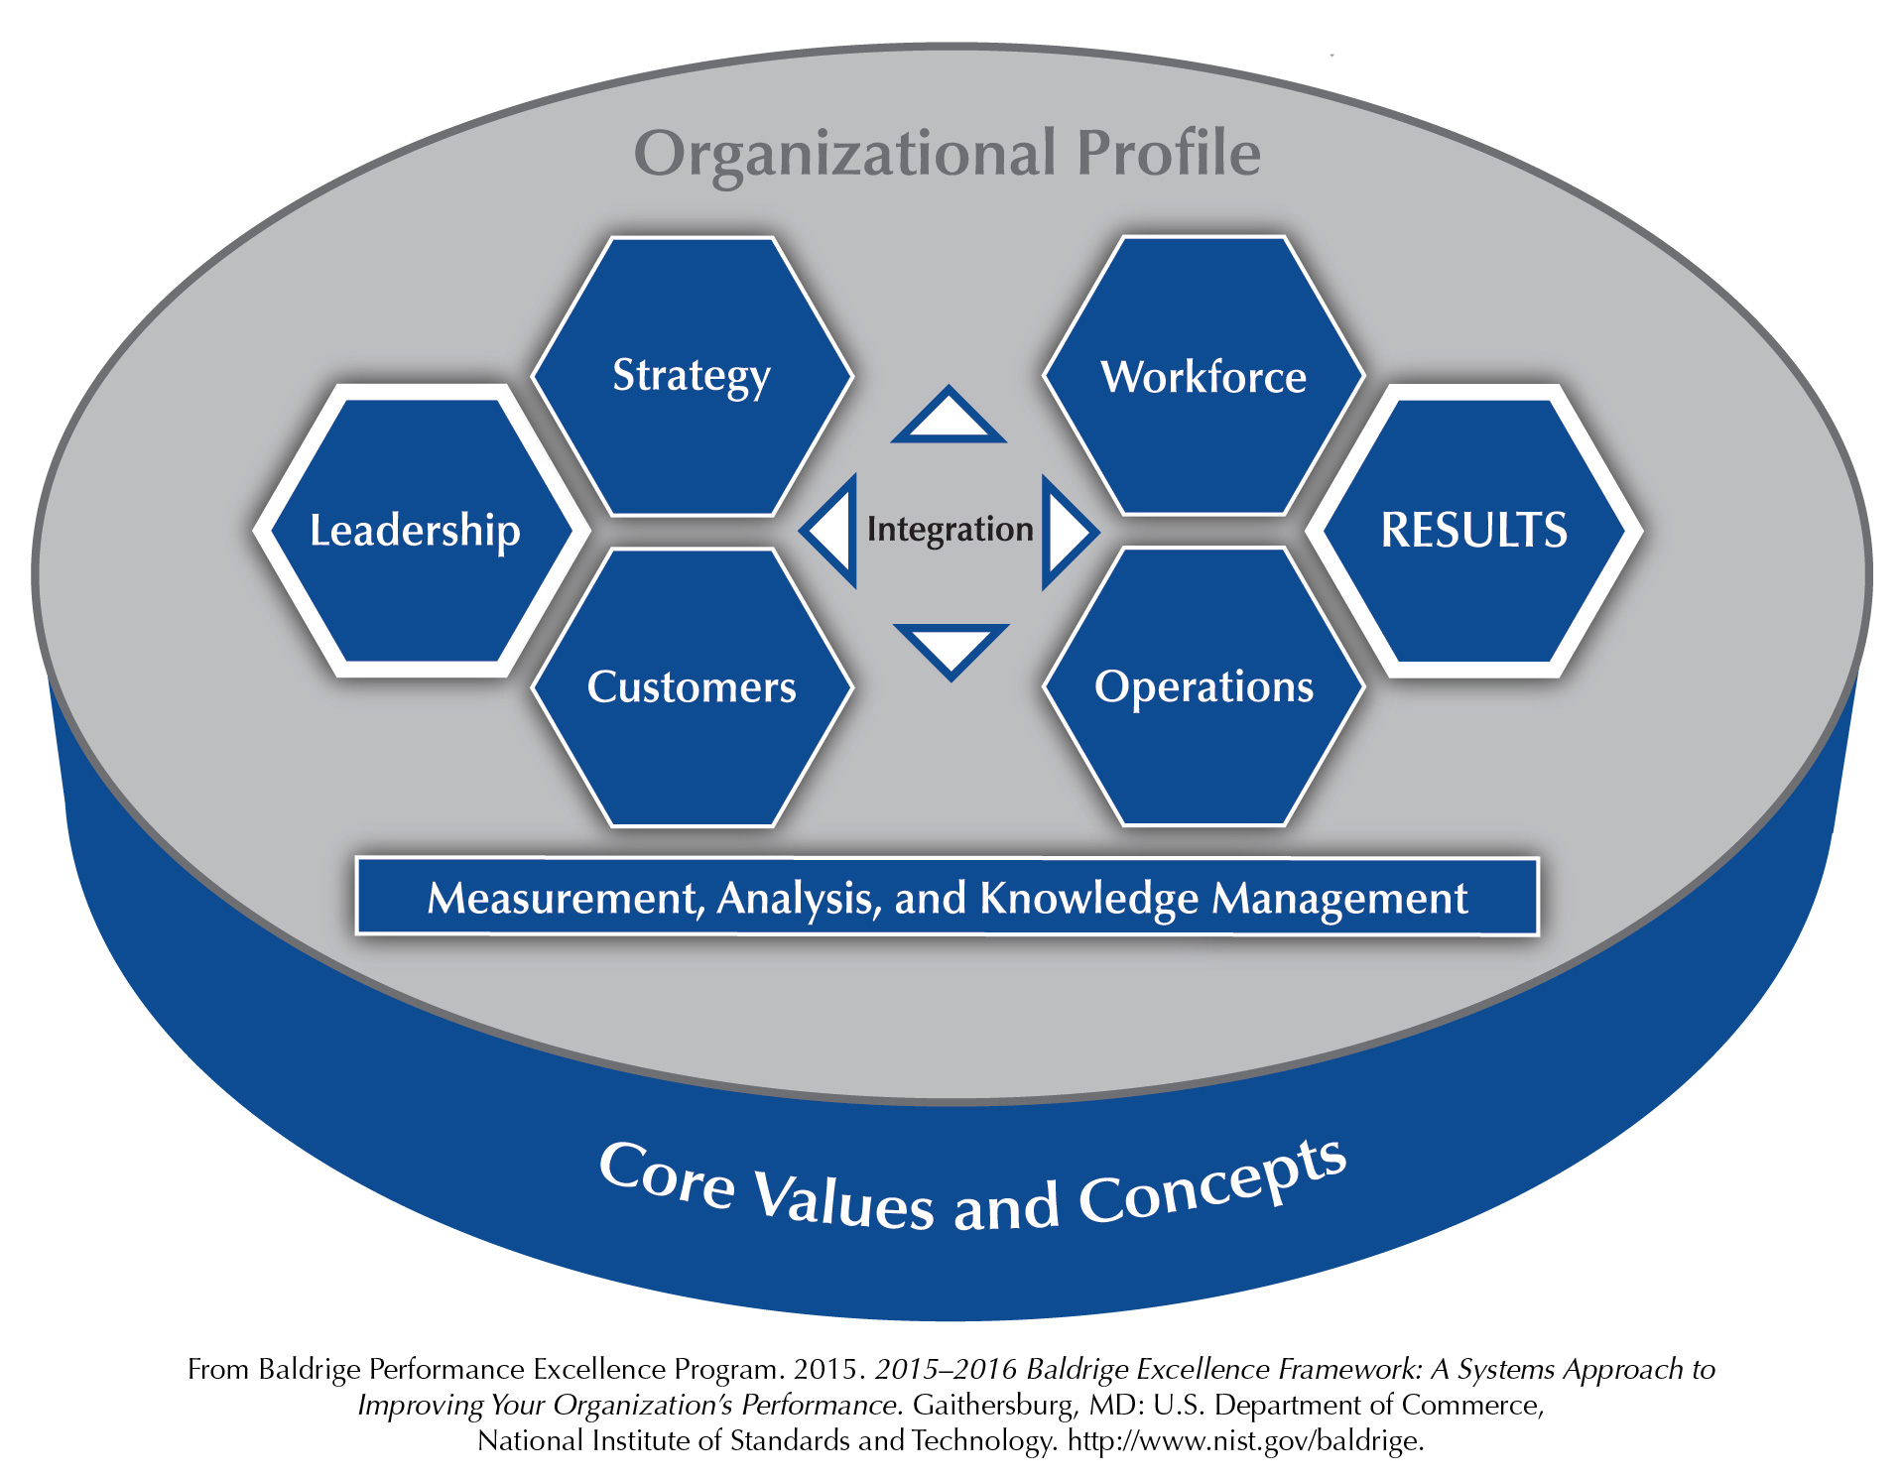

Slide 30
Data Architecture
The Data Architecture describes the data (which sometimes also includes information and/or knowledge) needed to enable effective decision making in the Business Architecture domain.

Slide 31
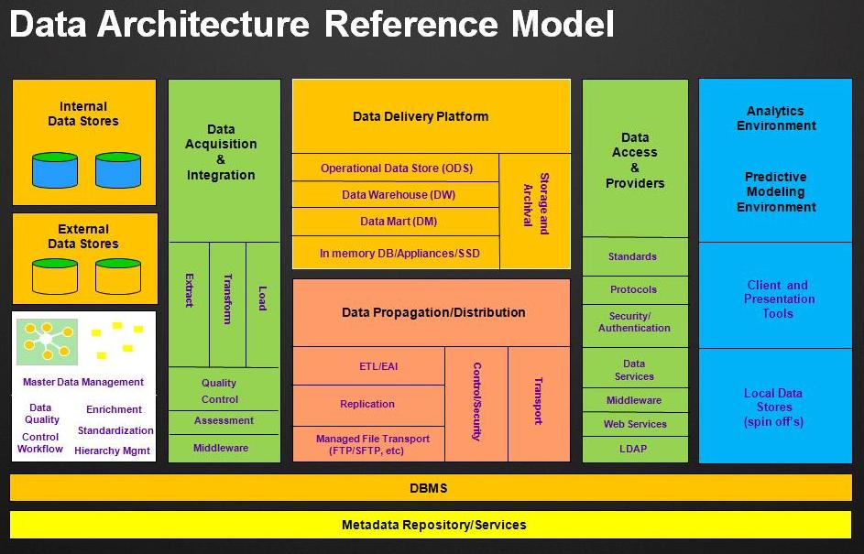

Slide 32
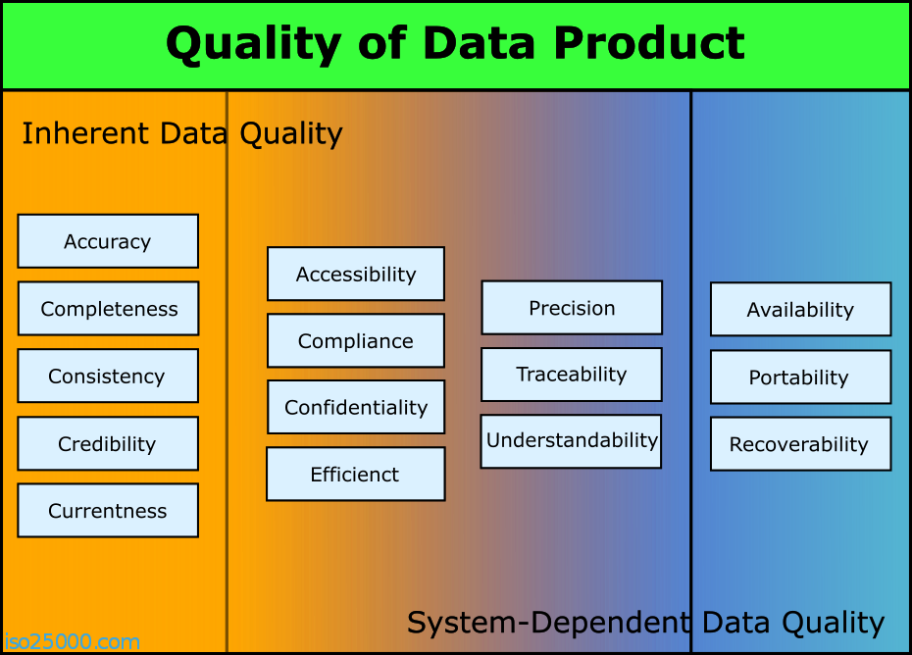

Slide 33
Application Architecture
The Application Architecture describes the applications (software programs) needed to process data, information, and knowledge to enable effective decision making in the Business Architecture domain.

Slide 34
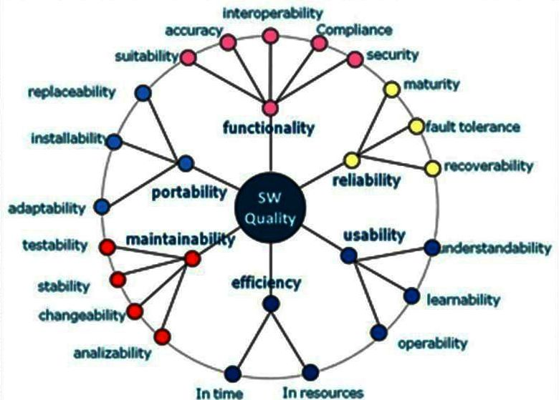

Slide 35
Technology Architecture
The Technology Architecture describes the technology (hardware) needed to (a) house applications that process data, information, and knowledge to enable effective decision making in the Business Architecture domain, and (b) transfer data, information, knowledge, and applications among stakeholders.

Slide 36
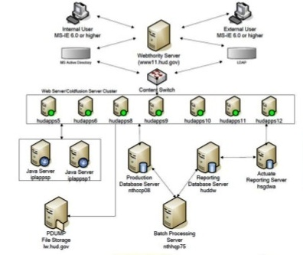

Slide 37
Enterprise Architecture Roadmap
Baseline Architecture
Transition Architecture(s) (Architecture Roadmap)
Target Architecture

Slide 38
Baseline vs. Target Architectures

Slide 39
So, how do you “do” Enterprise Architecture?
First, you start with a “Framework”
“A structure for content or process that can be used as a tool to structure thinking, ensuring consistency and completeness.” (Open Group Standard TOGAF® Version 9.1)

Slide 40
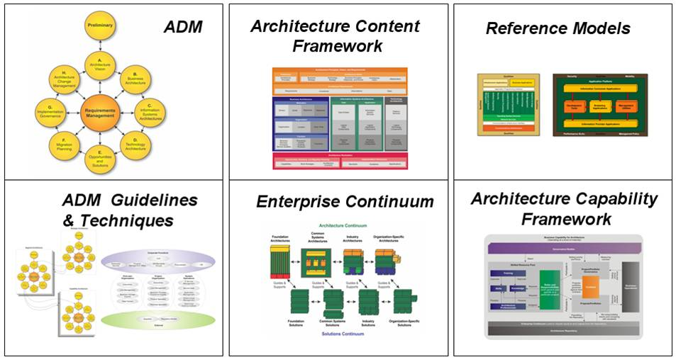
TOGAF Components

Slide 41
The TOGAF Architecture Development Method (ADM)
The “core” of TOGAF
The “how to” of developing an Enterprise Architecture

Slide 42
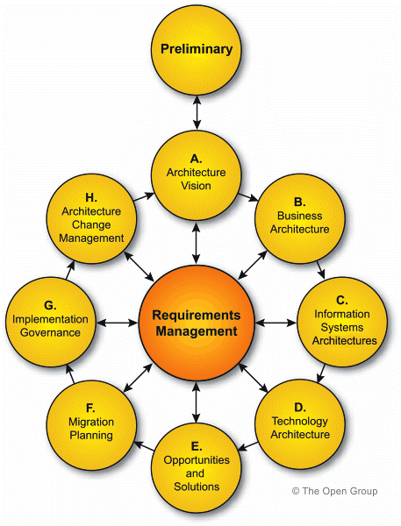

Slide 43
Preliminary Phase
The Preliminary Phase is about defining ‘‘where, what, why, who, and how we do architecture’’ in the enterprise concerned. The main aspects are as follows:
Defining the enterprise
Identifying key drivers and elements in the organizational context
Defining the requirements for architecture work
Defining the Architecture Principles that will inform any architecture work
Defining the framework to be used
Defining the relationships between management frameworks
Evaluating the enterprise architecture maturity

Slide 44
Phase A: Architecture Vision
Architecture Vision is the initial phase of the Architecture Development Method (ADM). The steps in Phase A are as follows:
Establish the architecture project
Identify stakeholders, concerns, and business requirements
Confirm and elaborate business goals, business drivers, and
Evaluate business capabilities
Assess readiness for business transformation
Define scope
Confirm and elaborate Architecture Principles, including business principles
Develop Architecture Vision
Define the Target Architecture value propositions and KPIs
Identify the business transformation risks and mitigation activities
Develop Statement of Architecture Work; secure approval

Slide 45
Phase H: Architecture Change Management
Phase H looks at establishing procedures for managing change to the new architecture. The steps in Phase H are as follows:
Establish value realization process
Deploy monitoring tools
Manage risks
Provide analysis for architecture change management
Develop change requirements to meet performance targets
Manage governance process
Activate the process to implement change

Slide 46
Requirements Management
Requirements Management looks at the process of managing architecture requirements throughout the ADM. The steps in the Requirements Management phase are as follows:
Identify/document requirements
Baseline requirements
Monitor baseline requirements
Identify changed requirements and record priorities
Assess impact of changed requirements on current phase; assess impact of changed requirements on previous phases; determine whether to implement change, or defer to later ADM cycle; issue new version of Requirements Impact Statement
Implement requirements arising from Phase H
Update the Requirements Repository with information relating to the changes requested, including stakeholder views affected
Implement change in the current phase
Assess and revise gap analysis for past phases

Slide 47
How does Enterprise Architecture align with …
Strategic Management?
Enterprise Engineering?
Quality Management?

Slide 48
 | Enterprise Architecture | Enterprise Engineering | Strategic Management | Quality Management
Time Orientation | Future – Long-term | Present and Short/ Medium-term Future | Future – Short/Medium/ Long-term Future | Present and Short/ Medium-term Future
Scope | Enterprise-wide | Enterprise-wide | Enterprise-wide | Local or Enterprise-wide
Scalable for different-sized organizations | Yes | Yes | Yes | Yes
Tailorable for different types of organizations | Yes | Yes | Yes | Yes
Focus on Business Drivers | High | High | High | Moderate (High in Baldrige)
Focus on Leadership | Low | Moderate | Moderate | High
Focus on Strategic Planning and Execution | High | Moderate | High | Moderate to High
Focus on Customers | High | High | Moderate | High
Focus on Stakeholders | High | High | Moderate | Moderate
Focus on Decision Making | Moderate | Moderate | High | High
Focus on Knowledge, Information, and Data | High | Moderate | High | High
Focus on Technology | High | Low | Low | Low
Focus on Workforce | High | Moderate | Moderate | High
Focus on Operations – Processes, Systems | Moderate | High | High | High
Focus on Project, Program, and Portfolio Management | High | Low | High | Moderate
Focus on Risk Management | High | Low | Moderate | Low
Focus on Results/ Outcomes | Moderate | high | high | high
Focus on Finance, Budgeting, Resource Allocation, ROI | High | Low | moderate | Moderate
Focus on Legal, Regulatory, and other Compliance | High | Low to Moderate | Low to Moderate | Moderate to High

Slide 49
Summary
Review of:
Strategic Management
Enterprise Engineering
Quality Management
Introduction to:
Enterprise Architecture
How the four approaches compare with one another

Slide 50
Questions?

Slide 51
Thank you!
Mike Novak
Director of Quality
EA Principals, Inc.
703-216-3329
michael.novak@eaprincipals.com
mike706160@aol.com

