Slide 1
Quality Tools that Outlast Managerial Trends
Questions and Discussion
ASQ Northern Virginia Section 0511
March 8, 2017

Slide 2
Project-based quality tools abound
Six Sigma, Lean, SPC, QFD, TQM, FMEA, Quality Circles … all provide tools that are situation specific
Commitments to implementations of these programs themselves are only medium term
How do we embed quality thinking into planning and execution practices that are lasting?

Slide 3
Management Fashion & Fads
'Organizational performance gaps opened by technical and economic environmental changes do not shape the demand for management fashions; sociopsychological forces do instead' (Abrahamson, 1996: 255)
'Process by which management fashion setters continuously redefine both theirs and fashion followers' collective beliefs about which management techniques lead rational management progress' (257)
Abrahamson, E. 'Management Fashion' Academy of Management Review 21:1, 1996, 254-285.

Slide 4
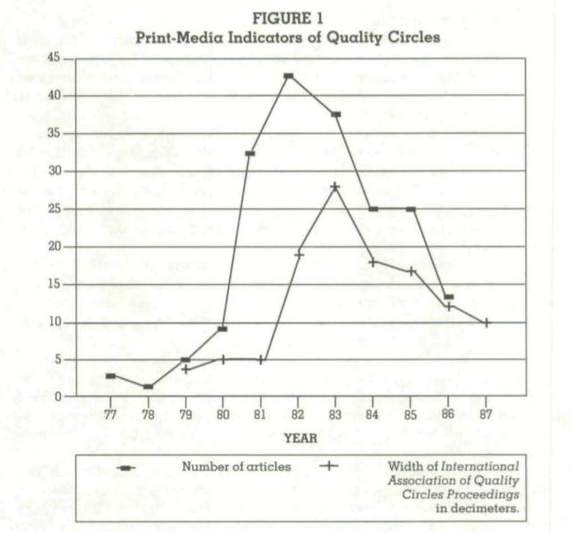
Management Fashion & Fads
'Quality Circles exemplify management fashion'
Abrahamson, 1996: 257

Slide 5
Surges and Fluctuations
'Historical data suggest that since the 1870s American managerial discourse has been elaborated in waves that have alternated between normative and rational rhetorics…. surges and contractions in the rhetorics of industrial betterment, scientific management, welfare capitalism/human relations, systems rationalism, and organizational culture/quality.' (Barley & Kunda, 1992: 363)
Barley, S and Gideon Kunda. 'Design and Devotion: Surges of Rational and Normative Ideologies of Control in Managerial Discourse' Administrative Science Quarterly. 37. 1992. 363-399. Emphasis added.

Slide 6
Surges and Fluctuations
'Standard threories of ideological change are shown to be inadequate for explaining either the general pattern or the timing of the surges.'
'...the tendency for innovative surges of managerial theorizing to alternate between rational and normative rhetorics of control appears to be rooted in cultural antinomies fundamental to all Western industrial societies: the opposition between mechanistic and organic solidarity and between communalism individualsim.' (Barley & Kunda, 1992: 363)
Barley, S and Gideon Kunda. 'Design and Devotion: Surges of Rational and Normative Ideologies of Control in Managerial Discourse' Administrative Science Quarterly. 37. 1992. 363-399. Emphasis added.

Slide 7
Sources of Fashion Trends
Ideological
Aesthetic
Political
Economic
Administrative regime change

Slide 8
Most durable tools and practices
What have been the most durable and well-received tools and practices?
Across time within a particular organization
Across various settings
Lean, SIPOC, Fishbone, Process Maps?
Any particular orientation to technology?
Simple tools
Dependent on a system
Minitab
BPA Mapping

Slide 9
Connected to other departments?
Were any of these tools embedded in planning or execution processes outside of quality?
Strategy planning
Project planning
Technology infrastrcture planning
Contracting
Budgeting

Slide 10
What are the classics of quality
How best to embed quality thinking and practices that outlast the trends of management fashion?
What are the true classics of quality?
Little black dress
French blue collared shirt
Charcoal grey suit

