Slide 1
Fifty Years in Quality
Geoffrey Withnell
RCT Systems
Presented to ASQ 511, Northern Virginia Section
March 13, 2019

Slide 2
Who am I?
Senior Member ASQ
Former Section Chair, Baltimore Section
CQE, CSSBB, CMQOE, CPGP, CQA, CSQE
Senior Member, PMI, Project Management Professional
SAFe Agile Practitioner
ITIL Foundation
BA, Management, University of Phoenix
Graduate statistics training, California State University, Dominguez Hills

Slide 3
The Journey Begins
Enlisted in the Marine Corps September 1968
Completed Aviation Engineering Clerk School, NAS Memphis – March 1969 and was assigned to Maintenance Quality section, Marine Attack Squadron 324, Beaufort, South Carolina
Also served:
Marine Attack Squadron 211, Chu Lai RVN
Marine Air Reserve Training Detachment, El Toro, California

Slide 4
Starting civilian work – And my Dad makes a prediction
1972-73 Engineering Clerk, St. Lucie Unit #1, Ft. Pierce FL
Document control for ~ 50,000 documents it takes to build a nuclear power plant
My Dad, a program manager for Westinghouse Aerospace, told me “You have your foot in the door in Quality. Stay with it. The Japanese are going to eat our lunch on Quality in the near future, and Quality experts are going to be in demand to catch up.” He was right!
1974-75 Construction Inspector, US Army Corps of Engineers, Aberdeen Proving Ground/Edgewood Arsenal
I got the only certification I have let permanently lapse –Certified Civil Engineering Technician, Institute for the Certification of Engineering Technicians

Slide 5
Back to California, into manufacturing and ASQ(C)
In 1975, I returned to California, and started to work in manufacturing
1975-1977 Line Inspector, ITT General Controls
Work done to MIL-Q-9858A
Lead inspector told me “As an inspector, a lot of people are going to call you a rotten SOB. Just remember, you are a PROFESSIONAL rotten SOB, they’re just amateurs.”
1977 Inspector, Defense Contract Administration
1977-1979 Lead Inspector, ITT General Controls
I met Phillip Crosby, then VP of Quality for ITT, after a major shutdown caused by a tooling error. I was vindicated, I inspected to the drawing. Management years before had ordered a change to the design, and the tooling change was not followed up. I had the following conversation with Mr. Crosby:
“Geoff, what are your career goals?”
“Your job”
“Should I update my resume?”
“Not this week.”

Slide 6
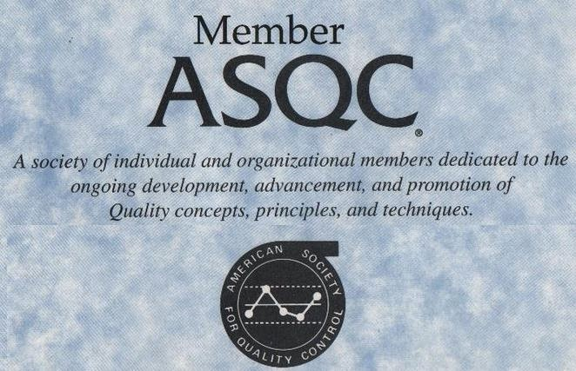
Back to California, into manufacturing and ASQ(C) cont’d
While at General Controls, I joined the Los Angeles Section of what was then the American Society for Quality Control, and took the CQE exam – The exam at that time was 8 hours, 4 hours in the morning on “theory” and 4 hours in the afternoon on “practical”. WOOF. I passed!

Slide 7
The 1980’s
For family reasons we moved back to Maryland in late 1979.
I worked at:
Fairchild Space and Electronics,
F-14 and A-10 firecontrol systems
TARPS systems
And ComSat Labs model shop
High precision (.00005 inch) communication waveguides
I was active in several positions on the Baltimore Section Board
In 1987 we moved to Cincinnati
I worked in various positons for suppliers to GE Aircraft Engine Group
GE had an interesting Supply Chain Management System
And CINPAC, who made the Meals-Ready-to-Eat for the DOD
Some interesting Statistical Work
I get the CQA

Slide 8
On to Michigan
1994 Jack Welch hits GE Aircraft Engine Group
Know as Neutron Jack – after he goes through, the buildings are still standing, but the people are gone
There is this new buzz going around about QS9000 in the automotive industry. We move to Saginaw MI, and I start in automotive at Saginaw Steering Systems.
I lead several organizations through QS9000 certification including:
Saginaw Steering Systems
Saginaw Metal Casting - passes 2 million work hours without a lost time accident while I’m there
Various customers of GM Service Parts Operations
“You can’t fix a quality problem in Evanston around a conference room table in Grand Blanc.”
I state at an ASQ meeting “Any CQE worth the paper his cert is printed on can pass the CSSBB exam with Juran’s Handbook, a dictionary of Six Sigma terms and a scientific calculator.” I get challenged on this, take the second CSSBB exam offered while so equipped – and pass.

Slide 9
Back to Maryland – to stay
For family reasons, we move back to Maryland – this time for good
2002 - Quality Design review for TSA security checkpoints at all airports with scheduled air service – 843 airposrts at the time
Sometimes, the trick is to get the design through the approval process before the customer can change the requirements AGAIN!
2003-2005 The American Red Cross Blood Services Quality System is in trouble with the FDA. The blood products quality is fine – the paperwork isn’t. Several quality experts from other industries are hired to modernize their system.
For actual product quality in this case, Six Sigma isn’t nearly good enough.
BearingPoint: BearingPoint hires me to work on Quality for the IRS. A couple of weeks in, my manager aske me if I think I can get a security clearance. I don’t know, I never tried. Well, I could, and I become part of a team setting up the National Security Agency’s Six Sigma program. I have been working in the intelligence community ever since.

Slide 10
Overall thoughts on our profession
It doesn’t really matter what quality system specification you use:
MIL-Q-9858
ISO-9000
AS-9100
CMMI
ITIL
PMBOK
What matters is that you follow a system, and management pays attention to what’s going on and what your customer thinks of what you give them
It doesn’t matter what industry you are in if you:
Know what your customer needs
Know what your process is capable of producing
Measure your process output
Address any problems found by your measurements
Communicate, communicate, communicate

