Slide 1
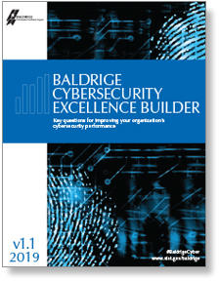

Baldrige Performance Excellence Program | 2019
Baldrige Cybersecurity
Excellence
Builder
Notes:
Baldrige Cybersecurity Excellence Builder

Slide 2
NIST Cybersecurity Initiatives
National Cybersecurity Center of Excellence
800, 1800, 500 Series Standards
Federal Information Processing Standards (FIPS)
Data Encryption Standards
Cybersecurity Framework
Baldrige Cybersecurity Excellence Builder
Notes:
NIST as national resource in cybersecurity. Some NIST cybersecurity initiatives.

Slide 3
Cybersecurity Data Breaches
Yahoo (3 billion)
Equifax (148 million)
eBay (145 million)
OPM (22 million)
Facebook (? billion)
Don’t make this list
Notes:
List of major cybersecurity breaches and number of stakeholders impacted.

Slide 4
Cybersecurity Ransomware
Atlanta
Baltimore
Albany
Don’t make this list
Notes:
List of major cybersecurity breaches and number of stakeholders impacted.

Slide 5
NIST Cybersecurity Framework Components
    Aligns industry standards and best practices to the Framework Core in a particular implementation scenario
    Supports prioritization and measurement while
    factoring in business
    needs
    Cybersecurity activities and informative references, organized around particular outcomes
    Enables communication of cyber risk across an organization
Core
Implementation
Tiers
Profile
    Describes how cybersecurity
    risk is managed by an organization
    and to what degree the risk management practices exhibit key characteristics
Notes:
The voluntary Framework for Improving Critical Infrastructure Cybersecurity consists of standards, guidelines, and best practices to manage cybersecurity-related risk. The Cybersecurity Framework’s prioritized, flexible, and cost-effective approach helps to promote the protection and resilience of critical infrastructure and other sectors important to the economy and national security.
The Cybersecurity Framework has three components:
The Core includes cybersecurity activities and informative references, organized around particular outcomes.
Tiers describe how cybersecurity risk is managed by an organization and to what degree the risk management practices exhibit key characteristics.
Profiles align industry standards and best practices to the Framework Core in a particular implementation scenario. This supports prioritization and measurement while factoring in business needs.

Slide 6
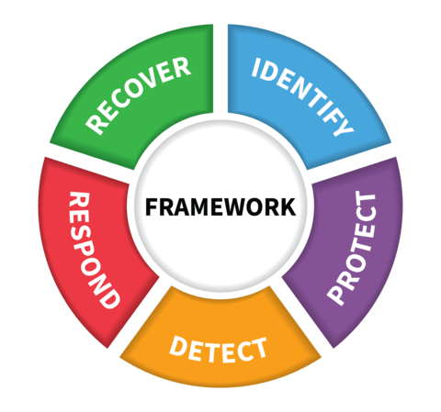
Cybersecurity Framework Core
What techniques can restore capabilities?
What processes and assets need protection?
What techniques can contain the impacts of incidents?
What safeguards are available?
What techniques can identify incidents?
Notes:
The Core includes five functions representing cybersecurity activities at their highest level.
Within these functions, activities are presented in more detail as categories, subcategories, and informative references.

Slide 7
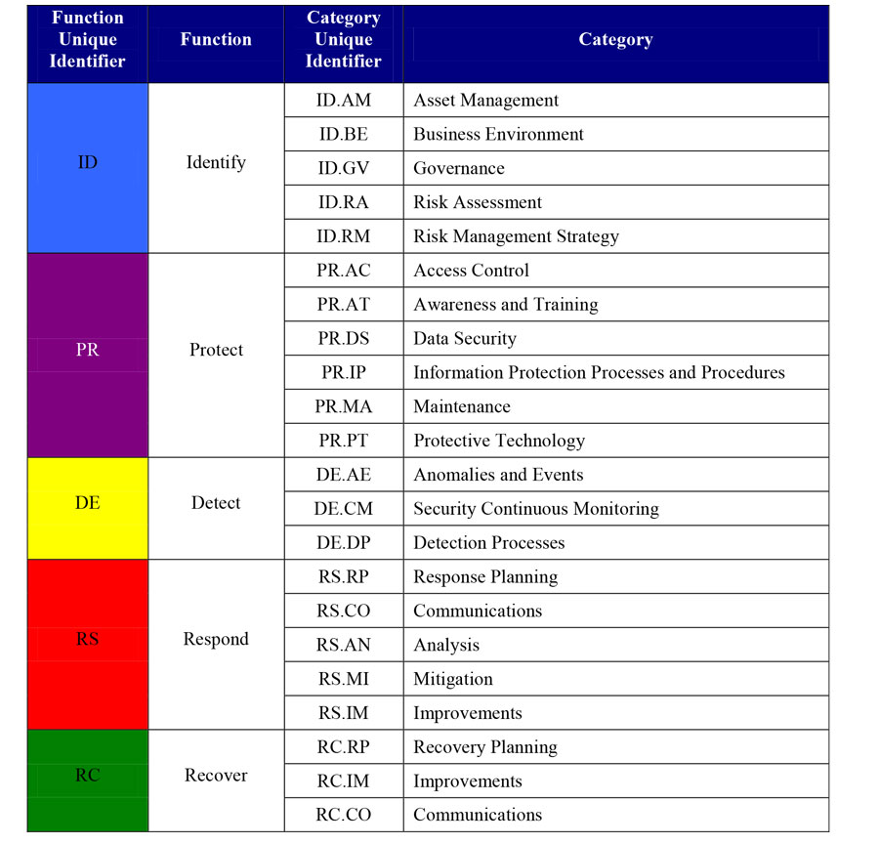
Cybersecurity Framework
Notes:
Detailed framework diagram.

Slide 8
NIST Malcolm Baldrige National Quality Award
Presidential Award for Organizational Performance Excellence
Signed into Law 1987 (Manufacturing / Quality)
Amendments
  Health Care
  Education
  Non Profit and Government
Notes:
Background on Baldrige program.

Slide 9
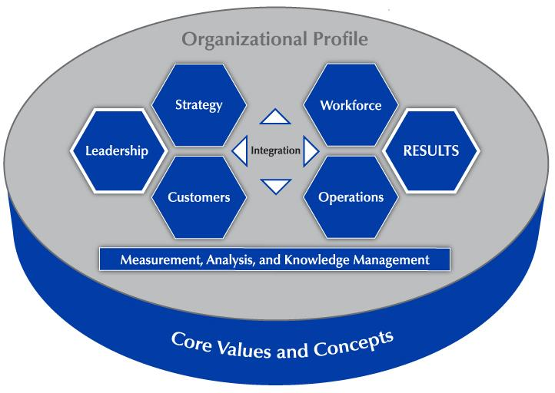
A Systems Perspective
Notes:
This overview shows how the Criteria provide a systems perspective for managing your organization. The Organizational Profile sets the context for your organization. It serves as the background for all you do.
The performance system consists of the six categories in the center of the figure. These categories define your processes and the results you achieve.
Performance excellence requires strong Leadership and is demonstrated through outstanding Results. Those categories are highlighted in the figure. The word “integration” at the center of the figure shows that all the elements of the system are interrelated.
The center horizontal arrowheads show the critical linkage between the leadership triad and the results triad and the central relationship between the Leadership and Results categories.
The leadership triad (Leadership, Strategy, and Customers) emphasizes the importance of a leadership focus on strategy and customers.
The results triad (Workforce, Operations, and Results) includes your workforce-focused processes, your key operational processes, and the performance results they yield.
The center vertical arrowheads point to and from the system foundation, which provides information on and feedback to key processes and the organizational environment.
The system foundation (Measurement, Analysis, and Knowledge Management) is critical to effective management and to a fact-based, knowledge-driven, agile system for improving performance and competitiveness.
The basis of the Criteria is a set of Core Values and Concepts that are embedded in high-performing organizations.
All actions lead to Results—a composite of product and process, customer-focused, workforce-focused, leadership and governance, and financial and market results.

Slide 10
The BCEB and the Cybersecurity Framework
BCEB: How well are you achieving this scenario? Where do you need to improve?
Core
Implementation
Tiers
Profile
How effective and efficient are your cybersecurity-related processes? How good are your results?
Notes:
If you’re not currently using the Cybersecurity Framework, the BCEB can serve as a “door” to its use. By answering the questions in the BCEB and assessing your answers, you will identify topics to explore in the Cybersecurity Framework, including references to industry-specific standards and guidelines.
If you are using the Cybersecurity Framework, the BCEB can help you assess how well you are implementing it.
With the BCEB, you can assess how well you’re achieving the Cybersecurity Framework profile you choose and determine what your strengths and opportunities for improvement are.
For the Core and the Implementation tiers, the BCEB helps you assess the efficiency and effectiveness of the processes you use to manage cybersecurity risk within the five Cybersecurity Framework functions and the goodness of the results you are achieving through those processes. What you find can help you determine the your organization’s implementation tier.

Slide 11
Criteria Categories
Leadership
Strategy
Customers
Measurement, Analysis, and Knowledge Management
Workforce
Operations
Results
Notes:
The Baldrige Cybersecurity Excellence Builder Criteria are a set of questions divided into an Organizational Profile and the seven categories in the diagram on the previous slide. Each category represents a critical aspect of managing and performing as an organization.
Each category is subdivided into items. There are 17 items, each focusing on an aspect of your organization.
These questions reflect a set of core values and concepts..

Slide 12
The Role of Core Values and Concepts
Notes:
The Criteria are built on a number of interrelated core values and concepts. These are beliefs and behaviors found in high-performing organizations.
Systems perspective is the value at the center of the figure. The next layer shows the other core values and concepts that are embedded in Criteria categories 1 through 6. These categories are the next layer in the figure. Systematic processes in those areas yield the performance results found in Criteria category 7, represented by the outermost layer.
Let’s take a closer look at these core values and concepts.

Slide 13
Core Values and Concepts
Customer-focused excellence
Valuing people
Organizational learning and agility
Focus on success
Managing for innovation
Management by fact
Societal responsibility
Systems perspective
Visionary leadership
Ethics and transparency
Delivering value and results
Notes:
First and foremost, Baldrige provides a systems perspective that requires visionary leadership—the first two core values.
The next seven core values are the hows of an effective system.
The final two core values, ethics and transparency and delivering value and results, are the outcome of using Baldrige as a guide.

Slide 14
Organizational Context
P.1 Organizational Description
P.2 Organizational Situation
Starting point for self-assessment
Basis for early action planning
Notes:
The Organizational Profile provides a snapshot of your organization, the key influences on how it operates, and the key challenges it faces. Your responses set the context for responding to the Criteria items. The Organizational Profile helps everyone (e.g., organizations using the Criteria for self-assessment, application writers, and reviewers) understand what is most relevant and important to the your business and to performance.
The Organizational Profile is the best starting point for assessment. If you identify topics for which conflicting, little, or no information is available, you can use these topics for action planning. By addressing the questions in the Organizational Profile, you can identify potential gaps in key information and bring into focus areas that affect key performance requirements and results.
P.1, Organizational Description, asks, “What are your key organizational characteristics?” It asks you to describe your organization’s operating environment, including identifying its core competencies, and its key relationships with customers, stakeholders, suppliers, and partners. It also asks for a description of your governance system.
P.2, Organizational Situation, asks, “What is your organization’s strategic situation?” It asks you to describe your competitive environment, key strategic challenges and advantages, and system for performance improvement. It includes a request to identify available sources of comparative and competitive data to emphasize the need for these sources and to provide a context for later responses.

Slide 15
1. Leadership
Senior leaders’ actions, organizational governance, and societal responsibilities
1.1 Leading for Cybersecurity
1.2 Governance and Societal Responsibilities
Notes:
Category 1 (Leadership) asks how senior leaders’ personal actions and your governance system guide and sustain your organization.
1.1, Leading for Cybersecurity asks about the key aspects of your senior leaders’ responsibilities, with the aim of creating an organization that is successful now and in the future.
1.2, Governance and Societal Responsibilities, asks about key aspects of your organization’s governance system, including the improvement of leadership. It also asks how your organization ensures that everyone in the organization behaves legally and ethically and how it fulfills its societal responsibilities.
From decades of the Standish Group Chaos Report – Top driver of project success is executive buy in.

Slide 16
2. Strategy
Strategic and action planning
Implementation of plans
2.1 Strategy Development
2.2 Strategy Implementation
Notes:
Category 2 (Strategy) asks how your organization develops strategic objectives and action plans, implements them, changes them if circumstances require, and measures progress.
The category stresses that your organization’s long‐term success and competitive environment are key strategic issues that need to be integral parts of your overall planning. Making decisions about your organization’s core competencies and work systems is an integral part of ensuring your organization’s success now and in the future, and these decisions are therefore key strategic decisions.
2.1, Strategy Development, asks how your organization establishes a strategy to address its challenges and leverage its advantages and how it makes decisions about key work systems and core competencies. It also asks about your key strategic objectives and their related goals. The aim is to strengthen your overall performance, competitiveness, and future success.
2.2, Strategy Implementation, asks how your organization converts your strategic objectives into action plans to accomplish the objectives and how your organization assesses progress relative to these action plans. The aim is to ensure that you deploy your strategies successfully and achieve your goals.

Slide 17
3. Customers
Listening to the voice of the customer
and engaging customers
3.1 Voice of the Customer
3.2 Customer Engagement
Notes:
Category 3 (Customers) asks how your organization listens to the voice of the customer and builds customer relationships.
The category stresses customer engagement as an important outcome of an overall learning and performance excellence strategy..
3.1, Voice of the Customer, asks about your organization’s processes for listening to your customers and determining their satisfaction, dissatisfaction, and engagement. The aim is to capture meaningful information in order to exceed your customers’ expectations.
3.2, Customer Engagement, asks about your organization’s processes for determining and customizing product offerings that serve your customers and markets; for enabling customers to seek information and support; and for identifying customer groups and market segments. The item also asks how you build relationships with your customers and manage complaints. The aim of these efforts is to improve marketing, build a more customer‐focused culture, and enhance customer loyalty.

Slide 18
4. Measurement, Analysis, and Knowledge Management
Analysis, review, and improvement of
organizational performance
Information and knowledge management
4.1 Measurement, Analysis, and Improvement of Organizational Performance
4.2 Knowledge Management
Notes:
Category 4 (Measurement, Analysis, and Knowledge Management) is the main point within the Criteria for all key information about effectively measuring, analyzing, and improving performance and managing organizational knowledge to drive improvement, innovation, and organizational competitiveness. In the simplest terms, category 4 is the “brain center” for aligning of your organization’s operations with its strategic objectives.
4.1, Measurement, Analysis, and Improvement of Organizational Performance, asks how your organization selects and uses data and information for performance measurement, analysis, and review in support of organizational planning and performance improvement. The aim is to guide your organization’s process management toward the achievement of key organizational results and strategic objectives, to anticipate and respond to rapid or unexpected organizational or external changes, and to identify best practices to share.
4.2, Knowledge Management, asks how your organization builds and manages its knowledge assets and how it ensures the quality and availability of data and information. The aim of this item is to improve organizational effectiveness and learning and to stimulate innovation.

Slide 19
5. Workforce
Building an effective workforce environment Engaging, developing, and managing your workforce
5.1 Workforce Environment
5.2 Workforce Engagement
Notes:
Category 5 (Workforce) addresses key workforce practices—those directed toward creating and maintaining a high‐performance work environment and toward engaging your workforce to enable it and your organization to adapt to change and to succeed.
5.1, Workforce Environment, asks about your workforce capability and capacity needs, how you meet those needs to accomplish your organization’s work, and how you ensure a supportive work climate. The aim is to build an effective environment for accomplishing your work and supporting your workforce.
5.2, Workforce Engagement, asks about your organization’s systems for managing workforce performance and developing your workforce members to enable and encourage all workforce members to contribute effectively and to the best of their ability. These systems are intended to foster high performance, to address your core competencies, and to help accomplish your action plans and ensure organizational success now and in the future.

Slide 20
6. Operations
Designing, managing, and improving work processes
Improving operational effectiveness
6.1 Work Processes
6.2 Operational Effectiveness
Notes:
Category 6 (Operations) This category asks how your organization designs, manages, and improves its products and work process. It also asks how you improve operational effectiveness.
Item 6.1, Work Processes, asks about the management of your key products and work processes, with the aim of creating value for your customers and achieving organizational success now and in the future. It also asks how you manage your supply chain.
Item 6.2, Operational Effectiveness, asks how you ensure efficient and effective operations in order to have a safe workplace environment and deliver customer value. It also asks how you manage security and cybersecurity.

Slide 21
7. Results
Performance and improvement in all key areas
Performance levels, trends, and comparative data
7.1 Cybersecurity Process Results
7.2 Customer Results
7.3 Workforce Results
7.4 Leadership and Governance Results
7.5 Financial Results
Notes:
Category 7 (Results) provides a systems focus that encompasses all results necessary to sustaining an enterprise: your key process and product results, your customer‐focused results, your workforce results, your leadership and governance system results, and your overall financial and market performance.
Category 7 provides “real‐time” information (measures of progress) for evaluating, improving, and innovating of processes and products, in alignment with your overall organizational strategy.
7.1, Cybersecurity Process Results, asks about your organization’s key product and operational performance results, which demonstrate product and service quality and value that lead to customer satisfaction and engagement.
7.2, Customer Results, asks about your organization’s customer‐focused performance results, which demonstrate how well your organization has been satisfying your customers and engaging them in loyalty‐building relationships.
7.3, Workforce Results, asks about your organization’s workforce‐focused performance results, which demonstrate how well your organization has been creating and maintaining a productive, caring, engaging, and learning environment for your workforce.
7.4, Leadership and Governance Results, asks about your key results in the areas of senior leadership and governance, which demonstrate the extent to which your organization is fiscally sound, ethical, and socially responsible.
7.5, Financial Results, asks about your key financial and market results, which demonstrate your financial sustainability and your marketplace achievements.

Slide 22
Steps in a Self-Assessment
Notes:
This approach shown in this slide guides you through a process for using the BCEB as a self-assessment and action tool. The BCEB suggests seven steps in a full self-assessment:
Scope: whole organization, or just a part?
Answer the Organizational Context questions (What):
Answer the Process questions (How and What)
Answer the Results questions (Outputs/Outcomes)
Apply the Assessment Rubric -Helps to assess the maturity of the cybersecurity risk management program
Prioritize: you can’t do everything at once; create an Action plan
Measure and evaluate your progress.
Using the BCEB is not an “all or nothing” effort. The steps are iterative. Depending on its situation and goals, an organization might spend a fair amount of time on a particular step. It might realize that it needs to go back and redefine the scope, or concentrate on one or more of the process and results items.

Slide 23
Assessment
Process (Categories 1 to 6)
Maturity
Level
Evaluation Factor
 | Approach | Deployment | Learning | Integration
Reactive
Early
Developing
Mature
Leading
Exemplary
Notes:
Once you have answered the questions in the Criteria for Performance Excellence, the scoring guidelines allow you (in a self-assessment) or outside assessors to evaluate your processes and your results and gauge your organizational maturity.
In doing this evaluation, a major consideration is what is important to your organization, as described in the Organizational Profile.
In a Baldrige Cybersecurity Excellence Builder assessment, your organization is evaluated on two dimensions: process and results.
Rubrick showing Maturity Levels vs Evaluation Factors.

Slide 24
Assessment
Results (Category 7)
Maturity
Level
Evaluation Factor
 | Levels | Trends | Comparisons | Integration
Reactive
Early
Developing
Mature
Leading
Exemplary
Notes:
Results assessment rubrick shwing Maturity Levels vs Evaluation Factors.

Slide 25
Assessing Processes
Approach: How do you accomplish your organization’s work? How systematic are your key processes?
Deployment: How consistently are your key processes used?
Learning: How well have you evaluated and improved your key processes? How well have improvements been shared?
Integration: How well do your processes address organizational needs?
Worksheet in Baldrige Excellence Builder
Notes:
Your processes are evaluated based on these four factors:
Approach: How do you accomplish the work of your organization? How systematic are the key processes you use?
Deployment: How consistently are your key processes used throughout your organization?
Learning: How well have you evaluated and improved your key processes? How well have improvements been shared within your organization?
Integration: How well do your processes address your current and future organizational needs?

Slide 26
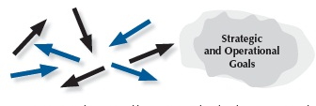



Steps toward Mature Processes
Reactive
Early / Developing
Mature
Leading / Exemplary
Notes:
This graphic is an aid for assessing process items (categories 1 through 6). In each case, the arrows indicate the degree of consistency and coordination among organizational units. The circular shapes shown next to the arrows depict the relative clarity or definition of an organization’s goals. The steps are as follows:
Reacting to Problems: Here operations are characterized by activities rather than by processes, and they are largely responsive to immediate needs or problems.
Early Systematic Approaches: Here the organization is at the beginning stages of conducting operations by processes with repeatability, evaluation and improvement, and some early coordination among organizational units.
Aligned Approaches occur in the third step toward a mature process. At this stage, operations are repeatable and are regularly evaluated for improvement, with learnings shared and with coordination among organizational units.
Integrated Approaches occur at the final stage of a mature process. The arrows indicate the evolution of the organization into an interconnected unit. At this stage, not only are processes repeatable, but also, in collaboration with other affected units, they are regularly evaluated for change and improvement. This collaboration and interconnection help organizations achieve efficiencies across units.

Slide 27
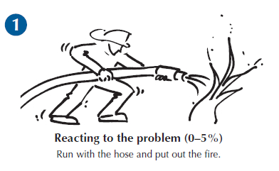
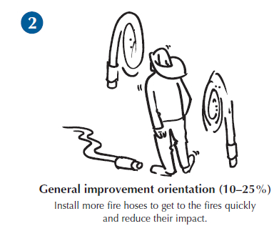
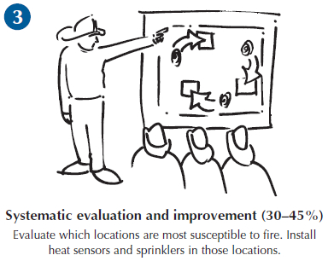
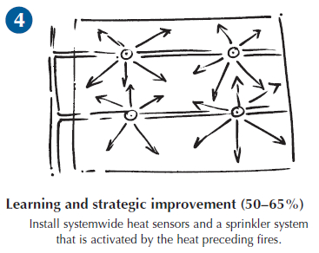
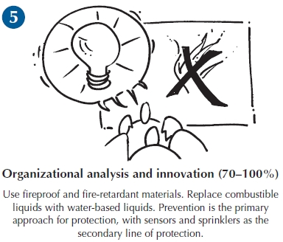
From Fighting Fires to Innovation:
An Analogy for Learning
Notes:
Learning is an essential attribute of high-performing organizations and, therefore, a critical concept in performance excellence. It is a key term used throughout the Baldrige Excellence Framework booklet and is one of the four scoring factors used to assess the maturity of an organization’s processes.
Effective, well-deployed organizational learning can help an organization improve from the early stages of reacting to problems to the highest levels of organization-wide improvement, refinement, and innovation. The firefighting analogy illustrated here shows a progression through the levels of maturity for this scoring dimension.

Slide 28
Assessing Results
Levels: What is your current performance?
Trends: Are the results improving, staying the same, or getting worse?
Comparisons: How does your performance compare with others?
Integration: Are you tracking important results? Are you using the results in decision making?
Notes:
Your results are evaluated based on these four factors:
Levels: What is your current performance?
Trends: Are the results improving, staying the same, or getting worse?
Comparisons: How does your performance compare with that of other organizations and competitors, or with benchmarks?
Integration: Are you tracking results that are important to your organization? Are you using the results in organizational decision making?

Slide 29
Cybersecurity Excellence Builder, Framework Crosswalk (in Cybersecurity Excellence Builder)
From Cybersecurity Excellence Builder, Categories and Items to Framework Functions and Categories
Within Framework, from Functions to Categories, to Sub-categories, to Informative References
Informative References include NIST 800, COBIT, ISA, ISO/IEC, CIS CIC detailed references
Notes:
Shows power of Cybersecurity Excellence Builder when used with Cybersecurity Framework. Able to drive down from a Category to a detailed specification section.

Slide 30
For more information
Baldrige Cybersecurity Excellence Builder https://www.nist.gov/sites/default/files/documents/2017/04/03/baldrige-cybersecurity-excellence-builder-v1.0.pdf
NIST Cybersecurity Framework (V1.1 Draft 2) https://www.nist.gov/sites/default/files/documents/2017/12/05/draft-2_framework-v1-1_without-markup.pdf
NIST Baldrige Program https://www.nist.gov/baldrige
NIST Cybersecurity https://www.nist.gov/topics/cybersecurity
Baldrige Performance Excellence Program | www.nist.gov/baldrige
Notes:
Information links

