Slide 1
Northrop Grumman Drive For Excellence Deep Diving Supplier Zero Defect Plans Julia Price Manager, Quality & Mission Excellence Northrop Grumman
Distribution Statement A: Approved for Public Release; Distribution is Unlimited; #19-1583; Dated 09/05/19

Slide 2
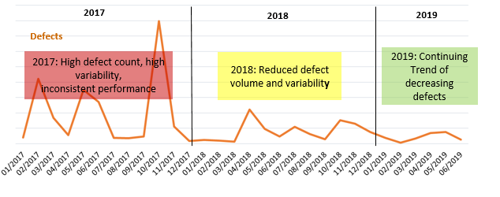
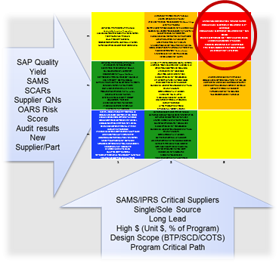
Supplier DFX Summary
Top 25 Suppliers
actively engaged in DFX
Partner with Suppliers to reduce defects they Buy, Make, and Ship
Focus on process control and continuous improvement implementation
Active engagement with Suppliers via monthly DFX plan reviews, on-site workshops, audits, and production readiness reviews
Cross functional supplier management teams drive supplier DFX plan maturity
80% Decrease in Supplier Responsible Defects from 2017 to mid-2019
Distribution Statement A: Approved for Public Release; Distribution is Unlimited; #19-1583; Dated 09/05/19
Notes:
Emphasis on sub-tier quality & effective change control/management
Continue support of GQC Supplier Q committee to identify F-35 Supply web risk

Slide 3
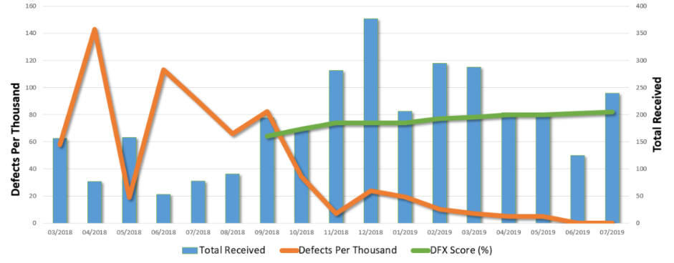
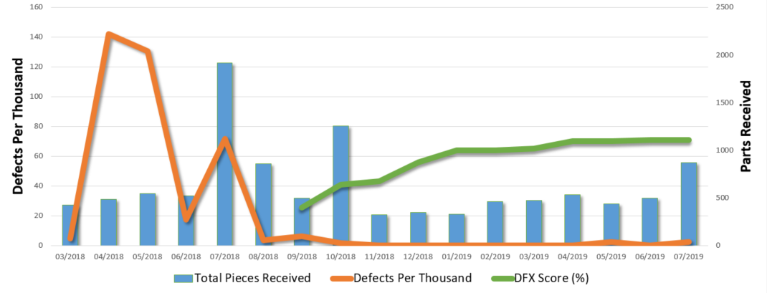
Supplier DFX Case Studies
Supplier 1
Build-to-spec electronics Supplier experienced repeated quality issues
Supplier developed APQP/PPAP plan as part of DFX expectation
Northrop Grumman held monthly reviews and conducted on-site DFX Process Audit
Achieved 8 months of green level quality performance and 3 months of on time delivery performance
Targeted approach to DFX produces better result than broad deployment
Supplier 2
Build-to-print mechanical Supplier struggled to meet delivery rates and experienced workmanship issues on first production contract
Flowed down DFX to & held on-site DFX workshop to identify top drivers
Monthly reviews held with continuing coaching
Achieved 6 months of zero defects and 40% improvement in delivery performance
Quarterly review of risk model to identify additional suppliers to target for DFX
Northrop Grumman Supplier Collaboration to Embrace Zero Defect Culture
Distribution Statement A: Approved for Public Release; Distribution is Unlimited; #19-1583; Dated 09/05/19
Notes:
High Engagement and Collaborative Problem Solving to Achieve Zero Defects
NGC Supplier Collaboration to embrace zero defect culture
NGC Supplier Collaboration to create zero defect results

Slide 4
Summary
Lessons Learned
Root Cause Tiger Teams established to focus on major Supplier themes
Root Cause Tiger Teams
Standardizing process(es) for requirements management:
SQ drawing review for “buy” items prior to eng release
AS9102 FAI
Supplier requirements review before production
Requirements traceability matrix
Special/critical process approval and control plans
Pilot Complete
Future DFX Flowdown
Expand breadth and depth of Supplier DFX
Supplier DFX Expansion
Further reduce defects with current Suppliers - on-going
Kick off new risk-based DFX efforts with Suppliers - on-going
DFX Workshops to develop org. “know-how” - complete
9145 Readiness Actions
Request Suppliers complete Maturity Survey - complete
Assessing impact of possible contract flowdown
Predictors of Success
Data to identify leading indicators of success and relative importance
Northrop Grumman Mission Systems Sector Supplier DFX Score
Degree and maturity of improvement activities as a predictor of future performance
Complete / On-going
Risk Cube 2.0
Implementing ML/AI analytics for predictive Supplier risk modeling
Q4 2019
Distribution Statement A: Approved for Public Release; Distribution is Unlimited; #19-1583; Dated 09/05/19
Notes:
Mission bullet points (current)
Resolving customer concerns with timely and effective corrective actions
Managing sector risk through early detection of potential systemic issues
Preventing quality escapes by leveraging lessons learned across the sector
Improving effectiveness and affordability of Northrop Grumman systems & processes
Previous bullet points (replaced)
Delivering timely and effective problem resolution for our customers
Maintaining a culture of continuous improvement and organizational learning
Developing innovative solutions for our company and our customers
Providing enterprise solutions across Northrop Grumman systems & processes

Slide 5
Distribution Statement A: Approved for Public Release; Distribution is Unlimited; #19-1583; Dated 09/05/19

