Slide 1
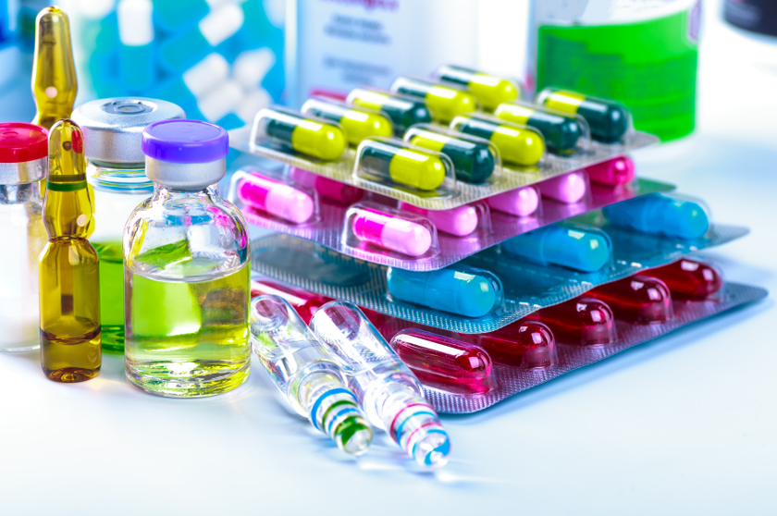
Drug Development and Review Process

Slide 2
Objectives
Go over the processes involved in drug discovery and development
Explain the role of the Food and Drug Administration (FDA) in the drug development and review process in the United States
Describe the phases involved in FDA drug approval

Slide 3
Research and Development Process (R&D)
Development of new drugs is a complex and costly process
It takes an average of 12 years and about $350 million to get a new drug from the laboratory to the pharmacy shelf
R&D involves discovery (preclinical studies) and development (clinical studies)
Only one in 1000 compounds which begin laboratory testing will make it to human testing

Slide 4
Role of FDA
The Food and Drug Administration (FDA) is required to review and approve all new drugs in the United States
The FDA reviews and evaluates new drugs based on the evidence presented from the clinical research studies performed by the drug sponsor-typically a pharmaceutical company

Slide 5
Summary of Drug Development and Evaluation

Slide 6
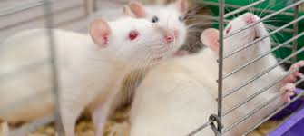
Preclinical Studies
Synthesis and purification of the new drug
Pharmacology of the new drug in animal models:
Pharmacokinetics: absorption, distribution, metabolism, excretion, half-life
Pharmacodynamics: mechanism of action and estimates of therapeutic effects
Toxicology including carcinogenicity, mutagenicity, and teratogenicity
Purpose:
Reasonably safe for initial use in humans?
Sufficiently effective against a disease target in chemical assay tests or animal models?

Slide 7
Investigational New Drug
Investigational New Drug (IND): Application for permission to administer a new drug to humans
Outlines the proposal to use the new drug for human testing in clinical trials
Studies in humans can only begin after IND is reviewed and approved by the FDA and an Institutional Review Board (IRB)

Slide 8
Phases of Clinical Studies
Phase 1: Efficacy studies on healthy volunteers
Phase 2: Clinical studies on a limited scale
Phase 3: Comparative studies on large number of patients
New Drug Application (NDA): Regulatory review
Phase 4: Continued comparative studies. Registration and market introduction

Slide 9
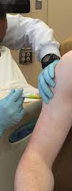
Phase 1
Typically involves 20-80 healthy volunteers (no women of childbearing potential)
Emphasis is on drug safety
Goal is to identify major side effects, metabolism and routes of excretion
Lasts about 1 year
About 70% of drugs will pass this phase

Slide 10
Phase 2
Typically involves 100-300 individuals who have the target disease
Emphasis is on effectiveness
Patients receiving the drug are compared to similar patients receiving a placebo or another drug
Lasts about 2 years
About 33% of drugs will pass this phase

Slide 11
Phase 3
Typically involves 1000-3000 patients
Emphasis is on safety and effectiveness
Investigates through well-controlled studies different populations and different dosages as well as uses of new drug in combination with other drugs
Lasts about 3 years; 25-30% of drugs will pass this phase
~7 products out 100,000 that started in the laboratory will make to this stage

Slide 12
New Drug Application
Pre-NDA period: FDA and drug sponsors meet
Submission of NDA: Formal step asking the FDA to consider approving a drug for marketing
FDA has 60 days to decide whether it will file it for approval consideration
If filed, a review team is assigned to evaluate the new drug

Slide 13
FDA Role
The review team evaluates the research on the safety of the drug and its effectiveness
The FDA reviews the information to go on the drug label
It inspects the facilities where the drug will be manufactured
The application will be classified as “approvable” or “not approvable”

Slide 14
FDA Role
If approvable, the FDA requests additional information from the sponsor
The NDA is again reviewed
Following drug approval, sponsors of the drug will be required to continually assess the safety of the drug

Slide 15
Phase 4
Post-market surveillance of the drug to continually assess the safety of the drug
May include incidence and severity of rare adverse reactions, cost-effectiveness analyses, comparative trials, and quality of life studies

Slide 16
Expedited Programs
Fast track designation
Breakthrough therapy designation
Accelerated approval
Priority review designation
These programs allow faster and more frequent communication and guidance from FDA as the studies are being conducted, so the process brings efficiency in time and resources

Slide 17
Concepts for Expedited Review
Serious Condition
AIDS, Alzheimer’s, heart failure and cancer
Available Therapy
preliminary clinical evidence indicates that the drug may demonstrate substantial improvement over available therapy on a clinically significant endpoint(s)
Unmet Medical Need
providing a therapy where none exists
providing a therapy which may be potentially better than available therapy

Slide 18
Emergency Use Authorizations
FDA Commissioner may allow unapproved medical products or unapproved uses of approved medical products to be used in an emergency to diagnose, treat, or prevent serious or life-threatening diseases or conditions when there are no adequate, approved, and available alternatives.
Coronavirus Disease 2019 (COVID-19) Emergency Use Authorizations for Medical Devices
Personal Protective Equipment EUAs
In Vitro Diagnostic EUAs
Ventilators and Other Medical Device EUAs

Slide 19
Emergency Use Authorizations
2020 Remdesivir Emergency Use Authorization
Zika Virus Emergency Use Authorization
2015 Enterovirus D68 (EV-D68) Emergency Use Authorization
2014 Ebola Virus Emergency Use Authorization
2013 Coronavirus Emergency Use Authorization (Potential Emergency)
2013 H7N9 Influenza Emergency Use Authorization (Potential Emergency)

Slide 20
FDA Office of Orphan Products Development (OOPD)
Developing Products for Rare Diseases & Conditions
The Orphan Drug Designation program provides orphan status to drugs and biologics which are defined as those intended for the safe and effective treatment, diagnosis or prevention of rare diseases/disorders that affect fewer than 200,000 people in the U.S., or that affect more than 200,000 persons but are not expected to recover the costs of developing and marketing a treatment drug.

Slide 21
FDA Office of Orphan Products Development (OOPD)
The Rare Pediatric Disease Priority Review Voucher Program says that a sponsor who receives an approval for a drug or biologic for a "rare pediatric disease" may qualify for a voucher that can be redeemed to receive a priority review of a subsequent marketing application for a different product.
The Humanitarian Use Device (HUD) program designates medical devices that are intended to benefit patients in the treatment or diagnosis of a disease or condition that affects or is manifested in not more than 8,000 individuals in the United States per year as eligible for Humanitarian Device Exemption.

Slide 22
Resources
http://www.fda.gov/Drugs/DevelopmentApprovalProcess/default.htm
https://www.fda.gov/ForPatients/Approvals/Fast/default.htm
https://www.fda.gov/ForIndustry/DevelopingProductsforRareDiseasesConditions/default.htm
https://www.fda.gov/downloads/Drugs/Guidances/UCM358301.pdf
www.ja-online.com/industry/Drug_Development_and_Approval.ppt
https://www.fda.gov/medical-devices/emergency-situations-medical-devices/emergency-use-authorizations

