Slide 1

Use of Quality Tools to Prevent Damage Due to Climate Change
David M. Saunders
davidsaunders107@gmail.com
ASQ Baltimore Section
September 8, 2020
Notes:
NOTE: THIS WILL BE USED AS THE INTRO TO RICHARD EMORY
Hello,
I’m David Saunders, I’ve been a member of ASQ for over 35 years.
I’d like to introduce my friend Richard Emory and tell a quick story from his book.
Richard Emory served as our nation’s top lawyer for all EPA criminal investigations of pollution crime. During the last 17 years of his EPA career, he worked internationally in foreign assistance to many other nations wanting clean water and clean air. Before coming to EPA, in Maryland he was an Assistant Attorney General prosecuting environmental offenders statewide. In one case [David, here you can tell the story of the polluting ship….]
When Richard was a young attorney working for the State of Maryland his office received a report that a large ship was polluting the Chesapeake Bay.
His office called the ship owners in NY and got no response. The Coast Guard was on station monitoring the mess.
So Richard and the other lawyers took bold action. They had the Department of Natural Resources police – sort of like park rangers – take their little patrol boat out to this giant ship, they arrested the captain, put him in handcuffs, and brought him to the Annapolis City jail. The pollution quickly stopped.
Richard was one of the highest-ranking attorneys at the Environmental Protection Agency. If your company got a letter from him, it would get attention. He’s the real deal – and I think we are fortunate to get his perspective first-hand.

Slide 2
Brainstorm Risks Due to Climate Change
(floods, sea-level rise, intense storms, heat, infrastructure failure…)
My Suppliers
My Organization
My Customers
Notes:
Before this session we gave you a simple worksheet like this to take notes.
During my talk you can use this worksheet to think about how climate change will impact you and your organization.
At the end, during the Q&A, you might want to refer back to your notes to ask questions.

Slide 3
Talk with a Climate Change Professional (CC-P)
Director of Sustainability for large mid-western university
Improving Vehicle Optimization
Improving Tree Maintenance
These sure sound like quality improvement projects.
Notes:
Let me begin with a little story.
I met a young woman who had just received certification as a Climate Change Professional.
She said she was the Director of Sustainability for a large mid-western university and she was working on two projects.
Project one was improving vehicle optimization.
Project two was improving tree maintenance.
Everything she did sounded like what we do in quality improvement.

Slide 4
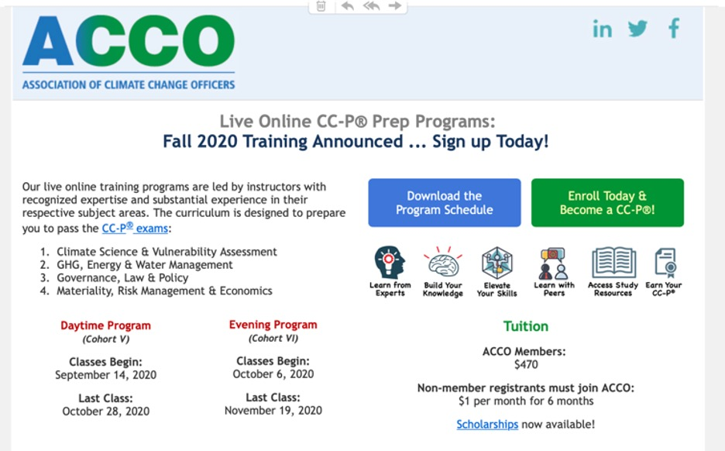
Notes:
So I checked out the Association of Climate Change Professionals and found that much of what they do is what we call Quality Improvement Projects.
I’m taking their certification classes because I think that we can play a key role as our organizations face climate change.

Slide 5
Agenda
Dr. W. Edwards Deming
Vulnerability Assessments
CO₂ Mitigation
GHG (Greenhouse Gas) Reporting
Solar Panels
Taking Action
Good News
Notes:
Today’s agenda is aimed at giving you a look at what I think is coming.
Here is our plan.
A few words about Dr. W. Edwards Deming
Vulnerability Assessments
CO₂ Mitigation
GHG Reporting
Solar Panels
Taking Action
Finally some Good News

Slide 6
Dr. W. Edwards Deming
Notes:
In the 1980s I had the good luck to study with Dr. W. Edwards Deming – who is often credited with being the father of modern quality methods.
During his four-day lecture he did a simulation called the Red Bead Experiment which introduced me to control charts.
I then apprenticed with Dr. Bill Latzko and eventually became a coach at Dr. Deming’s famous lectures.

Slide 7
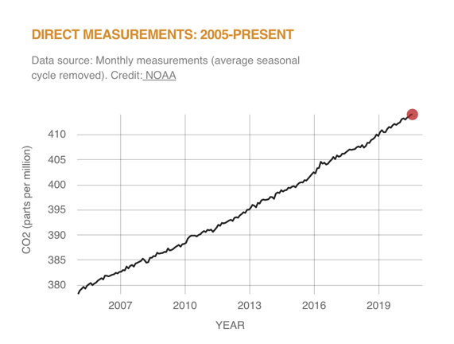
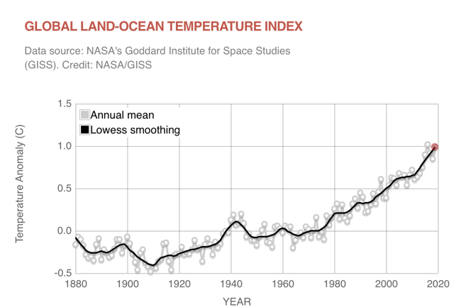
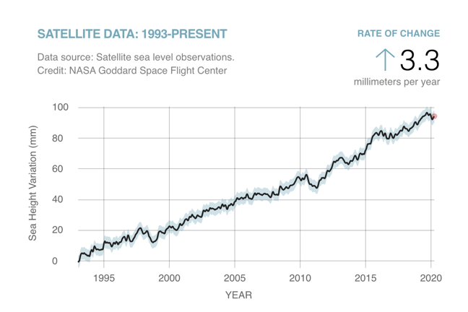
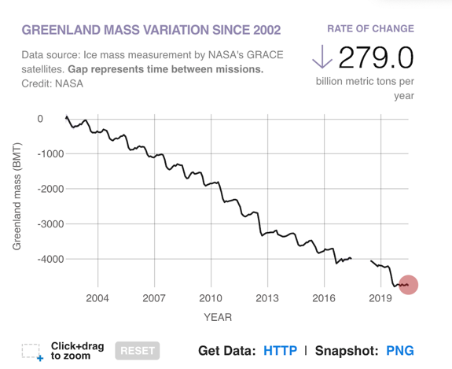
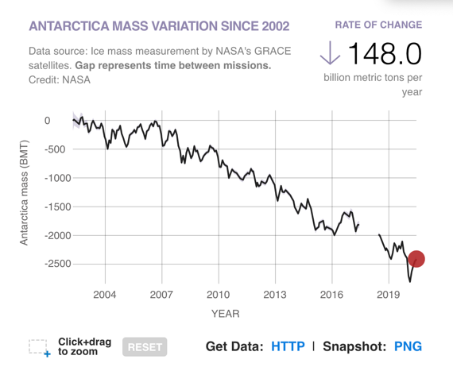
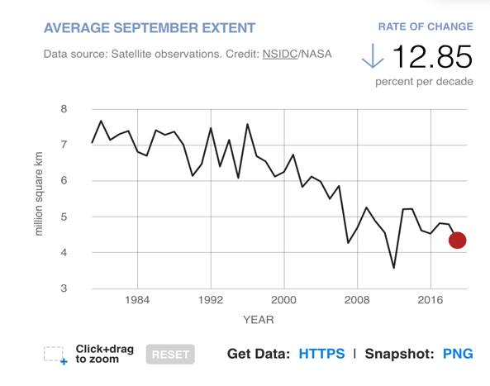
Carbon Dioxide in Atmosphere
Global Temperature
Sea Level Rise
Antarctica Ice Sheet
Arctic Sea Ice
Greenland Ice Sheet
Source: https://climate.nasa.gov/vital-signs/ice-sheets/
Notes:
When I began to study climate change, I was already ahead of the class because I knew control charts, improvement methods, facilitation skills, document control, and how to use ISO standards.
Putting together a dashboard like this was second nature to me.
I’m sure everyone in ASQ can readily see the top three charts demonstrate increases in CO2, global temperature, and sea level.
The bottom charts shows ice melting in Greenland, Antarctica, and the Arctic Sea.
We all know that 7 to 9 points is a row all going in the same direction are a special cause of variation – they are not random. These charts all show a trend.
As I said, as quality professionals we can play a critical role in fighting climate change for the benefit of our organizations because we know how to read the charts.

Slide 8
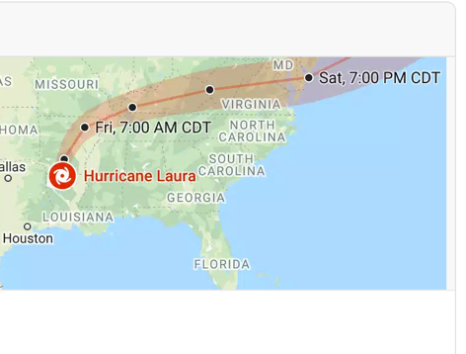
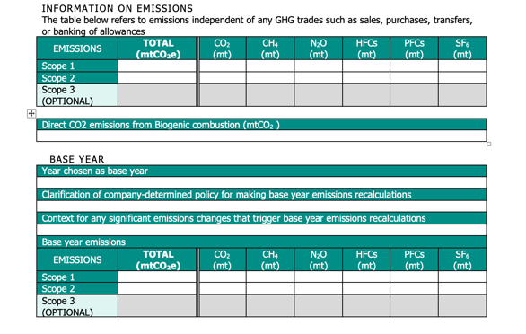
Have any of you been asked:
1. To conduct vulnerability assessment.
2. To develop a CO₂ mitigation plan.
3. To report progress on environmental issues.
Author has permission to use ACCO charts.
Notes:
Have any of you been asked to
To conduct vulnerability assessment for climate change
To develop a CO₂ mitigation plan.
To report progress on environmental issues.
If YES, click “yes” on the participant window
If you haven't been asked yet, I think you will be asked soon, or someone else in your organization will be given the assignment.
This is a chance for you to add value to your organization.

Slide 9
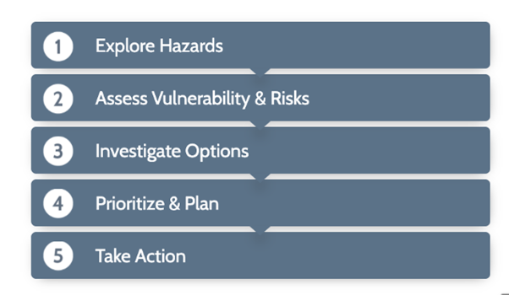
1. How to conduct a vulnerability assessment
National Oceanic and Atmospheric Administration (NOAA)
Source: https://toolkit.climate.gov/
Notes:
The National Oceanic and Atmospheric Administration, NOAA, has produced this wonderful website called the US Climate Resilience Toolkit.
It’s used by all Federal Agencies.
And they walk you through a five-step process
1. Explore Hazards
2. Assess Vulnerability & Risks
3. Investigate Options
4. Prioritize & Plan
5. Take Action
Sounds to me like a quality improvement project.
This website is superb and contains a wealth of climate science.

Slide 10
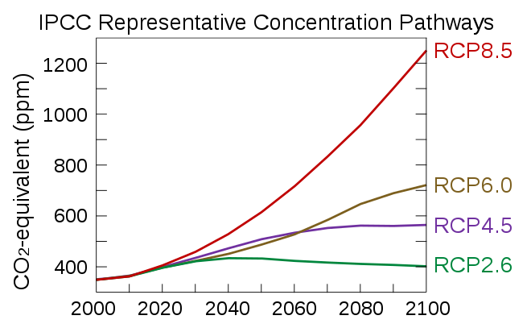
The Intergovernmental Panel on Climate Change (IPCC)
RCP1.9 is 1.5 °C, the Paris Agreement.^{[4]}
Source: https://en.wikipedia.org/wiki/Representative_Concentration_Pathway
Notes:
So if you are asked to do a vulnerability assessment for facilities, roads, or transportation hubs, you will need to use the RCP scenarios developed by the IPCC. I’ll explain all of this.
IPCC is the Intergovernmental Panel on Climate Change.
It is a scientific body that has established the Representative Concentration Pathway (RCP).
RCP is the warmth per square meter of earth’s surface as measured in watts.
Basically RCP 6 represents the heat of 6 watts per square meter hitting the entire surface of the earth.
You will see RCP scenarios used in Climate Change literature worldwide.
RCP 1.9 will result in only a 1.5 C degree rise, which is the target for the Paris Agreement.
So you can see a wide variation in scenarios.
An RCP 8.5 projects that CO2 in the atmosphere will reach over 1200 parts per million by the end of this century.
This will result in the melting of the ice caps as Richard described.

Slide 11
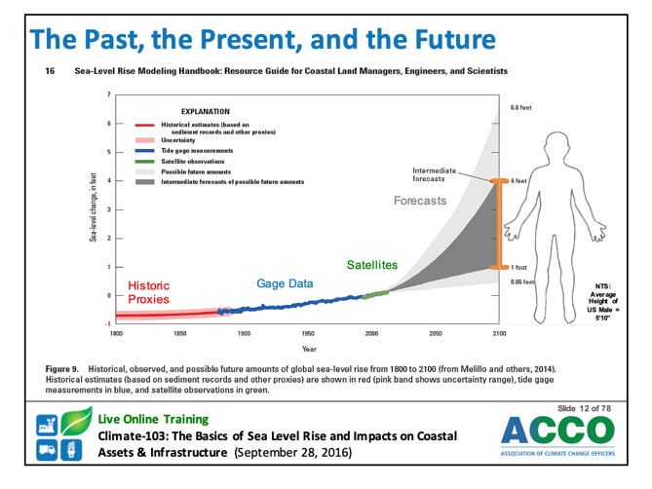
Notes:
Here is how the RCP is converted into sea level rise.
An intermediate RCP 4.5 would raise sea levels four feet.
A rise of four feet will probably impact every organization represented in this room.
You will be asked to develop different adaptation plans for several RCPs.

Slide 12
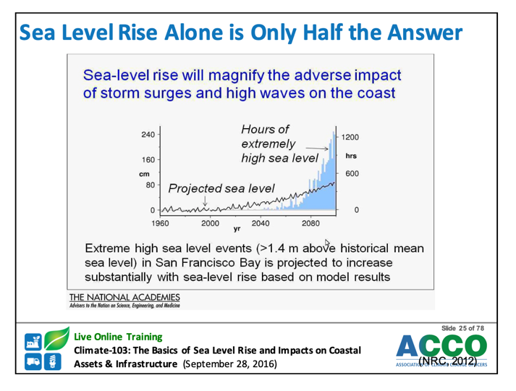
Notes:
As I learned in class, models of sea-level rise are not enough.
We must also consider high tides and storm surge.
Hurricane Laura is a good example.

Slide 13
Source: https://www.fairfaxcounty.gov/gisapps/dmv/default.aspx#!
Notes:
One of our homework assignments was to check the vulnerability of a residential community in Fairfax County.
If you go to the website shown, you can create a flood plain map.
There are a good number of such mapping tools available and you may use several as you do a vulnerability assessment.

Slide 14
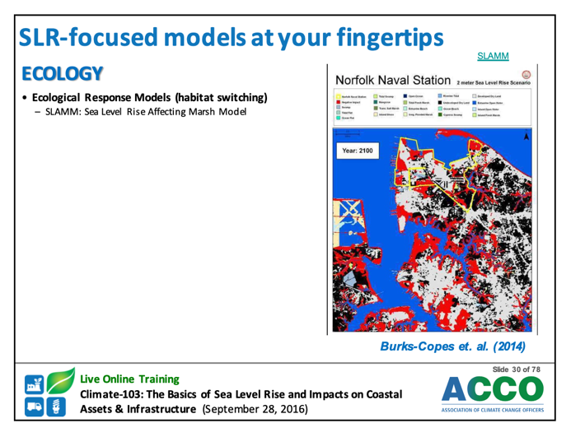
Notes:
Here’s computer modeling of sea-level rise vulnerability of the Norfolk Naval Station.
My instructor was with the Army Corp of Engineers and showed us some very sophisticated adaption plans from the US Navy.

Slide 15
Notes:
I don’t want to leave the impression that sea-level rise is the only risk.
We also have to consider wildfires, floods, and intense heat.
In the next slide I’ll show you a mapping tool for intense heat.

Slide 16
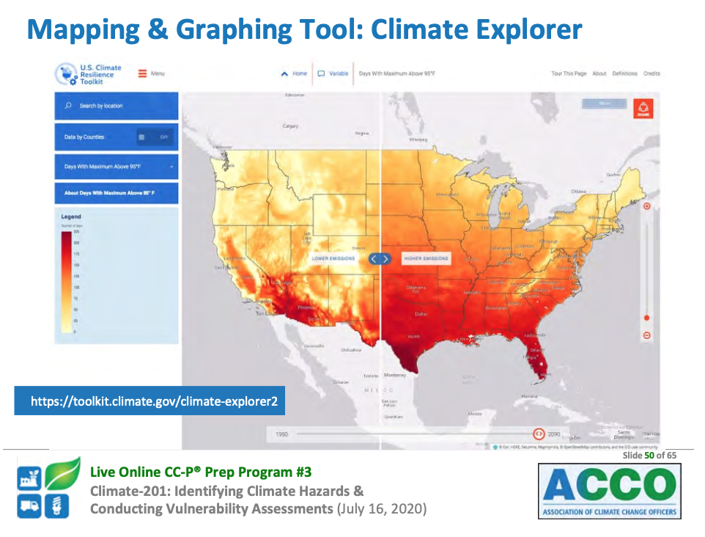
Lower Emissions
Higher Emissions
Notes:
What would it be like living somewhere with 100 days per year above 95 degrees?
What happens if we have a facility in that region?
What if we have suppliers in the red zone on the map?
Will they be able to operate? Will their workforce remain intact?
The NOAA website has many tools for determining future sea-level rise and temperature.

Slide 17
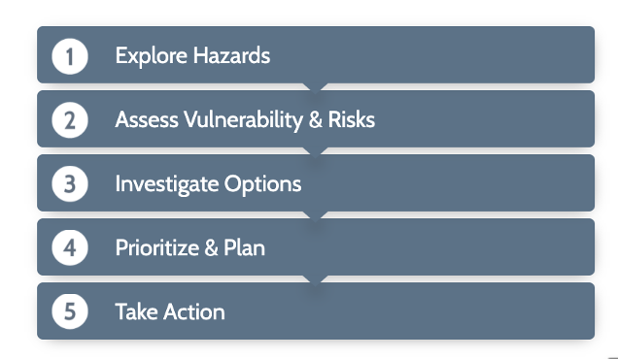
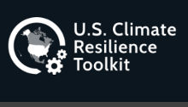
1. How to conduct a vulnerability assessment
Source: https://toolkit.climate.gov/
Notes:
So once we determine the risk, then comes investigation of options, prioritization, planning, and action.
So my point is that we, as quality professionals, are well suited to conduct vulnerability assessments and follow-up action projects.
You don’t have to be a climate scientist to fight climate change.

Slide 18
1. To conduct vulnerability assessment.
2. To develop a CO₂ mitigation plan.
3. To report progress on environmental issues.
Notes:
Let’s next discuss how to develop a CO₂ mitigation plan.
How to stop emitting carbon dioxide and other greenhouse gases, to prevent disaster.

Slide 19
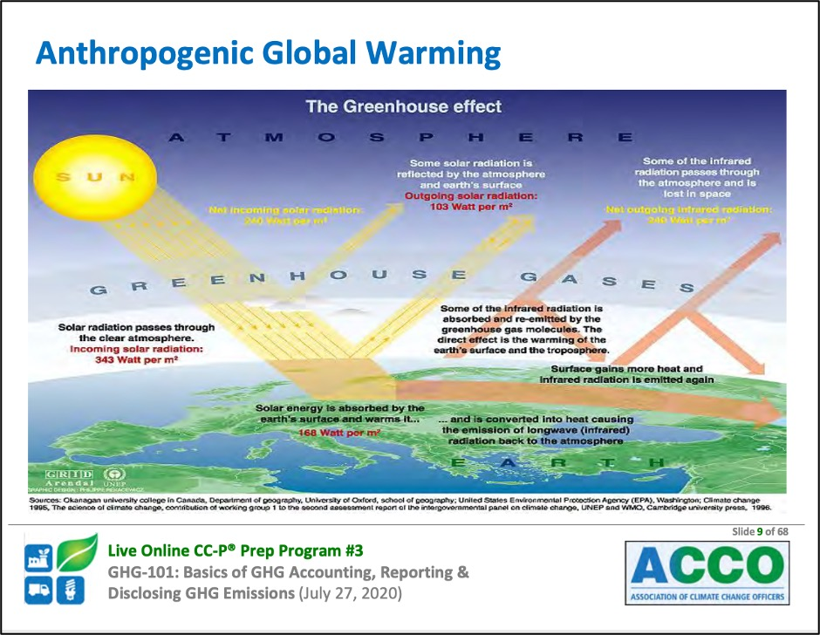
Notes:
Anthro-po-genic global warming is a fancy word for man-made global warming.
For example, as we burn coal, the carbon atom combines with two oxygen atoms, to form carbon-dioxide – CO₂.
The carbon dioxide molecule then floats to the troposphere where it stays for about 100 years.
When CO₂ is hit by a photon, it vibrates and creates heat.
Some heat escapes into space, but some heat radiates back to earth.
This has been going on for millions of years.
However, since the start of the industrial age, about 1880, mankind has burned enough carbon to generate an extra 300 billion tons of CO₂ gas.
The additional CO₂ acts as a blanket.
The result is that earth has warmed about one-degree centigrade.

Slide 20
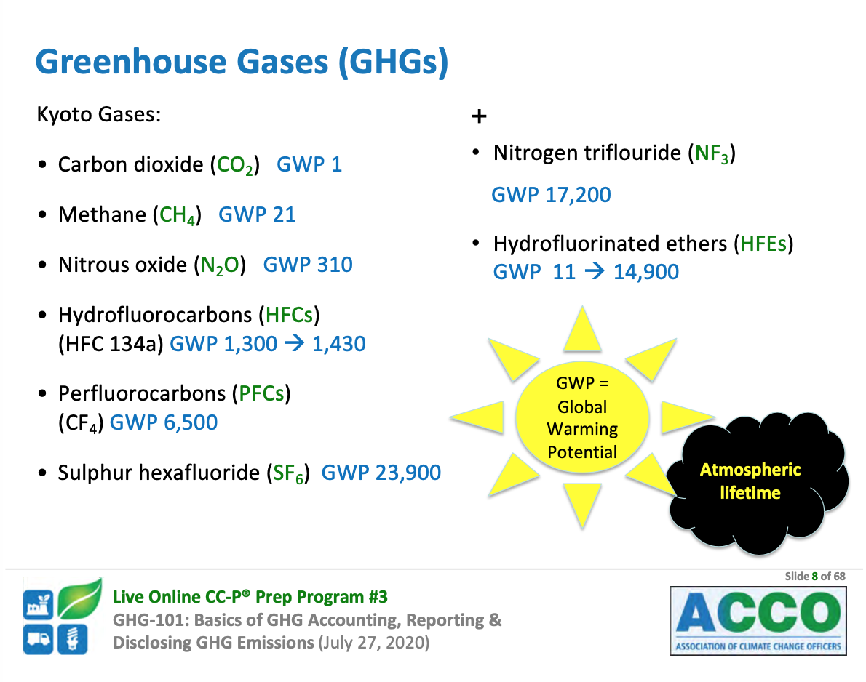
Notes:
In 1992 the United Nations (Framework) Convention on Climate Change (UNFCCC) met in Kyoto (key-o-tow) Japan.
Six Greenhouse Gases were identified as the predominate cause of global warming.
Here is how the model works.
One ton of carbon dioxide in the air, for 100 years, has a Global Warming Potential of one.
So all GHGs are compared to one ton of carbon dioxide.
Methane (natural gas) has a Global Warming Potential of 21. It is 21 times more damaging than CO2.
Nitrous oxide has a GWP of 310. It’s 310 times more damaging than CO2.

Slide 21
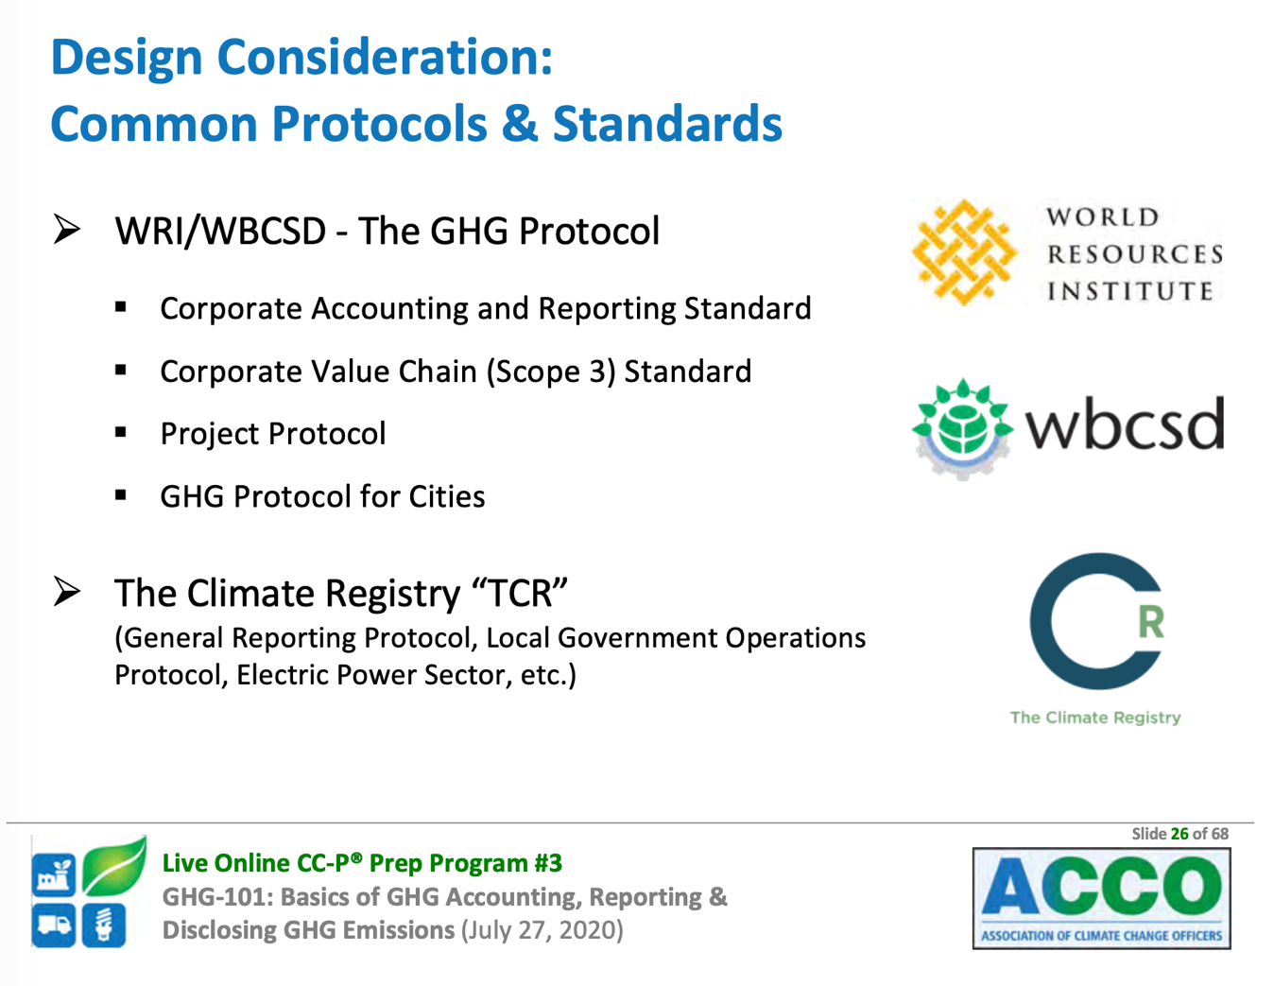
World Business Council for Sustainable Development (WBCSD)
Notes:
There are several worldwide protocols and standards for measuring and tracking greenhouse gas emissions.
Depending upon your industry, you will be asked to use the proper standard.
Each agency that issues standards has specialized training in their application.
Someone in your organization will have to research these standards and learn to use them.
This is another opportunity to provide value to your organization.

Slide 22
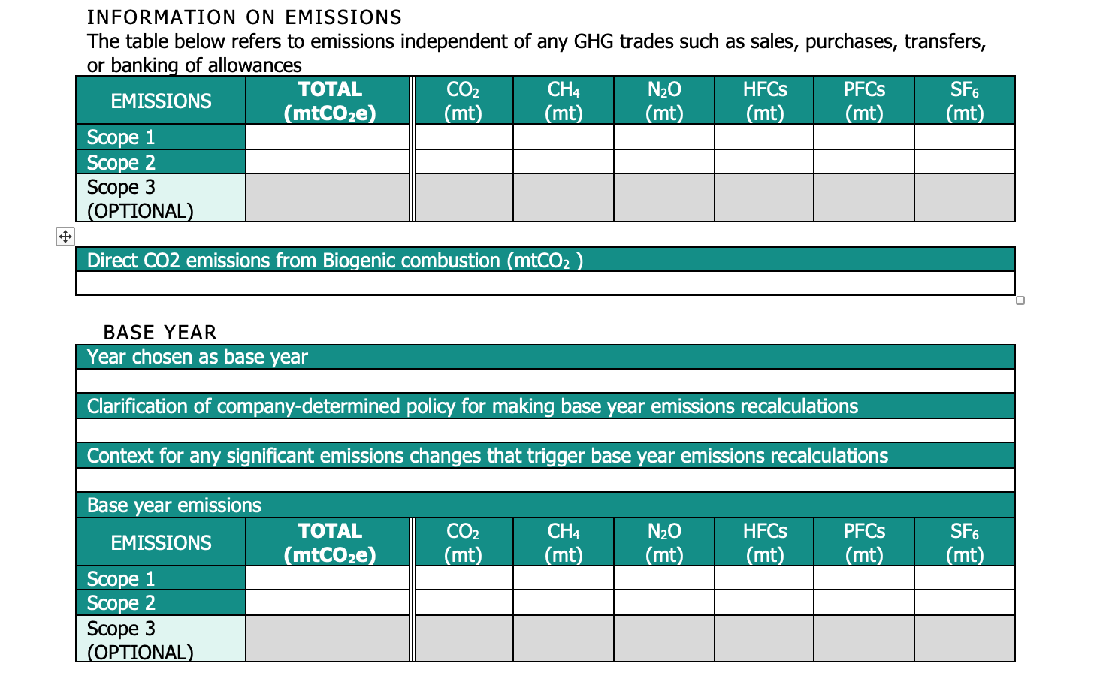
Notes:
Here is a fairly typical database for recording GHG emissions.
It goes chemical-by-chemical and automatically does the calculations.
The data is located in many places in you company.
Someone will have to organize a way to collect and manage the data.
This is something that ASQ members are well suited to do, and to do well.
The data manager needs to like data and pay attention to details.
Knowledge of greenhouse gases can be learned.
I suspect there are probably very few people in your entire organization who can name the six critical Kyoto (key-o-tow) greenhouse gases.
With some practice you can be the first to know these chemicals – and then to identify where they are emitted.

Slide 23
1. To conduct vulnerability assessment.
2. To develop a CO₂ mitigation plan.
3. To report progress on environmental issues.
Notes:
Let’s look at reporting.

Slide 24
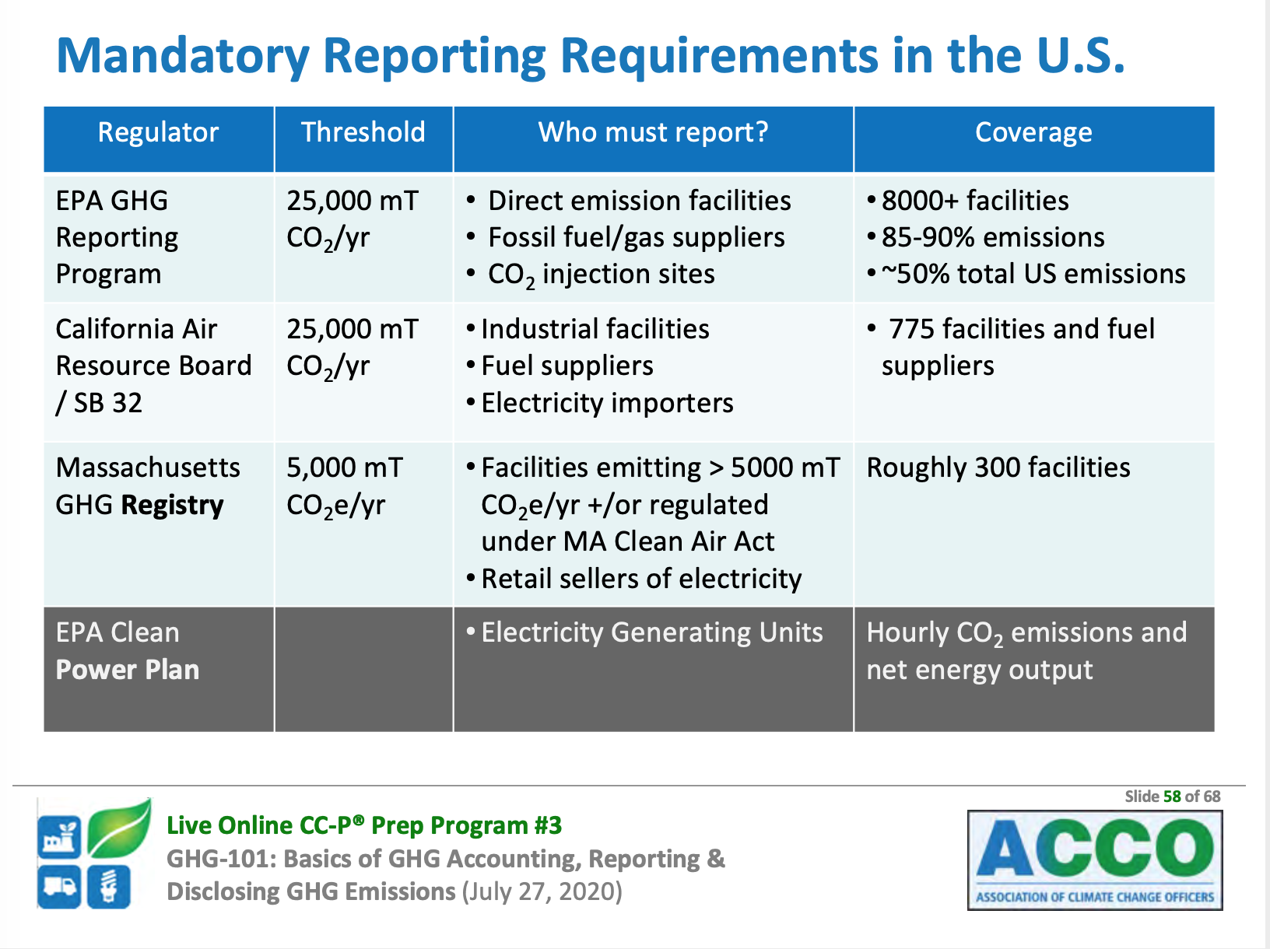
Notes:
So far, the EPA requires reporting from facilities that emit more than 25,000 metric tons per year.
California and Massachusetts have more stringent requirements.
I expect that more and more states will require GHG reporting.
I believe your organization will eventually be required to report.

Slide 25
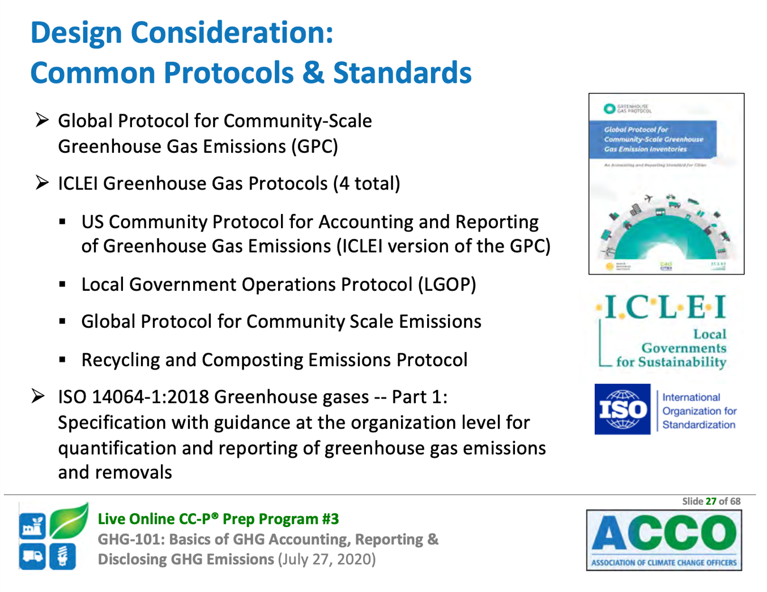
Notes:
There are several standards for measuring and reporting greenhouse gases, including ISO 14064 (fourteen thousand, sixty-four).

Slide 26
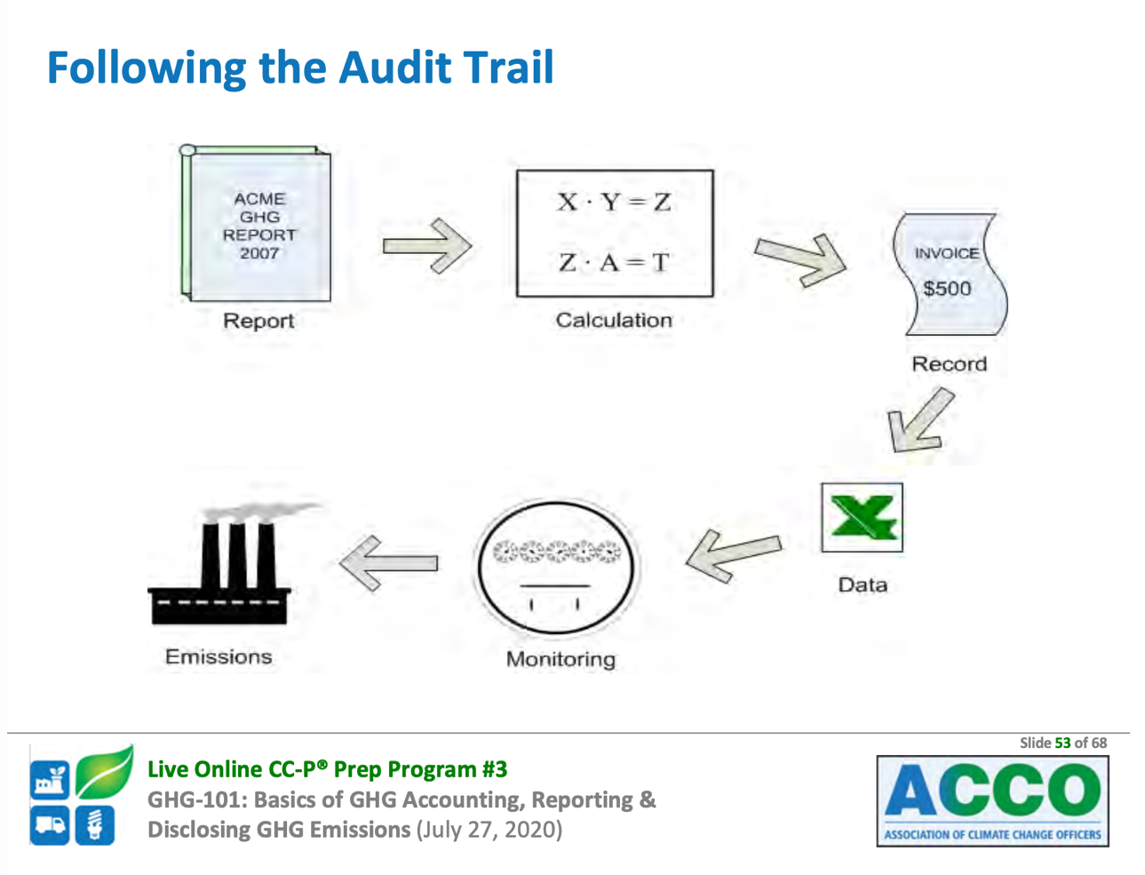
Notes:
Emission measurements and results of mitigation activities are often subject to audits.
Here is another skill we have, to either conduct audits or to interact with auditors.

Slide 27
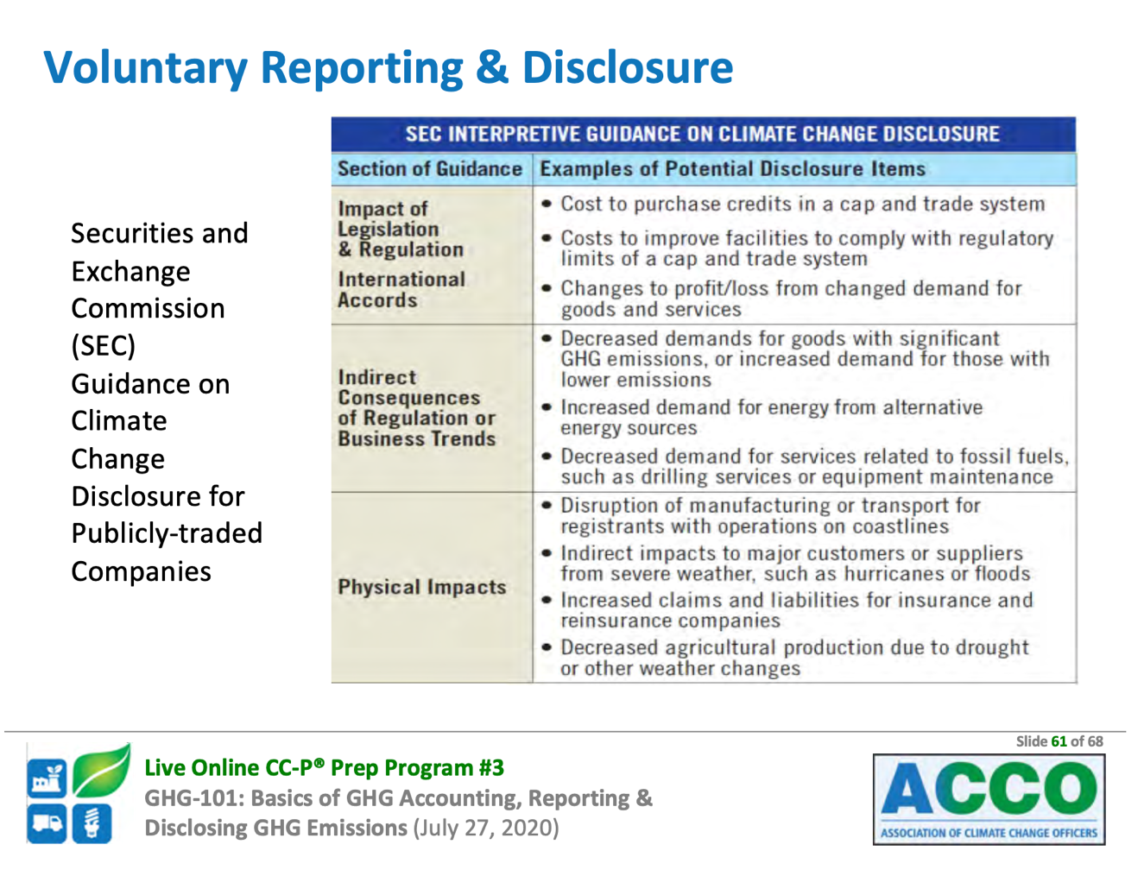
Notes:
More and more, investors are asking for data on GHG emissions.
The SEC has issued a Guidance on potential disclosure items.
You can help the lawyers in your company do the reporting.

Slide 28
1. To conduct vulnerability assessment.
2. To develop a CO₂ mitigation plan.
3. To report progress on environmental issues.
Notes:
My point is that this is coming to your organization and I think that we in the quality professions are especially well qualified to lead the climate change team.
So a few more points before questions.

Slide 29
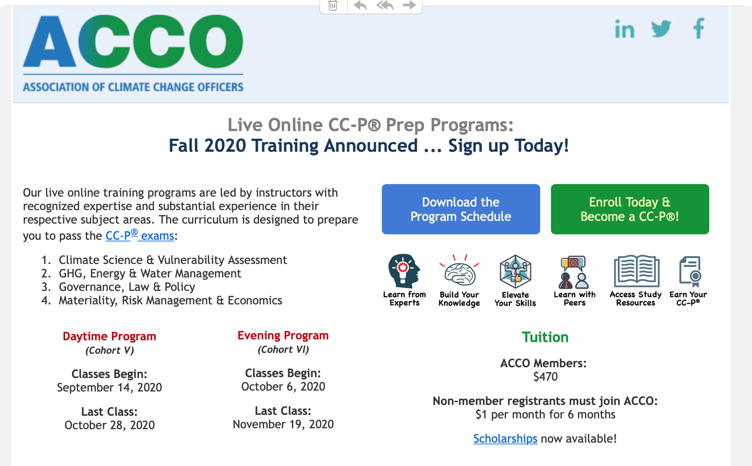
Notes:
To become a certified Climate Change Professional, there are eight required classes and four exams, along with other requirements.
If any of you are interested, the next daytime class begins on September 14, and the next evening class starts on October 6.
I believe it is far easier than becoming a Certified Quality Engineer.
The total cost of classes and exams is under $500.
I hope that one day ASQ and ACCO will have a joint certification program.

Slide 30
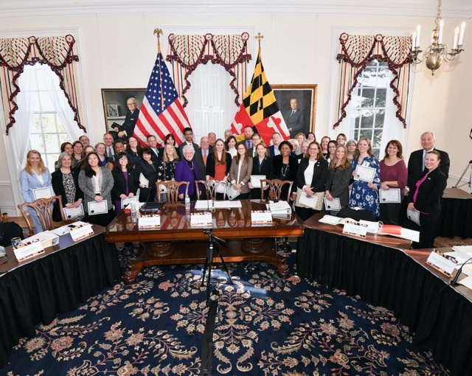

Maryland Climate Leadership Academy
https://www.mdclimateacademy.org/
Sponsored by Department of Natural Resources for Maryland
Tuition paid if you qualify and live in Maryland.
Notes:
The State of Maryland, Department of Natural Resources will pay tuition for participants who are Maryland residents.
Go to the Maryland Climate Academy website to apply.
Or contact me for more information.

Slide 31
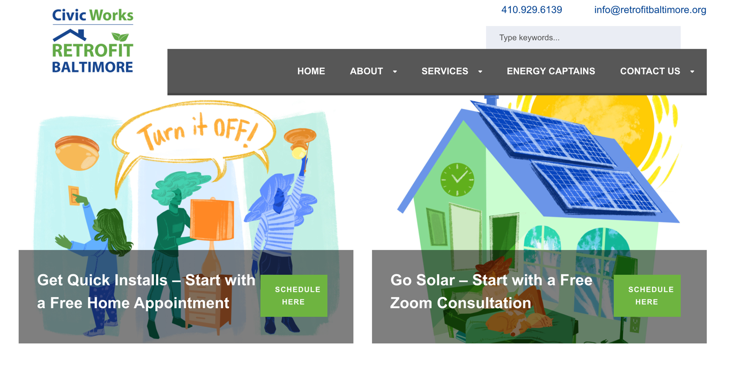
For more info: http://energyprograms.civicworks.com/
Notes:
For your personal efforts at fighting climate change, if you are interested in installing solar panels on your home, go to the Civic Works Energy Program website.
They have a rep who will talk you through the process and show you how credits work for kilowatts you don’t use that can be sold back to the grid.

Slide 32
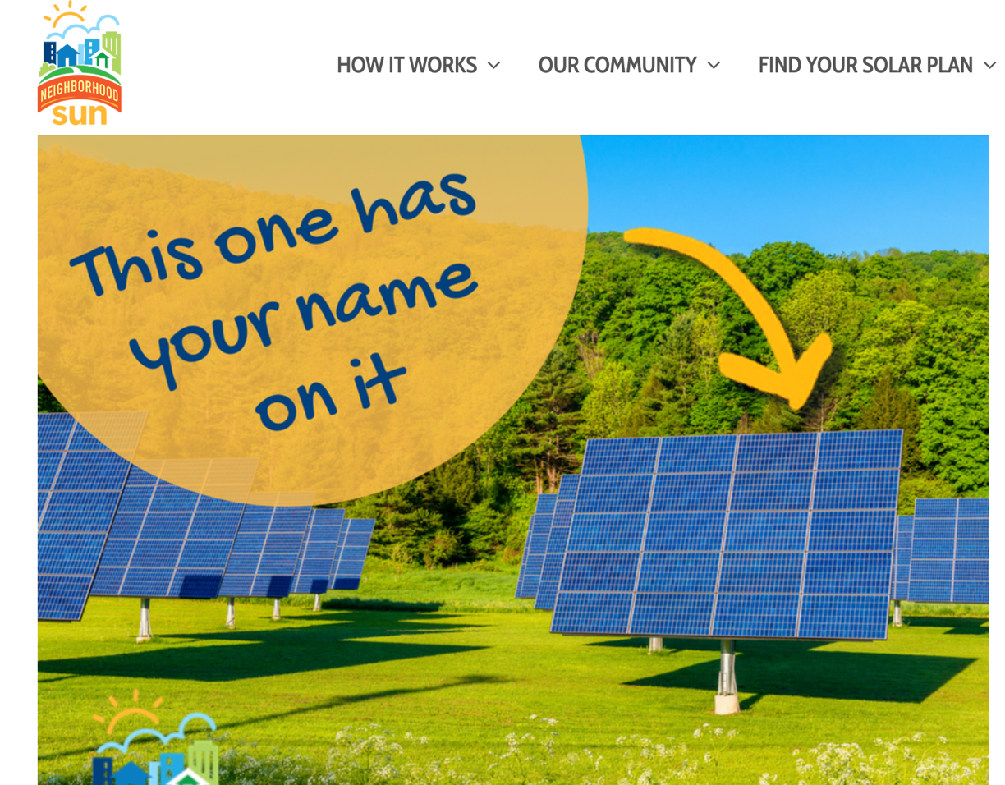
For more info: https://neighborhoodsun.solar/
Notes:
If you want solar, but not on your roof, then you can join a community solar farm.
Google Neighborhood Solar to get more info.
The White March solar farm is fully subscribed.
But they are actively looking for subscribers which will open soon.

Slide 33
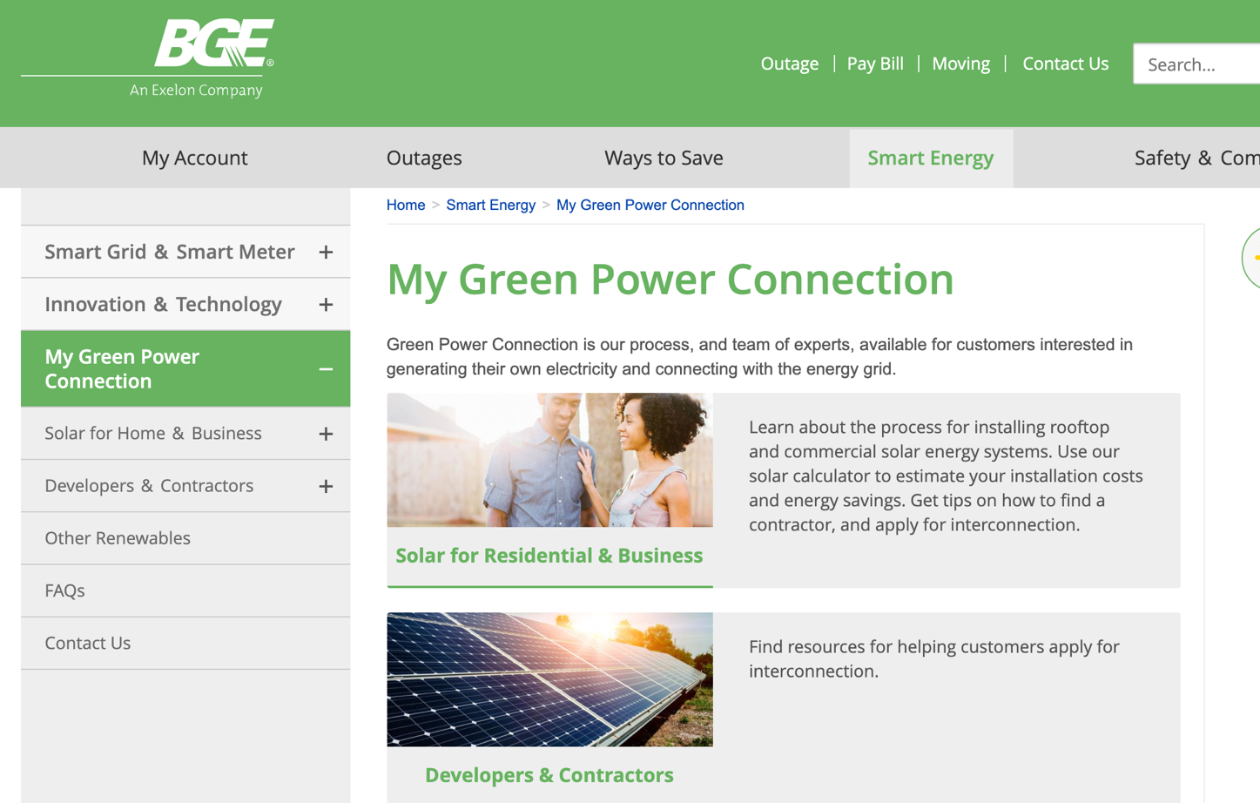
Notes:
And you can also look to your public utility for renewable energy.
I currently buy wind power from Washington Gas and Electric that is delivered by BGE.

Slide 34
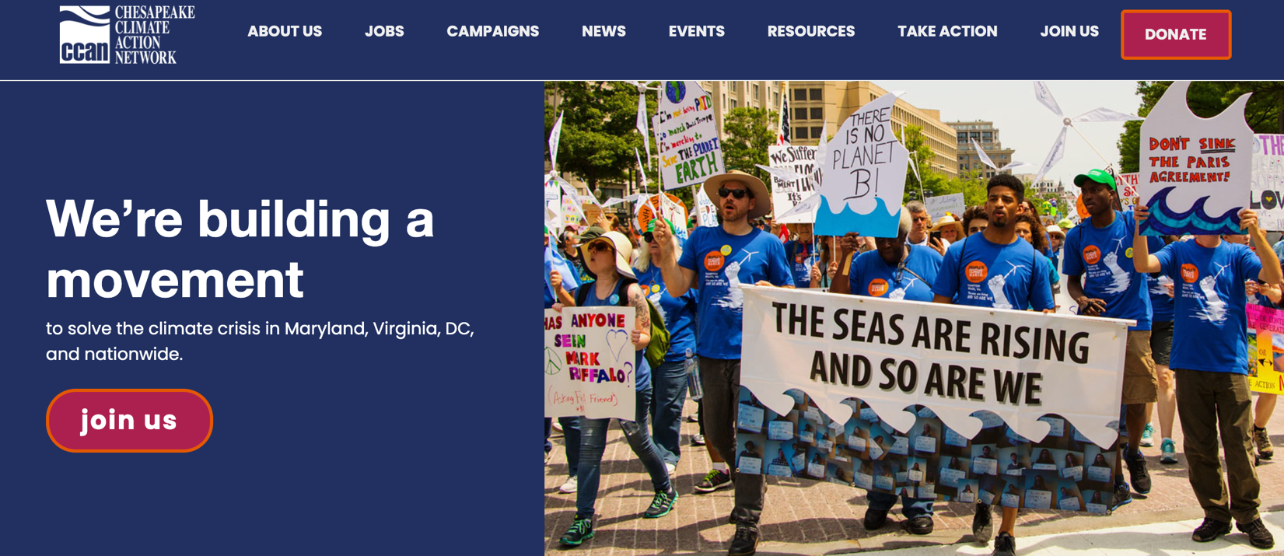
Chesapeake Climate Action Network (CCAN)
For more info: https://chesapeakeclimate.org/
Notes:
In terms of policy, I’m a volunteer with the Chesapeake Climate Action Network referred to as CCAN.
We aim to influence the Maryland State Legislature.
A major project is to stop the construction of a methane pipeline through the Eastern Shore.
If you are interested in stopping fossil fuels, I urge you to join.
There are many other similar organizations including the Sierra Club.

Slide 35
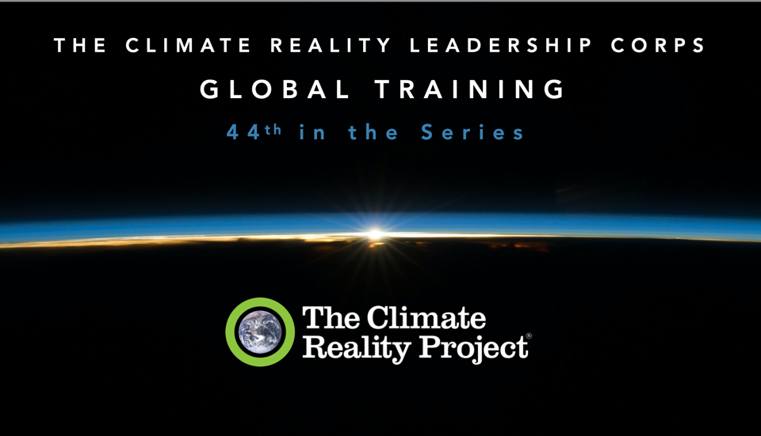
Notes:
In conclusion, you may be asking if there’s any hope, especially given Richard’s talk.
If you attend VP Al Gore’s training, he does a bit of what we did today.
He gives the bad news first – doom and gloom – then at the end, he gives you hope.
Now I’m going to show you signs of hope.

Slide 36
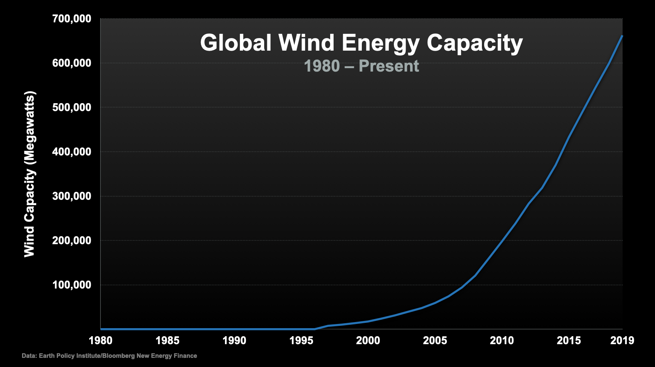
Notes:
Al Gore pointed out that the use of Global Wind Energy has skyrocketed in the past 20 years.
This slide accompanied with pictures of hundreds of windmills (many from the European Union).

Slide 37
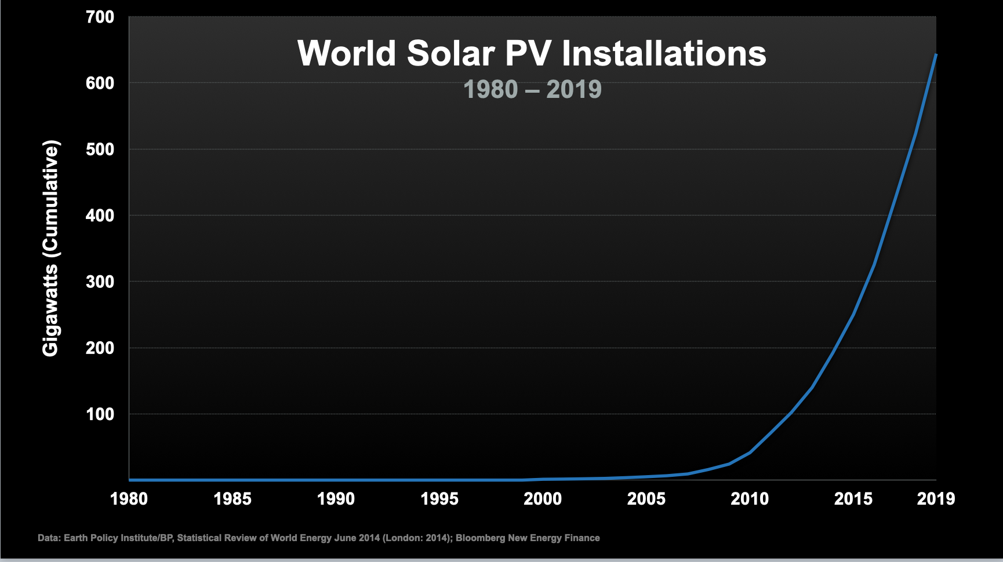
Notes:
Also the installation of solar panels is on a similar rise.
Al Gore showed an amazing chart from Chile that demonstrated growth that went right off the page.

Slide 38
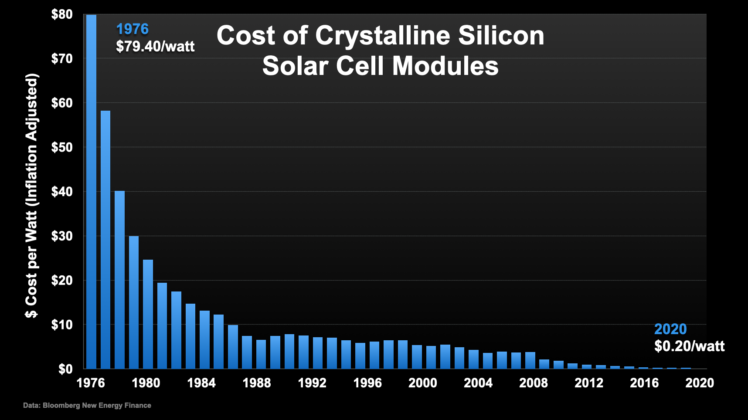
Notes:
The cost of solar is in a steady decline.
Solar panels will soon be cheaper than burning coal.

Slide 39
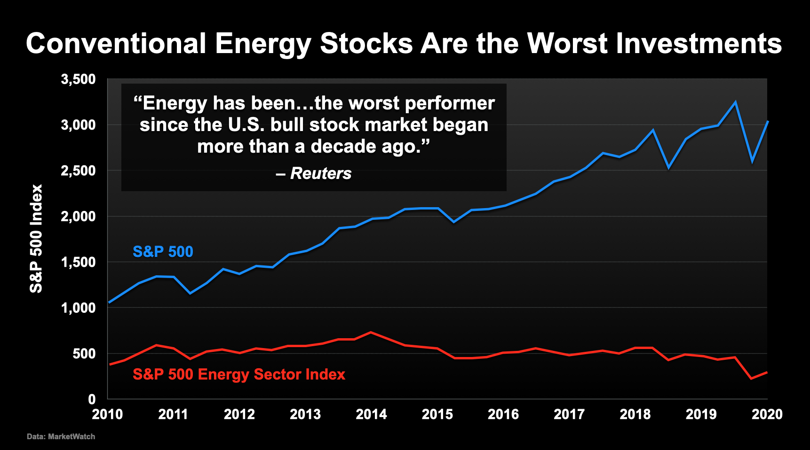
Notes:
And best of all, Wall Street is finally recognizing climate change.
Fossil fuel stocks shown in red have not grown at all in the past decade.
Oil companies have already started to write off billions of dollars for oil they will never pump and burn.
They even have a name for it.
Oil in the ground is called a “stranded asset.”
I bet that in fifteen years you won’t be able to buy a new care with an internal combustion engine anywhere on planet earth.
But electric cars will be readily available.

Slide 40
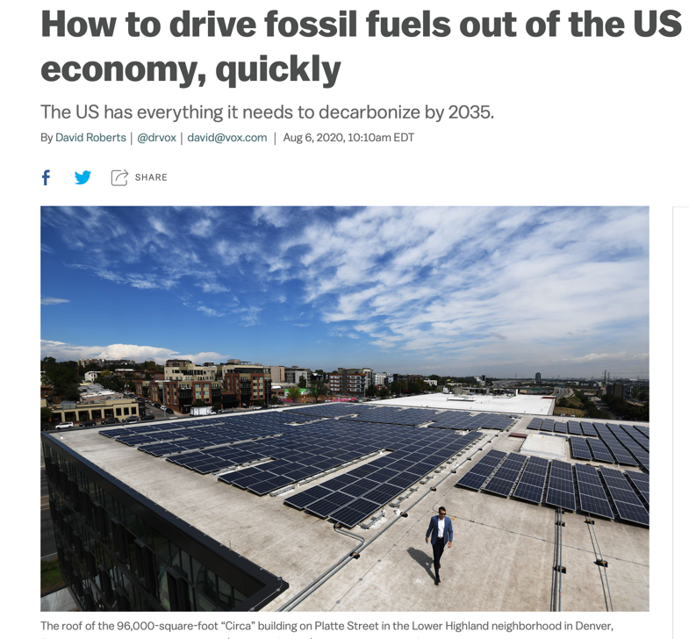
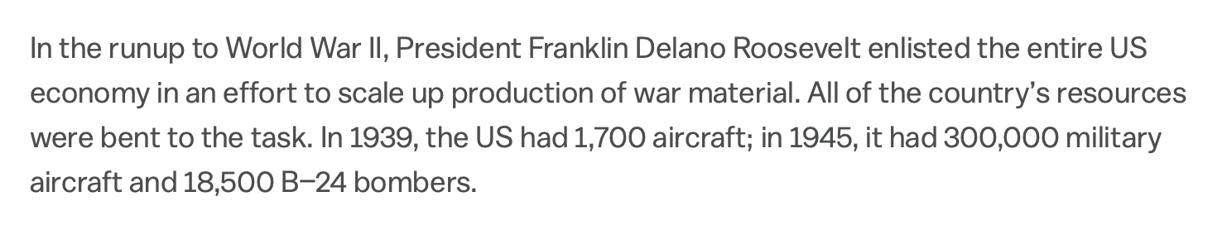
Source: https://www.vox.com/energy-and-environment/21349200/climate-change-fossil-fuels-rewiring-america-electrify
Notes:
Another optimistic approach is described in the book Rewiring America.
The authors basically argue that we need a WWII Arsenal of Democracy all-hands approach.
For example in 1939 the US had 1,700 aircraft: in 1945 we had 300,000 military aircraft and over 18,000 B-24 bombers.
So when the whole country gets involved, we can get a lot done.
If the entire nation focuses on building solar panels, batteries, windmills, heat pumps, and a smart grid, we can bend the curve.

Slide 41

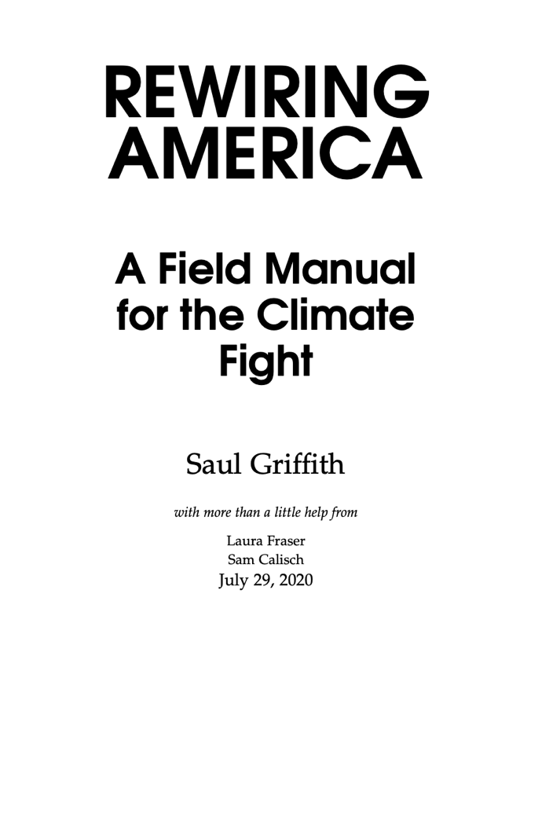
Notes:
The book is available as a free download. Just Google Rewiring America

Slide 42
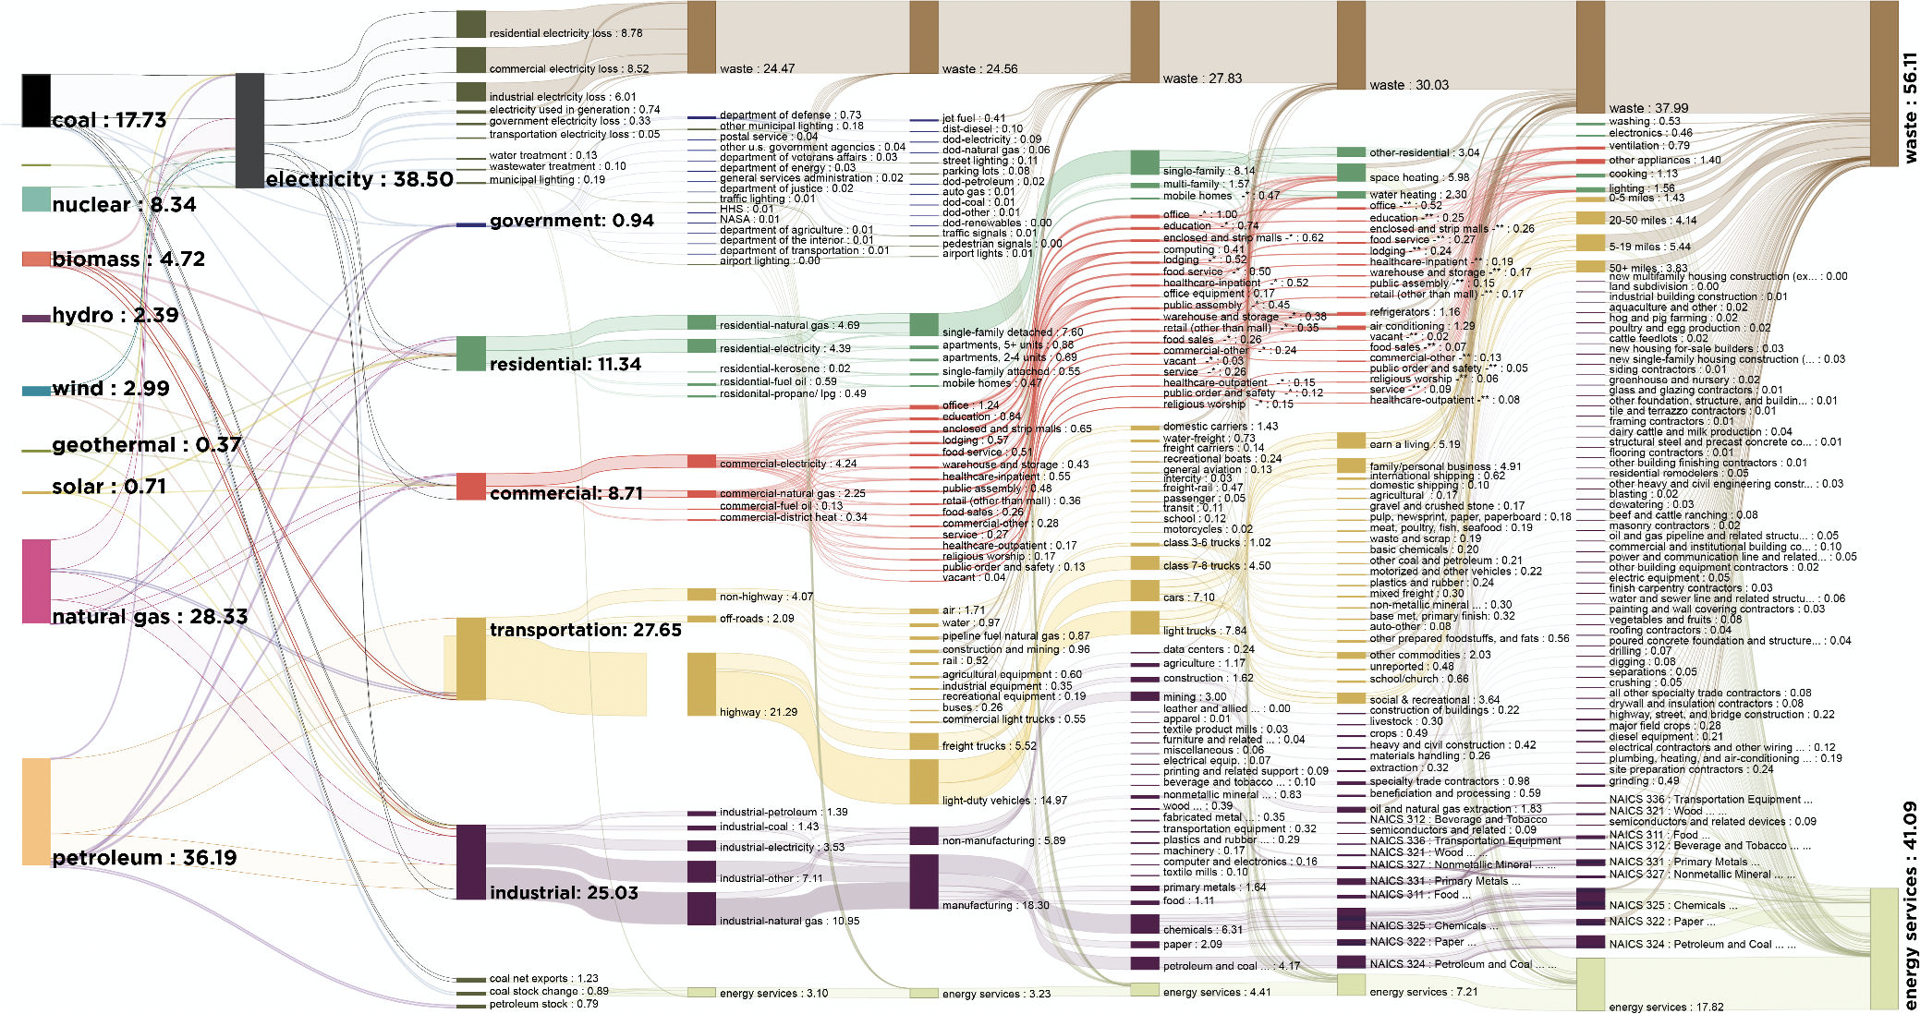
Notes:
The authors have mapped the entire energy usage of the United States.
By the way, almost half the energy is wasted.
For example, if you place your hand on the hood of your car and feel the engine heat – that’s wasted energy.
Internal combustion engines are very inefficient, especially compared to solar powered electric vehicles.

Slide 43
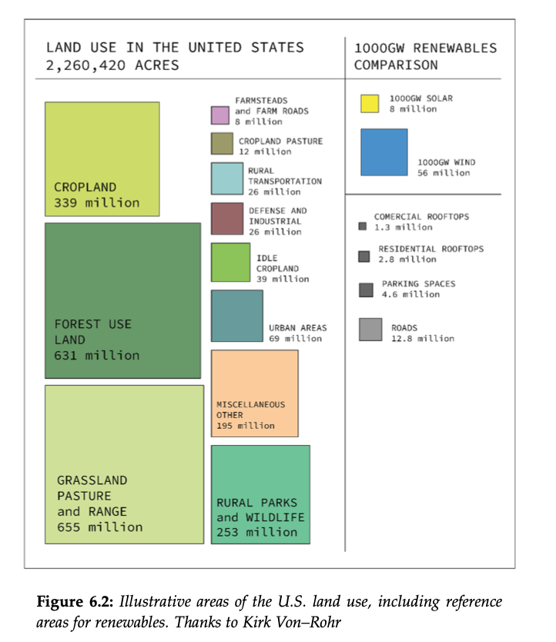
Notes:
The authors even calculate the amount of land that would be needed for windmills and solar panels.
We have enough land; we just need the will to use it.
And best of all…

Slide 44
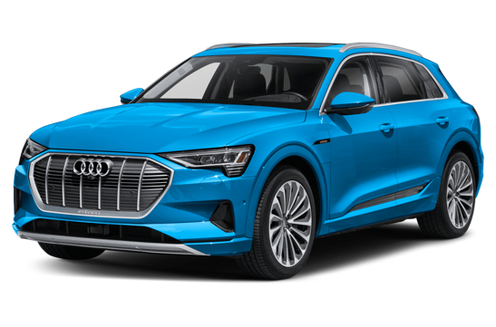
Notes:
A world of electric cars, powered by solar farms will be quiet.
No more constant drone of internal combustion engines.

Slide 45
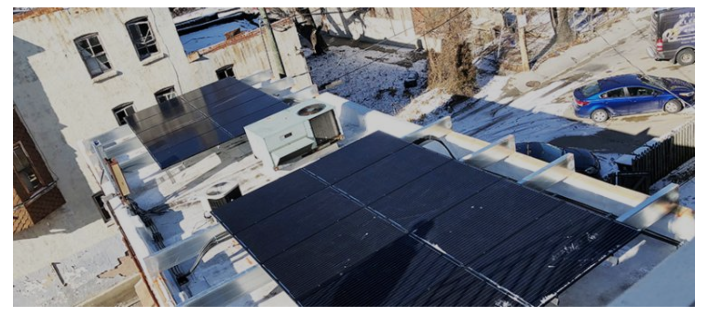
Source: https://civicworks.com/introducing-solar-installation-initiative-baltimore-city/
Notes:
Here is a rooftop solar panel on top of a Baltimore business.
It won’t be long until every building has rooftop solar panels.

Slide 46

A solar powered car.
Solar Panels
Home battery
https://www.tesla.com/solarpanels
Notes:
Soon we’ll see solar panels paired with large batteries.
To pay for it, the authors of Rewiring America say we should use tried and true financial instruments.
America can’t afford solar panels, batteries and heat pumps if they have to use credit cards with 12 to 15% interest rates.
But they can better afford 30-year low interest government-backed climate loans at 2 to 3%.

Slide 47
Agenda
Dr. W. Edwards Deming
Vulnerability Assessments
CO₂ Mitigation
GHG Reporting
Solar Panels
Taking Action
Good News
Notes:
So I hope I’ve given you food for thought and an interest in thinking about how you can add value to your company by learning to fight climate change. Thank you very much, I’ll now take questions.

