Slide 1

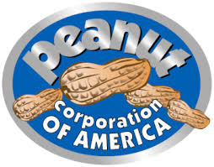
Food Safety in the US: Are we doing enough?
The Jack In the Box and Peanut Corporation of America case
By: Edwin Videla
Date: 3/12/2025
Notes:
Hi everybody , my name is Edwin Videla and today I’ll be talking about food safety using a couple of cases that have had deep impact on how food safety is managed in the US.
The jack in the box outbreak if 1993
The Peanut corporation America of 2009

Slide 2

Presenter
Edwin Videla
Pharmaceutical Chemist, University of Chile
MBA Project management University of Texas
Certified Food Safety and Quality Auditor (CFSQA)
15 years of experience in Quality control/assurance in Pharmaceutical and Food Industries
ASQ Section 0511 Northern Virginia member since 2023
Notes:
I’ll start by introducing myself, My name is Edwin Videla, I am a……….,
I have had the opportunity due to my work to audit several food manufacturing plants for pork processing, bakery items, frozen products, Ice Cream, olives and truffles.
This has made deeply aware of the need to manage food safety in a way that ensures safe products for consumers.

Slide 3
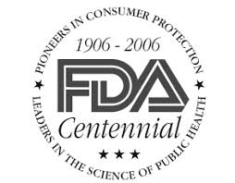
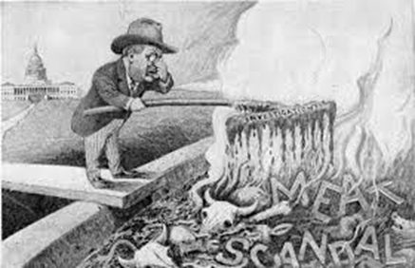
INTRODUCTION TO FOOD SAFETY IN THE US
1785 Massachusetts Act Against Selling Unwholesome Provisions
1862 -President Abraham Lincoln formed the U.S. Department of Agriculture (USDA) and appointed chemist Charles M. Wetherill to lead the Division of Chemistry, which would become the Bureau of Chemistry in 1901 and the Food and Drug Administration in 1906.
1906 – Pure Food and Drug Act & Meat Inspection Act
1938 – Federal Food, Drug, and Cosmetic (FD&C) Act
1958 – Food Additives Amendment & GRAS List
1969 – Creation of FDA’s Good Manufacturing Practices (GMPs)
1973 – First FDA Regulations on Low-Acid Canned Foods
Notes:
Food safety refers to the practices and measures taken to ensure that food is free from contaminants, safe to eat, and does not cause illness or harm. It involves handling, preparing, and storing food in ways that prevent foodborne diseases caused by bacteria, viruses, parasites, or chemical hazards.
The story of food safety starts a long time ago. In ancient Egypt and Babylon, food safety practices were influenced by religious and cultural beliefs. The Egyptians, for example, had strict rules about handling food, and priests were often in charge of food preparation. They believed that cleanliness was essential to avoid disease, a principle that is still relevant today. The famous Chinese book, “The Yellow Emperor’s Classic of Internal Medicine,” written around 3000 BC, contains detailed descriptions of food safety practices. It is believed that the first English food law – the Assize of Bread ­– was proclaimed by King John of England in 1202, prohibiting adulteration of bread with ingredients such as ground peas or beans. American colonists enacted a replica of the Assize of Bread regulation in 1646, and later passed the Massachusetts Act Against Selling Unwholesome Provisions in 1785, which is believed to be the first U.S. food safety law.
1862 United States Department of Agriculture (USDA) plays a crucial role in food safety, particularly in regulating and ensuring the safety of meat, poultry, and egg products.
In 1904, Upton Sinclair spent seven weeks gathering information while working incognito in the meatpacking plants of the Union Stock Yards in Chicago for the socialist newspaper Appeal to Reason, which published his novel in serial form in 1905. It Exposed contaminated and unsafe meat production practices. The novel “The jungle” was later published in book format by Doubleday in 1906.[2] It Exposed contaminated and unsafe meat production practices.
This trigger the enacting of the1906 Pure Food and Drug Act & Meat Inspection Act that created the Food and Drug Administration FDA
1938 The FDA itself exemplified the state of affairs in the marketplace by assembling a collection of products that illustrated shortcomings in the 1906 law. It included Banbar, a worthless "cure" for diabetes that the old law protected; Lash-Lure, an eyelash dye in which a number of women suffered injuries to their eyes, including one confirmed case of permanent blindness.; numerous examples of foods deceptively packaged or labeled; Radithor, a radium-containing tonic that sentenced users to a slow and painful death; and the Wilhide Exhaler, which falsely promised to cure tuberculosis and other pulmonary diseases. A reporter dubbed this exhibit "The American Chamber of Horrors," a title not far from the truth since all the products exhibited were legal under the existing law.
1958 Food Additives Amendment & GRAS List, establishes a list of ingredients that are safe for human consumption and a process for their evaluation
1969 GMPs are guidelines to ensure the environment in a manufacturing facility whether is food or drugs is clean, adequate for food production.
1973

Slide 4
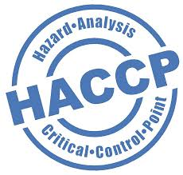
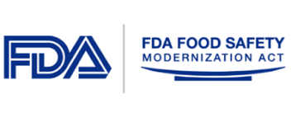
INTRODUCTION TO FOOD SAFETY IN THE US
1993 – Jack in the Box E. coli Outbreak
1994 – USDA Declares E. coli O157:H7 an Adulterant
1996 – USDA's Pathogen Reduction/HACCP Rule
2002 – Public Health Security and Bioterrorism Preparedness Act
2011 – Food Safety Modernization Act (FSMA)
2016 – Implementation of FSMA’s Foreign Supplier Verification Program (FSVP)
Notes:
1994 USDA Declares E. coli O157:H7 an Adulterant asa result of the Ajck on the box outbreak
1996 The rule requires establishments to: Develop and implement written sanitation procedures, Test for microbes, Meet Salmonella reduction performance standards, and Develop and implement a HACCP system.
2002 Directs the FDA to protect the food supply from terrorist attacks
2011 FSMA major regulatory change since 1938 with the approach of preventing hazards in food products rather than reacting to them
2016 The FSVP rule ensures food products imported in the US meet US regulation
Approximately 15% of the overall food supply in the United States is imported. This reliance varies significantly across different food categories. For instance, imports account for about 32% of fresh vegetables, 55% of fresh fruit, and 94% of seafood consumed in the U.S. These figures highlight the country's dependence on international sources for specific food items.​

Slide 5
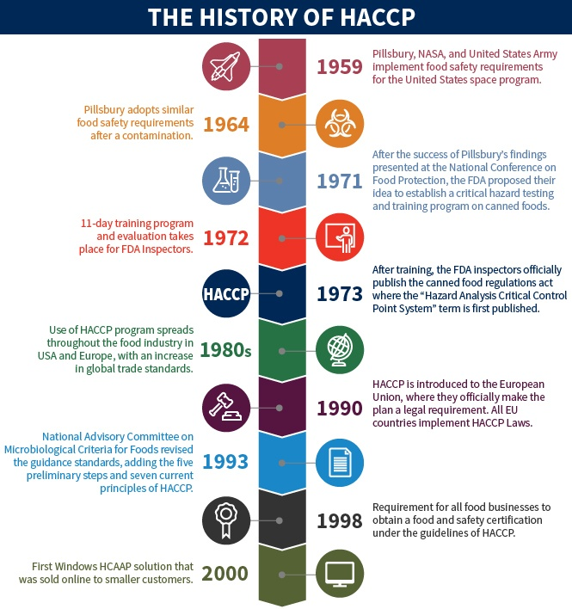
Hazard Analysis Critical Control Point
Notes:
HACCP (Hazard Analysis and Critical Control Points) is a systematic approach to food safety that identifies, evaluates, and controls hazards throughout the food production process. It focuses on preventing contamination rather than relying solely on end-product testing.
Until the 1960s all food safety was focused on reactive measures meaning by this testing product after this was manufactured. Then NASA and Pillsbury, a food manufacturer start working together to make food that could be used in by astronauts in the space program. You can understand dealing with astronauts in a close environment and with limited rations, the NASA program imposed strict pathogen limits on food. This required cumbersome testing procedures, which let little of the food produced pass pathogen control. So HACCP was created, as a method to control certain variables in the process to produce consistently safe food making it practical for commercial food production.
EU implemented haccp in 1990, the FDA adopted HACCP in 1995 for seafood, USDA made it its standard in 1996 for meat and poultry, and FDA adopted HACCP for juice products in 2001

Slide 6
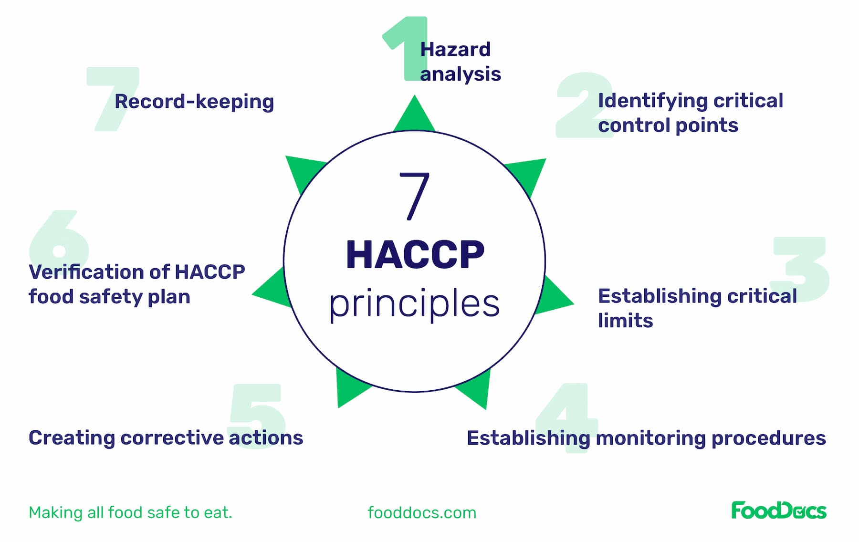
Hazard Analysis Critical Control Point
Notes:
The 7 HACCP principles ensure food safety by identifying and controlling hazards in food production
Hazard Analysis – Identify potential food safety hazards.
Critical Control Points (CCPs) – Pinpoint key steps where hazards can be controlled.
Critical Limits – Set safe limits (e.g., temperature, pH).
Monitoring – Regularly check CCPs to stay within limits.
Corrective Actions – Define steps to fix issues when limits are exceeded.
Verification – Test and confirm that the system is effective.
Record Keeping – Maintain documentation for compliance and tracking.

Slide 7
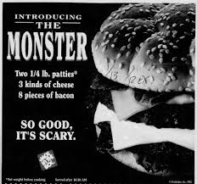
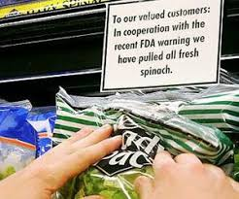
GROUNDBREAKING CASES OF FOOD SAFETY ISSUES IN THE US
Several major foodborne illness outbreaks in the U.S. have led to significant reforms in the food industry
The 1906 Meat Inspection Act and Pure Food and Drug Act: Unsanitary conditions in the meatpacking industry
The 1993 Jack in the Box E.coli Outbreak:
Pathogen: Escherichia coli O157:H7
Impact: 732 people became ill, 178 suffered permanent kidney and brain damage, and four children died
2006 Dole Spinach E. coli Outbreak
Pathogen: Escherichia coli O157:H7
Impact: 205 illnesses, 31 cases of hemolytic uremic syndrome, and three deaths.
Notes:
The following major foodborne illness outbreaks have had a significant impact in the US food safety regulations
1906 Meat Inspection Act and Pure Food and Drug Act
1993 The jack in the box case
The 2006 Dole Spinach E. coli O157:H7 outbreak was caused by contamination from cattle manure or wild animal feces in California’s Salinas Valley.

Slide 8
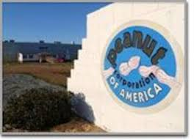
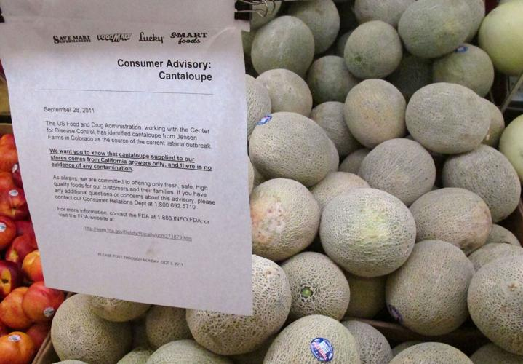
GROUNDBREAKING CASES OF FOOD SAFETY ISSUES IN THE US
The 2008-2009 Peanut Corporation of America Salmonella Outbreak
Pathogen: Salmonella Typhimurium
Impact: 714 illnesses, nine deaths, and one of the largest food recalls in U.S. history.
The 2011 Listeria Outbreak in Cantaloupes
Pathogen: Listeria monocytogenes
Impact: 147 illnesses, 33 deaths, and one miscarriage, making it one of the deadliest foodborne illness outbreaks in U.S. history.
The 2018 Romaine Lettuce E. coli Outbreak
Pathogen: Escherichia coli O157:H7
Impact: 210 illnesses, 96 hospitalizations, and five deaths.
Notes:
The 2011 Listeria outbreak in cantaloupes, linked to Jensen Farms in Colorado, was caused by unsanitary packing facility conditions and improper equipment cleaning procedures.
The 2018 romaine lettuce E. coli O157:H7 outbreak was caused by contaminated irrigation water from an agricultural water reservoir in the Yuma, Arizona growing region.
In my next slides I’ll focus on 2 of the cases mentioned as they have the biggest impact on food safety regulations.

Slide 9

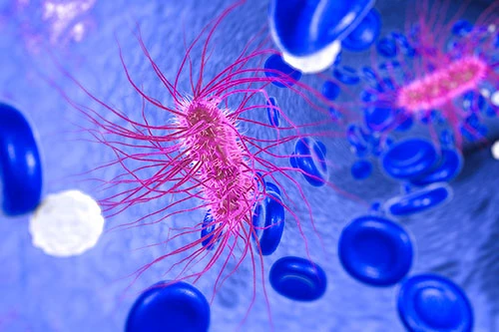
JACK IN THE BOX-BACKGROUND
The 1993 Jack in the Box E.coli Outbreak:
Pathogen: Escherichia coli O157:H7
Location: Western U.S. (Washington, California, Nevada, Idaho)
Impact:
732 people became ill
178 suffered severe complications (kidney failure, brain damage)
4 children died
Notes:
Lets talk about jack in the box outbreak of 1993
What is jack in the box? Jack in the Box is an American fast-food restaurant chain, best known for its burgers, tacos, and late-night menu. Founded in 1951 in San Diego, California, the chain has grown to over 2,000 locations, primarily on the West Coast and Southwest of the U.S.
What is Escherichia coli O157:H7? is a Shiga toxin-producing E. coli (STEC) strain that can cause severe foodborne illness in humans. It is one of the most dangerous E. coli strains due to its ability to cause hemolytic uremic syndrome (HUS), which can lead to kidney failure, especially in young children, the elderly, and immunocompromised individuals.

Slide 10
JACK IN THE BOX-BACKGROUND
Detection Timeline:
Early January 1993 – Doctors in Seattle reported several cases of severe foodborne illness, particularly among children, with symptoms of bloody diarrhea and kidney failure.
Washington State Health Department Investigation – Officials analyzed patient interviews and found a common factor: many had recently eaten hamburgers from Jack in the Box
Laboratory Confirmation – Stool samples confirmed the presence of E. coli O157:H7, a dangerous strain of bacteria.
Expanding the Investigation – As reports of illness spread to California, Nevada, and Idaho, public health officials traced the contaminated meat back to a California slaughterhouse that had supplied beef to Jack in the Box.
Notes:
January 12, 1993 – Seattle Children's Hospital reported four cases of HUS.
January 13–15, 1993 – More cases emerged, prompting the Washington State Health Department to launch an official foodborne illness investigation.
January 16, 1993 – Epidemiologists linked the illnesses to undercooked hamburgers from Jack in the Box.
January 18, 1993 – The health department issued a warning about eating undercooked ground beef, leading to the largest recall of beef in U.S. history at the time (more than 250,000 pounds).

Slide 11
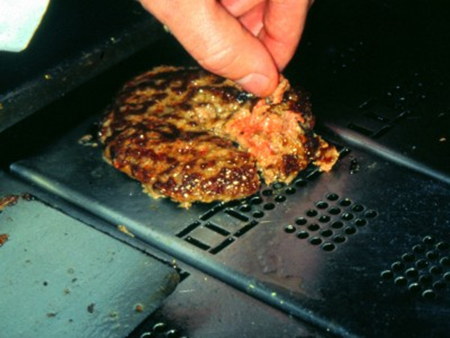
JACK IN THE BOX-ROOT CAUSE ANALYSIS
Key Takeaways from the Root Cause Analysis:
✅ The beef supply chain was contaminated before it reached restaurants.
✅ Jack in the Box used an outdated cooking temperature, failing to kill E. coli.
The outbreak was linked to a failure to cook beef to the USDA-recommended temperature (155°F), as the company followed an outdated standard (140°F).
✅ Regulations did not require beef suppliers to test for E. coli O157:H7.
Undercooked hamburgers contaminated with E. coli O157:H7 were served at Jack in the Box locations.
✅ Weak food safety policies and lack of training contributed to the outbreak.

Slide 12
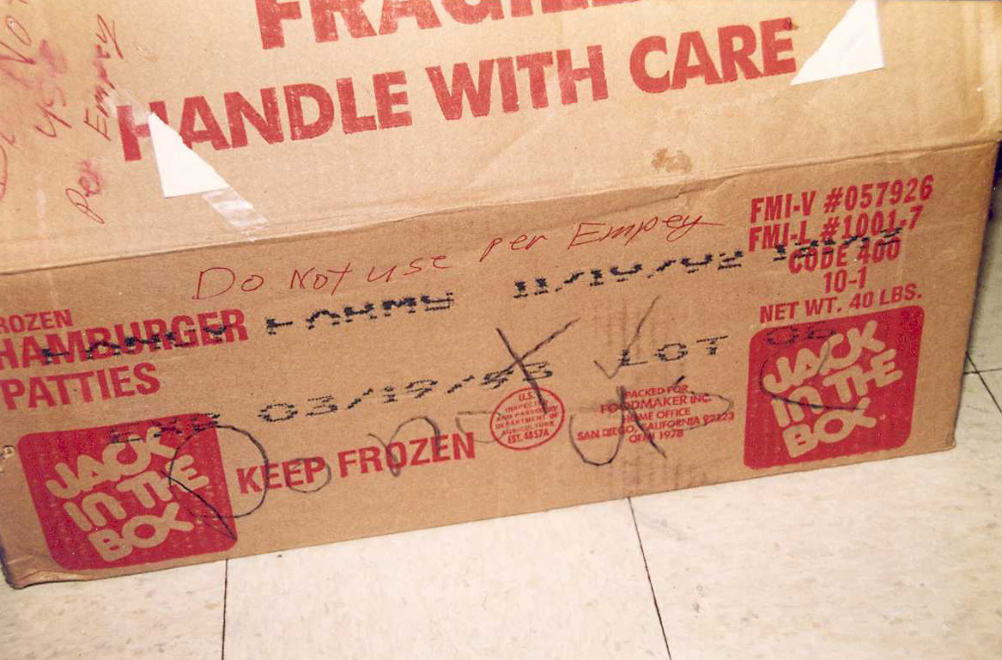
JACK IN THE BOX-IMMEDIATE RESPONSE AND RECALL EXECUTION
Public Response:
By late January, Jack in the Box issued a recall of all contaminated beef.
The outbreak received nationwide media attention, putting pressure on the USDA to tighten food safety regulations.
Jack in the Box recalled approximately 272,000 pounds of ground beef after the 1993 E. coli O157:H7 outbreak was traced back to contaminated meat supplied to its restaurants.
Notes:
The contaminated beef patties in the 1993 Jack in the Box E. coli O157:H7 outbreak were supplied by Von’s Companies Inc., a California-based meat supplier.
Von’s meat processing division was likely phased out between 1993 and 1997, with full closure occurring by the time Safeway took over in 1997.After the Safeway acquisition, Von’s no longer processed its own meat but instead relied on Safeway’s and later Albertsons' meat supply chain.

Slide 13

JACK IN THE BOX-IMMEDIATE RESPONSE AND RECALL EXECUTION
The recall was one of the largest in U.S. history at the time and affected restaurants in four states: Washington, California, Nevada, and Idaho.
The 1993 E. coli outbreak nearly destroyed Jack in the Box, but it also forced the company and the entire fast-food industry to prioritize food safety. Today, it is recognized as a leader in food safety standards, having learned from its past failures.
Notes:
Middle:
Jack in the Box accepted responsibility, unlike many companies that deny wrongdoing.
It settled lawsuits with victims’ families and paid over $50 million in damages.
Worked with government agencies to shape new food safety policies.

Slide 14
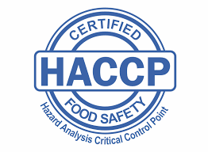
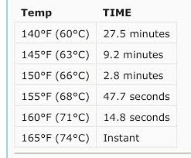
JACK IN THE BOX-LESSONS LEARNED AND INDUSTRY IMPACT
USDA declared E. coli O157:H7 an adulterant in ground beef.
Led to mandatory HACCP (Hazard Analysis and Critical Control Points) systems in meat and poultry plants.
Strengthened food safety protocols and consumer awareness about cooking temperatures. The Food and Drug Administration (FDA) increased the recommended internal temperature for cooked hamburgers from 140°F to 155°F.
Notes:
Mandatory HACCP Plans for Meat, Poultry, & Egg Processors
Implementation of HACCP's 7 Principles
3. Pathogen Reduction & Microbial Testing
4. Sanitation Standard Operating Procedures (SSOPs)
5. USDA Enforcement & Inspections

Slide 15
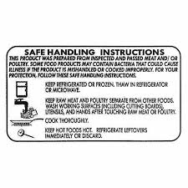
JACK IN THE BOX-LESSONS LEARNED AND INDUSTRY IMPACT
The USDA's Food Safety and Inspection Service (FSIS) introduced safe food-handling labels for packaged raw meat and poultry retailed in supermarkets.
The FSIS introduced testing for E. coli O157:H7 in ground meat.
The Jack in the Box recall was one of the most significant food recalls in U.S. history, demonstrating the importance of rapid response, clear communication, and stronger food safety policies to prevent future outbreaks.

Slide 16
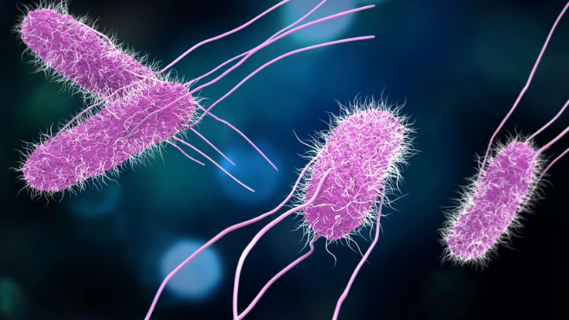

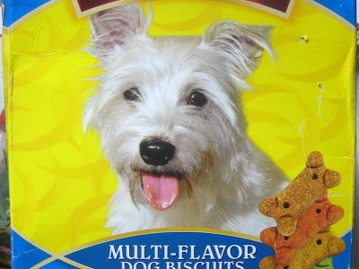
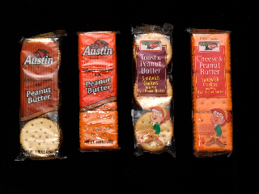
PEANUT CORPORATION OF AMERICA-BACKGROUND
The 2008-2009 Peanut Corporation of America Salmonella Outbreak
Pathogen: Salmonella Typhimurium
Location: Nationwide (U.S.)
Impact:714 confirmed illnesses across 46 states
9 deaths
Massive recall of over 3,900 peanut-containing products from major brands like Kellogg’s and Nestlé
Notes:
Who is PCA?
Founded: 1977Headquarters: Lynchburg, Virginia
Operations: Processed and sold peanut butter and peanut paste used in various food products.
Main Customers: Sold to food manufacturers, schools, and institutions, but not directly to consumers.
What is salmonella typhirium?
Salmonella Typhimurium is one of the most common and dangerous serotypes of Salmonella, causing major foodborne outbreaks. Due to its ability to spread through various foods and its resistance to antibiotics, it remains a major public health concern.
Salmonellosis
Diarrhea (sometimes bloody)✅ Fever✅ Abdominal cramps✅ Nausea and vomiting✅ Dehydration (severe cases)

Slide 17
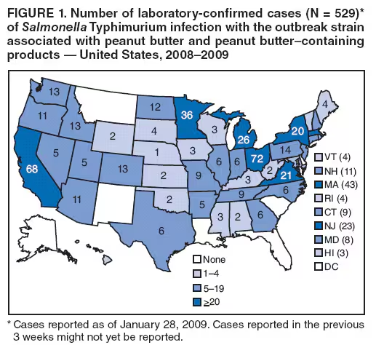
PEANUT CORPORATION OF AMERICA-BACKGROUND
In late 2008, health officials noticed a rise in Salmonella Typhimurium infections nationwide.
Typical symptoms include: Diarrhea (sometimes bloody), abdominal cramps, nausea, vomiting, Fever, chills, headache, muscle aches, fatigue
Epidemiologists traced the outbreak to peanut butter and peanut paste used in processed foods (e.g., crackers, granola bars, pet treats).
The CDC and FDA linked the contamination to PCA’s processing facilities, leading to an urgent recall.
Notes:
Step-by-Step Investigation: How PCA Was Identified
1. Identifying the Outbreak Pattern
Fall 2008 to early 2009: The CDC noticed an unusual spike in Salmonella Typhimurium cases across multiple states.
PulseNet, a national foodborne illness surveillance system, detected that all cases were caused by the same genetic strain of Salmonella Typhimurium, meaning they came from a common contaminated source.
2. Epidemiological Interviews
Investigators conducted detailed interviews with infected individuals, asking about their food consumption history.
A common trend emerged: Many people had eaten processed foods containing peanut butter or peanut paste before getting sick.
Unlike previous Salmonella outbreaks linked to raw peanuts, this one involved processed peanut products, meaning contamination likely occurred after processing.
3. Traceback Investigation
Investigators traced the peanut butter and peanut paste ingredients used in contaminated foods back to their suppliers.
The common link across different brands was Peanut Corporation of America (PCA), which supplied peanut ingredients to over 200 companies.
PCA's Blakely, Georgia plant was identified as the primary contamination source.
4. Laboratory Confirmation: Matching Salmonella Strains
FDA and state health departments collected samples from PCA’s Blakely facility.
Tests found Salmonella Typhimurium in peanut butter and paste, matching the exact strain found in sick patients.
Environmental swabs from the facility also tested positive for Salmonella, confirming unsanitary conditions.

Slide 18
PEANUT CORPORATION OF AMERICA-ROOT CAUSE ANALYSIS
The Peanut Corporation of America (PCA) knowingly shipped contaminated peanut products from its Georgia and Texas processing plants.
Investigators found unsanitary conditions, including:
Roaches, mold, and leaking roofs
Salmonella-contaminated equipment
Evidence that PCA falsified lab test results, shipping products even after Salmonella was detected.
Notes:
Read
5. Linking PCA’s Role in the Outbreak
Further investigation revealed PCA knowingly shipped contaminated peanut products.
Emails and company records showed PCA had received positive Salmonella test results but still shipped the products.
Conclusion
Through epidemiological interviews, traceback analysis, and lab testing, investigators directly linked the outbreak to PCA’s contaminated peanut products.

Slide 19
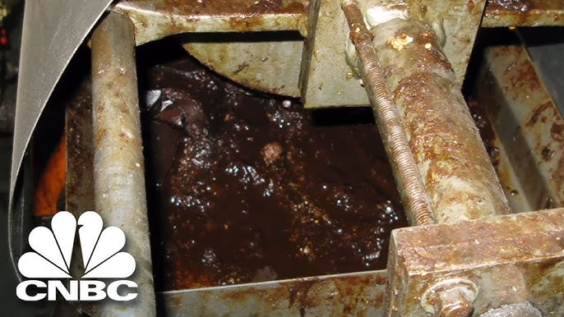
PEANUT CORPORATION OF AMERICA-ROOT CAUSE ANALYSIS
https://youtu.be/87dkTVH-qRg?si=ff-H9TaryvUZBqKY
Notes:
This is a video that shows the extent of the contamination at a PCA plant
As you can see there were many deficiencies that made possible product contamination

Slide 20
PEANUT CORPORATION OF AMERICA-IMMEDIATE RESPONSE AND RECALL EXECUTION
1. Initial Denial & Continued Operations
PCA continued shipping products even after internal tests showed Salmonella contamination.
Internal emails later revealed that PCA’s CEO, Stewart Parnell, ordered shipments despite positive Salmonella tests, saying: “Just ship it.“
2. Product Recalls (January 2009)
Under FDA pressure, PCA issued a limited recall of peanut butter and peanut paste in early January 2009.
As more illnesses were linked to PCA products, the recall expanded to over 3,900 products from major brands like Kellogg’s, Nestlé, and General Mills.
Notes:
So what were the immediate responses from PCA when first cases appear
FDA initiates a recall affecting over 3900 products
PCA denies wrongdoing however the investigation shows:

Slide 21
PEANUT CORPORATION OF AMERICA-IMMEDIATE RESPONSE AND RECALL EXECUTION
3. FDA Investigation & Shutdown
The FDA inspected PCA’s Georgia plant and found:
Unsanitary conditions (mold, rat droppings, leaky roof).
Records of falsified lab results—PCA had knowingly shipped contaminated products.
FDA doesn’t even know of Plainview Texas.
PCA shut down operations in early 2009 and filed for bankruptcy by February.
4. Legal & Public Backlash
As evidence of criminal negligence emerged, PCA’s CEO and executives faced criminal charges.
Stewart Parnell was sentenced to 28 years in prison, the harshest food safety-related sentence in U.S. history.
Notes:
this outbreak led to the company’s shutdown,
executive convictions,
.

Slide 22
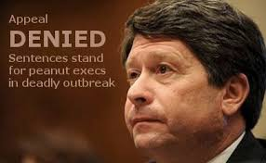
PEANUT CORPORATION OF AMERICA-LESSONS LEARNED AND INDUSTRY IMPACT
✅ Largest peanut product recall in U.S. history (over 3,900 products).
✅ Peanut Corporation of America shut down and filed for bankruptcy.
✅ PCA’s executives were criminally prosecuted—CEO Stewart Parnell was sentenced to 28 years in prison for knowingly selling tainted food.
✅ Led to the Food Safety Modernization Act (FSMA) in 2011, giving the FDA more power to prevent foodborne illnesses rather than just reacting to them.
Notes:
This was the largest peanut recall in US history as it affected over 3900 products that contained peanut butter and peanut paste, major brands included Kellogg’s, General Mills, Ritz, Jenny Craig and products such as crackers, snacks, candy, chocolates, Ice cream, protein bars and even pet food
PCA shuts down and files for bankruptcy
Some of major effects this outbreak had in the food industry were major food safety reforms, including stricter oversight under the FDA Food Safety Modernization Act (FSMA).

Slide 23
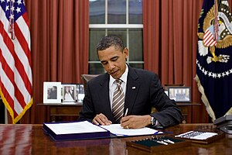
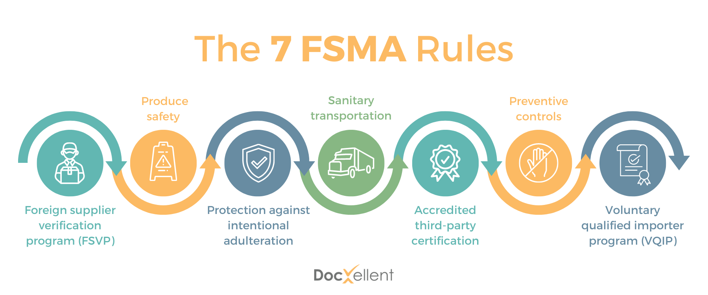
CONCLUSIONS
FSMA Food Safety Modernization Act signed into law on January 4, 2011
Notes:
These two cases show how regulation and entities like the FDA and USDA have become key in US History to keep American safe of foodborne illnesses.
One of the most important revolutions in Food safety in recent years has been the implementation of FSMA that took a new approach to food safety by focusing on preventing rather than testing for hazards
Talk about each point
1.-FSVP requires U.S. importers to ensure that food products brought into the U.S. from foreign suppliers meet U.S. food safety standards. FSVP shifts the focus from reaction to prevention, ensuring imported food is as safe as domestic food.
2.-The Produce Safety Rule under FSMA sets science-based standards for growing, harvesting, packing, and holding fruits and vegetables to reduce the risk of contamination.
3.-The Protection Against Intentional Adulteration Rule under FSMA requires food facilities to implement risk-based strategies to prevent intentional contamination aimed at causing public harm.
4.-The Sanitary Transportation Rule under FSMA establishes requirements for safe transportation of food to prevent contamination.
5.-The Accredited Third-Party Certification Rule under FSMA establishes a program where FDA-recognized third-party auditors can certify foreign food facilities meet U.S. safety standards. This certification helps expedite imports and ensure compliance with FDA regulations.
6.-The Preventive Controls Rule under FSMA requires food facilities to implement risk-based preventive controls to prevent contamination.
7.-The Voluntary Qualified Importer Program (VQIP) Rule under FSMA offers expedited FDA review and entry for food imports from reliable foreign suppliers. Importers must meet strict safety and compliance standards, including third-party certification of their supply chain.

Slide 24
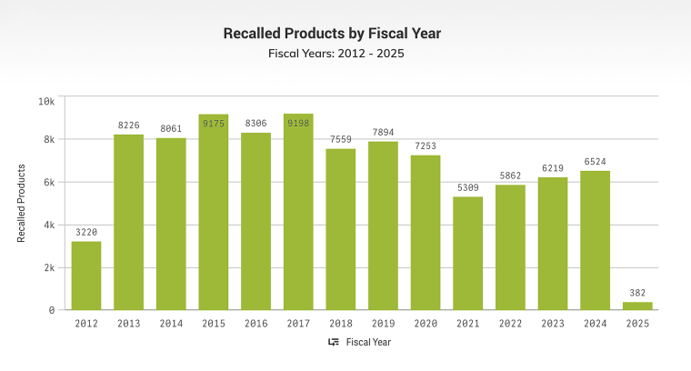
Conclusions
Impact of FSMA on Food Safety:
Decrease in Recalls: Many food recalls are now caught before products reach consumers due to better preventive measures.
Better Supply Chain Oversight: Companies must document safety measures, increasing accountability.
Fewer Outbreaks: Some foodborne illness outbreaks (e.g., Listeria and Salmonella) have decreased due to stricter controls.
However, challenges remain, such as enforcement gaps, small business compliance costs, and emerging food safety risks.
Notes:
I’ll dive a little deeper on the challenges on the next page.

Slide 25
Future Challenges
Key challenges of FSMA:
Complexity and Understanding:
The intricate nature of FSMA regulations can be difficult for smaller food producers to navigate, leading to confusion about which rules apply to them and how to comply effectively.
Cost of Compliance:
Implementing necessary changes to meet FSMA standards can be costly for businesses, particularly for smaller operations, requiring investments in new equipment, training, and record-keeping systems.
Limited Enforcement Capacity:
The FDA may struggle to adequately monitor and enforce compliance across all food producers due to resource constraints, particularly for smaller businesses with less oversight.

Slide 26
Future Challenges
International Challenges:
Ensuring compliance for imported foods can be complex, requiring robust verification systems and collaboration with foreign regulatory agencies.
Traceability Issues:
Implementing effective traceability systems to rapidly identify and remove contaminated products can be challenging, especially for complex food supply chains.
Small Business Exemptions:
While some small businesses may be exempt from certain FSMA rules, this can still create confusion regarding compliance requirements and potential risks.

Slide 27
Q&A
Thank you

Slide 28
Relevant Links
The International Outbreak Museum
https://www.outbreakmuseum.com/salmonella/peanut-corporation-of-america-pca/
https://www.today.com/health/recall/food-recalls-2024-rcna177622

