Slide 1

ASQ Section 0511 Northen Virginia March 2026 Section Meeting
Last updated 2026MAR11 Guoling Chen
Host: Guoling Chen, Section Chair 2026
Chat & Attendance Monitor: Jeff Parnes, Past Chair, Vice Treasurer, Webmaster, Electronic Media and Videography Chairs 2026
Committees' updates:
Ken Rapuano, Programs Chair (2 pages)
Edwin Videla, Arrangements Chair and Ranger Outing Lead (2 pages)
Tonight’s Program:
Ken Rapuano, Programs Chair (2 pages)

Slide 2
Reminders
Please sign in with your full name for RU issuance. If you did not, please send us your full name in the chat.
ASQ 0511’s Section Leadership Meeting is on the 2nd Wednesday of each month, 6 to 7pm. Section Members are also welcomed to join!
Section Member Meeting is on the 2nd Wednesday of each month, 7 to 8:30pm, UNLESS there’s a ranger outing that month.

Slide 3
Agenda (11 MAR 2026) 0.15 RU
Section Business (7:00 to 7:30pm)
2026 SLC Officers, Call For Volunteers
ASQ 0511 RU Offerings
Programs Schedule
Feb & May 2026 Ranger Outings
Tonight’s Program (7:30 to 8:30pm)
What Does Trust Have to do with Leadership?

Slide 4
1. Introduction to 2026 SLC Officers, Call for Volunteers
Guoling Chen,
Section Chair
________________________

Slide 5

Section Leadership Committee (SLC)
ASQ 0511 is governed by elected officers and appointed committee chairs.
The officers are elected annually in the previous year and serve from 01/01 thru 12/31 of the following year.
Committee chairs are appointed as vacancies occur or as the need arises.
Volunteering in SLC can earn RU 1.5/year (prorated if less than a year)
Ad-hoc volunteering RU values depending on the project

Slide 6
2026 Section Leadership Committee (SLC)
Guoling Chen: Chair
Larry Hunt: Chair Elect
Jeff Parnes: Past Chair, Vice Treasurer, Electronic Media, Videography, Webmaster
Jeff Cadel: Secretary
Jo Collins: Vice Secretary (till 3/31/2026), Compliance Chair
Muzaffar Zaffar: Treasurer, Education, Recertification Chairs
Ken Rapuano: Programs Chair
Edwin Videla: Arrangements Chair and Ranger Outing Lead
Cyndi Reichardt: Database Administrator
Leslie Braun: Membership Chair, Finance Chair, Welcome Committee
Sara McAlpine: Welcome Chair
Barbara McCullough: Nominations Chair
Maria Habib: Process Improvement Chair
Vladimir Nesterovich: Strategy Chair

Slide 7
Call for Volunteers
Vacant: Voice of Customer, Audit, Placements, Historian; Vice Secretary (from 4/1/2026);
Help needed heavily for:
Pre- & post-event marketing & communications,
Ranger outing logistics and on-site support,
Programs assistance,
Member welcoming and engagement,
Action item follow up and execution,
Maintaining electronic platforms (e.g. myASQ),
Procedure creation/revision

Slide 8
2. ASQ 0511 RU Offerings
Guoling Chen,
Section Chair
Acknowledgement: Muzaffar Zaffar, Education and Recertification Chairs
________________________

Slide 9
Recertification – 18 RUs in 3 Years
Case 1: Full Time Employed
Employment: 0.3 RU / month → 10.8 RUs / 3 Years
→ need 7.2 RUs from other resources.
Case 2: Part time Employed
Employment: 0.15 RU/ month → 5.4 RUs / 3 Years
→ need 12.6 RUs from other resources
Case 3: Retired
→ Need 18 RUs from various resources.
ASQ Section 0511 offers up to 6 RUs per years from various activities

Slide 10
ASQ 0511 Unique RU Offerings
Ranger Outing (RO):
In-person educational event. Guided Tour (0.15 RU) to an industry
of impact or places of historical relevance in the DMV area.
Optional Networking lunch for add-on 0.1 RU.
Optional Preparatory Review (OPR) for RO or Webinar Events:
Educational material review, Documents or Videos;
Certification statement during registration in Memberplanet and/or
Paper Sign-in Sheet;
30 mins for 0.05 RU increment; currently up to 0.15 RU;
Be willing to use your knowledge of the OPR during the Event;
Must attend the main Event to receive this add-on RU.

Slide 11
ASQ 0511 Typical RU Offerings in a Year
Ranger Outing:
0.15 RU (Guided Tour) + 0.1 RU (Networking Lunch)
+ 0.05 to 0.15 RU (OPR) = Up to 0.4 RU each x 4 = 1.6 RU
Monthly Member Meeting (2nd Wed 7pm, 1.5 hr, non-RO month)
0.15 RU x 8 = 1.2 RU
Monthly SLC Meeting (2nd Wed 6pm, 1 hr)
0.1 RU x 12 = 1.2 RU
Paid ASQ member 0.5 RU / year = 0.5 RU
Volunteer in SLC (12 months): 1.5 RU
Total = 6 RU / Year
6 RU x 3 years = 18 RUs for Recertification!
NEW this month: OPR 0.05 RU

Slide 12

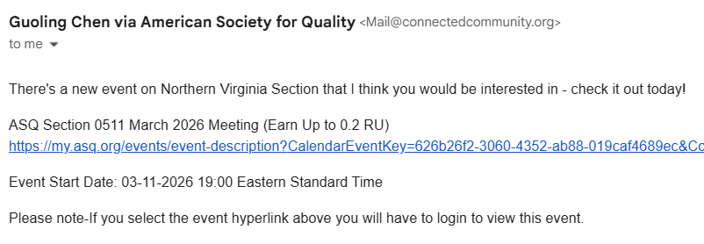
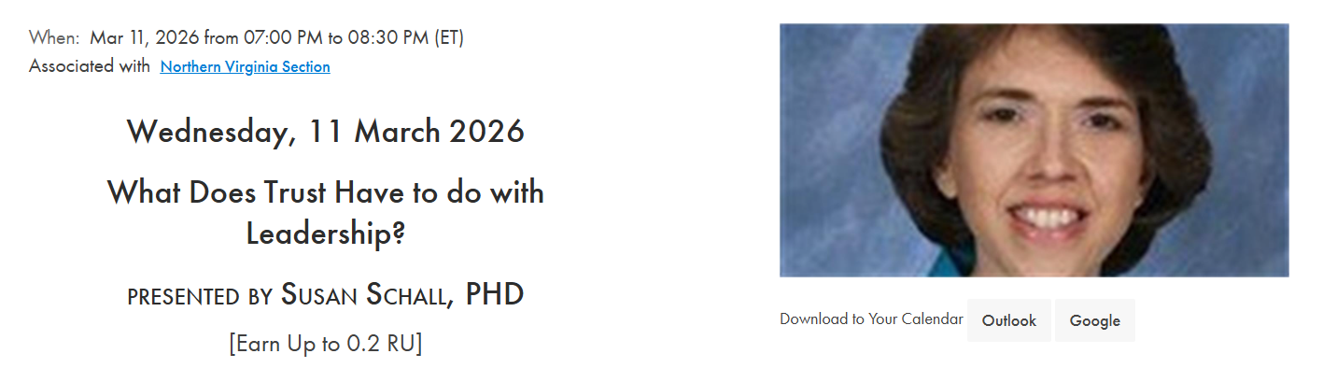
Check out Upcoming Events: Invitation Email; myASQ “Events” tab - Visible to the General Public

Slide 13

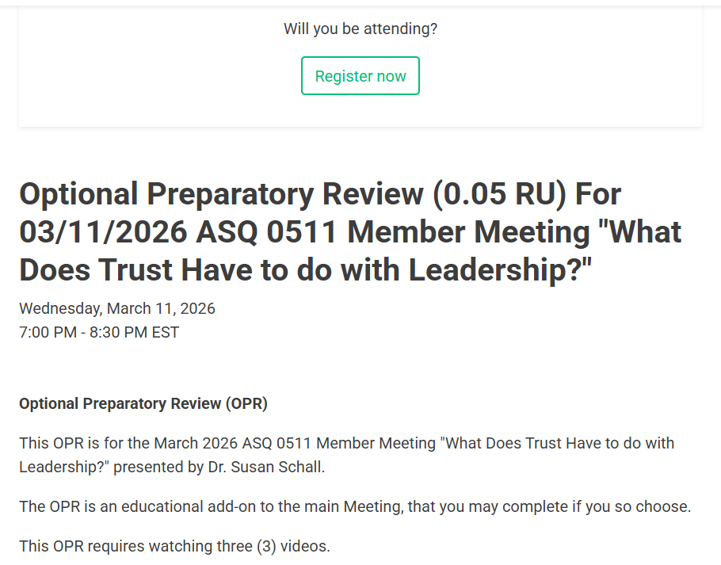
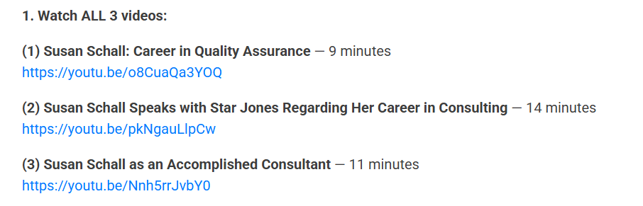
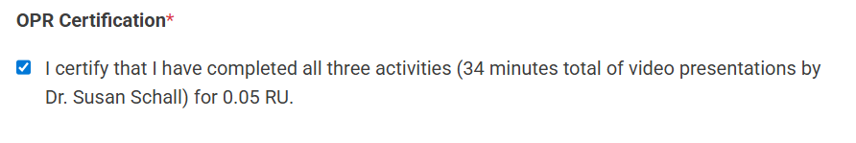
OPR Certification in Memberplanet

Slide 14
3. Programs Schedule
Ken Rapuano,
Programs Chair
________________________

Slide 15
Upcoming Programs
Schedule of the upcoming programs in 2026
January – Path to Quality: Vladimir, Barbara, and Ken (moderators)
February – Ranger Outing (Port City Brewery)
March – “What Does Trust Have to do with Leadership?” Susan Schall
April – Logistics of Emergency Room Operations, Andrew Meisler
May – Ranger Outing (Green Spring Garden, reschedule from 10/25)
June – Quality Compliance in Biotech/Pharmaceutical, Jo Collins
July – Ranger Outing (Indoor, TBD)
August – [Tentative] Jeff P’s Recruit
September/October – Ranger Outing (Outdoor, TBD)/”Updates to ISO 9001”
November – “Ranger Outings, A Year in Review”
December – TBD, Chair’s Report or Path to Quality
Pg1 of 4 Ken. R

Slide 16
Upcoming Programs Available
We have a full year for 2026!
Do you want to present a program, but are stuck for ideas? The Section has a variety of options.
Moderate a Round Table using the Questions-on-Questions format Vladimir developed
Present a Case Study on a quality disaster that made the news; Jeff Parnes has presented 2 and Edwin included several in his talk on food safety.
Present a background on any technical or industry divisions that you are a member of through ASQ (such as Audit, Automotive, Finance) … preferably as a two-parter with your own perspective as a quality professional in that field.
Pg2 of 4 Ken. R

Slide 17
4. February and May 2026
Ranger Outings
Edwin Videla,
Arrangements Chair &
Ranger Outing Lead
______________________

Slide 18
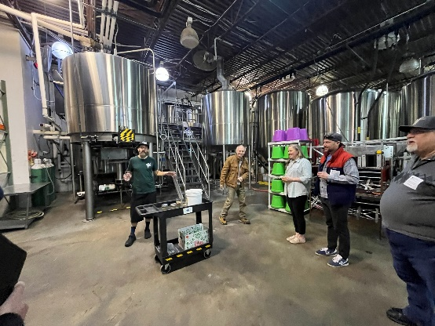
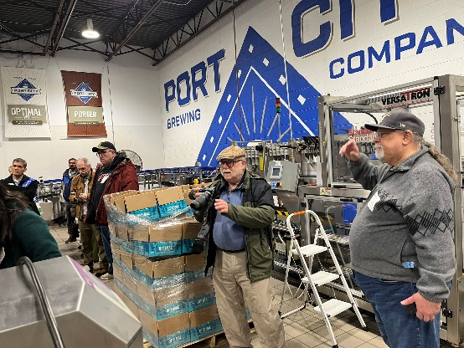
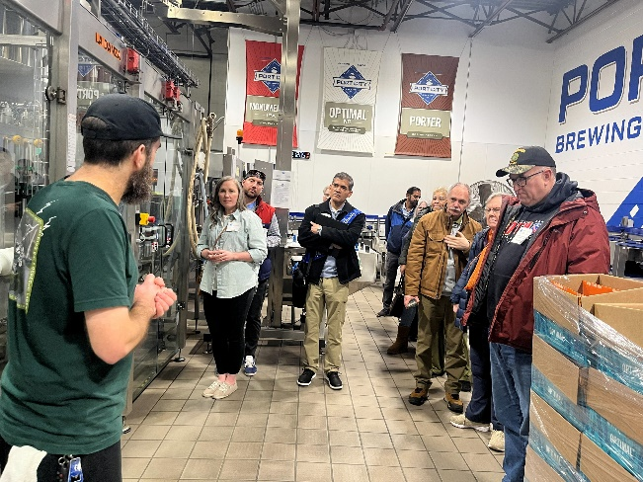
Ranger Outing February 21, 2026 Port City Brewing Company
The Logistics
Event started at 11A.M.
Our Guide and Brewmaster was Justin Fox
15 participants out of 25 max
What we learned
How the brewery started
The main ingredients: water, malted grains, hops, yeast
The brewing process
The equipment
Fermentation and yeast behavior
Beer styles and the best tasting it
Improvement Opportunities
Marketing
Earlier announcement and reminders
Target audience
Pg1 of 2 Edwin V.

Slide 19


Next Ranger Outing: May 2026 Green Spring Gardens
Step Into History and Bloom at Green Spring Gardens!
Join us on Saturday, May 16 at 11:00 AM for a visit to the stunning Green Spring Gardens in Alexandria, VA. Explore beautiful themed gardens, peaceful ponds, seasonal blooms, and a historic 1784 manor house — all in one unforgettable setting.
Whether you love nature, history, or simply a beautiful day out, this is a visit you won’t want to miss!
Location: 4603 Green Spring Rd, Alexandria, VA 22312
Pg2 of 2 Edwin V.

Slide 20
Section Program
________________________

Slide 21
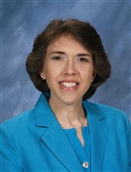
Section 0511 Program for March 2026:
What Does Trust Have to do with Leadership?
Presented by Dr. Susan Schall, Founder and Lead Consultant
SOS Consulting, LLC
Pg3 of 4 Ken. R

Slide 22
Dr. Susan Schall
Dr. Susan Schall is an accomplished industrial engineer with extensive experience in technical and management positions in manufacturing. She founded SOS consulting in 2004.
Dr. Schall earned a BS in mathematics at SUNY-Fredonia, followed by a BS, MS, and Ph.D. in industrial engineering at Penn State.
She has volunteered at ABET – an NGO that accredits post-secondary education programs in applied and natural science, including serving on the Engineering Accreditation Commission. As the first ABET Adjunct Training Director, she transformed volunteer training.
Dr. Schall has served in roles as president of the PSU College of Engineering Alumni Society and the Pennsylvania State Industrial Engineering Industrial Advisory Council. She is currently a Member at Large of the Board of the International Statistical Engineering Association (ISEA).
She has provided her services as a member of the board of examiners of the Malcolm Baldrige National Quality Award on two occasions.
She is ASQ Certified Quality Engineer and Certified Manager of Quality/ Organizational Excellence.
Dr. Schall is also Associate District Lay Leader of the Shenandoah River District, United Methodist Church in Virginia.
Pg3 of 4 Ken. R

